Slide 1
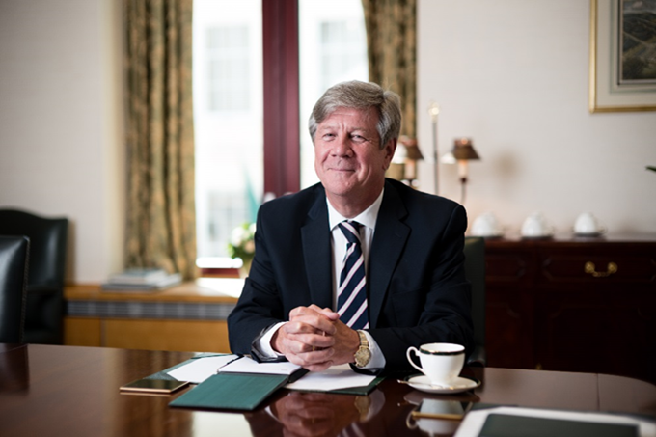
Leadership and motivation masterclass
Professor Adrian Furnham
Norwegian Business School
with thanks to Chris Woodman and Robert Hogan

Slide 2









































































Slide 3




Slide 4















































Slide 5



























Slide 6

No more heroes
A much-quoted figure is that there are 75,000 books published on leadership.
Leadership is not static, it is continuously evolving from ‘The Great Man Theory’ of the 19th Century, ‘Situational Leadership’, ‘Servant Leadership’, and relatively recently ‘Authentic Leadership’.
What impact will the recent events and the pandemic have on leadership?.
What will leadership look like in the coming years?.
Most importantly: can it be taught?

Slide 7

The trends of leadership?
Diversity: heterogeneity.
More focus on purpose and meaning.
More consultative.
Less charisma more humility.
Importance of the team and the collective.
Vulnerability.
Emotional intelligence, awareness of self and others.
More open and transparent.
More empathy and compassion.
More focus on stakeholders not just shareholders.
Understanding technology.
Able to respond to change effectively.

Slide 8

The path to leadership
Technical: recruited and selected for ability, knowledge and skill.
Supervisory: promoted to managerial positions as a function of effort, progress (and politics).
Strategic: elected/selected to board level jobs as a function of reputation, ambition and history

Slide 9
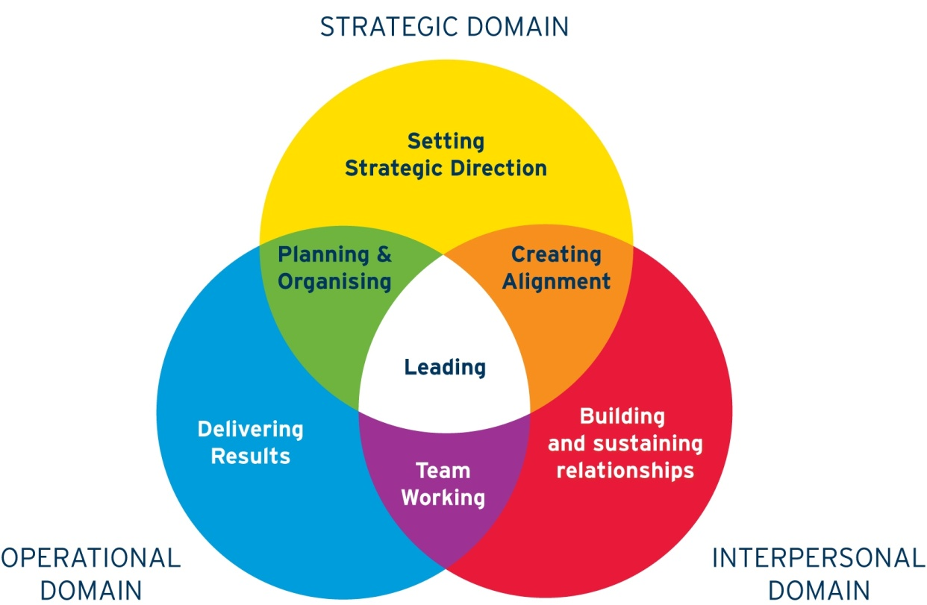
The primary colours model

Slide 10



The essentials of management
Challenge
  Clear objectives for individual and company. People know their objectives.
Support
  Providing emotional, social, technical, financial, and informational support.
Feedback
  Regular, specific, and behavioural.

Slide 11


Can you teach anything to anybody?
Can you teach anybody to:
Fly a helicopter; play the violin; speak Zulu; sing in tune; ride a horse; be a good leader etc.
YES, but how?
You can teach skills: people do improve BUT it all depends on a number of factors called moderator variables.

Slide 12

Can leadership be trained?
Experiential
‘Stretch assignments’, shadowing, outplacement, job rotation.
Educational
MBA, short course, case studies, simulations.
Personal
Coaching and mentoring.

Slide 13

Some of the characteristics of the new world
Disruption.
Diversity.
Distraction.
Digitalisation.

Slide 14

Disruptive Innovation
Often led by entrepreneurs, outsiders and risk-takers.
It is focused on the customer/end-user and empowers them.
It is nearly always the result of new technology: it bypasses, replaces, and upgrades the old technology.
It is often, but not always revolutionary.
We are in an era where it happens a lot.

Slide 15
Nine Proven successful entrepreneurial competencies
Proactive
Initiative.
Assertiveness.
Achievement orientation
Sees and acts on opportunities.
Efficiency orientation.
Concern for high-quality work.
Systematic planning.
Monitoring.
Commitment to others
Commitment to work contract.
Recognising the importance of business relationships.

Slide 16

Entrepreneurial characteristics
1. Drive and energy.
2. Self-confidence.
3. Long-term involvement.
4. Money is regarded as a measure of success.
5. Persistence in problem solving.
6. Ability to set, and to commit themselves to, clear goals.
7. Moderate risk taking.
8. The ability to use failure as a positive learning experience.
9. Concern for feedback of performance.
10. Taking initiative and seeking personal responsibility.
11. Actively use resources, such as expertise of others, to accomplish goals.
12. Competing against self-imposed standards.
13. Tolerance of ambiguity and uncertainty.

Slide 17
Environment
Opportunities,
ambiguity, uncertainty.
Entrepreneur personality traits
Commitment, decisiveness,
persistence, perseverance,
determination, integrity,
reliability.
Cognitive element
Problem solving, goal oriented,
has vision, conceptual ability,
intelligence, business acumen.
Motive strength
Strongly competitive, drive to achieve.
Expectancy of success
Self-confidence, self-belief,
self-awareness.
Skills
Team building, capacity to inspire,
learn from mistakes, capitalise on
opportunities.
Action/behaviour
Takes initiative,
assumes personal
responsibility for
actions, seeks
feedback/monitors
performance,
tolerates ambiguity,
uses money as a
measure, puts
business as first
Priority.
Goals
Create something,
new/innovate,
growth of business.
Outcomes
Success/
failure.
Feedback

Slide 18
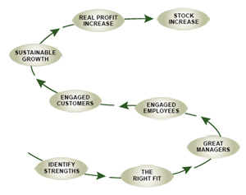
The Gallup Path
The Gallup Path is used by the world’s most successful businesses.

Slide 19
Gallup’s 12 questions
Do I know what is expected of me at work?
Do I have the materials and equipment I need to do my work right?
At work, do I have the opportunity to do what I do best every day?
In the last seven days, have I received recognition or praise for doing good work?
Does my supervisor, or someone at work, seem to care about me as a person?
Is there someone at work who encourages my development?

Slide 20
Gallup’s 12 questions
At work, do my opinions seem to count?
Does the mission/purpose of my company make me feel my job is important?
Are my co-workers committed to doing quality work?
Do I have a best friend at work?
In the last six months, has someone at work talked to me about my progress?
This last year, have I had opportunities at work to learn and grow?

Slide 21
Motivations
Hygiene Factors
Quality of Supervision
Promotion Opportunities
Pay
Opportunity for Personal Growth
Promotes Job Satisfaction
Company Policies
Prevents job Dissatisfaction
Recognition
Physical Working Conditions
Responsibility
Relations With Others
Achievement
Job Security

Slide 22
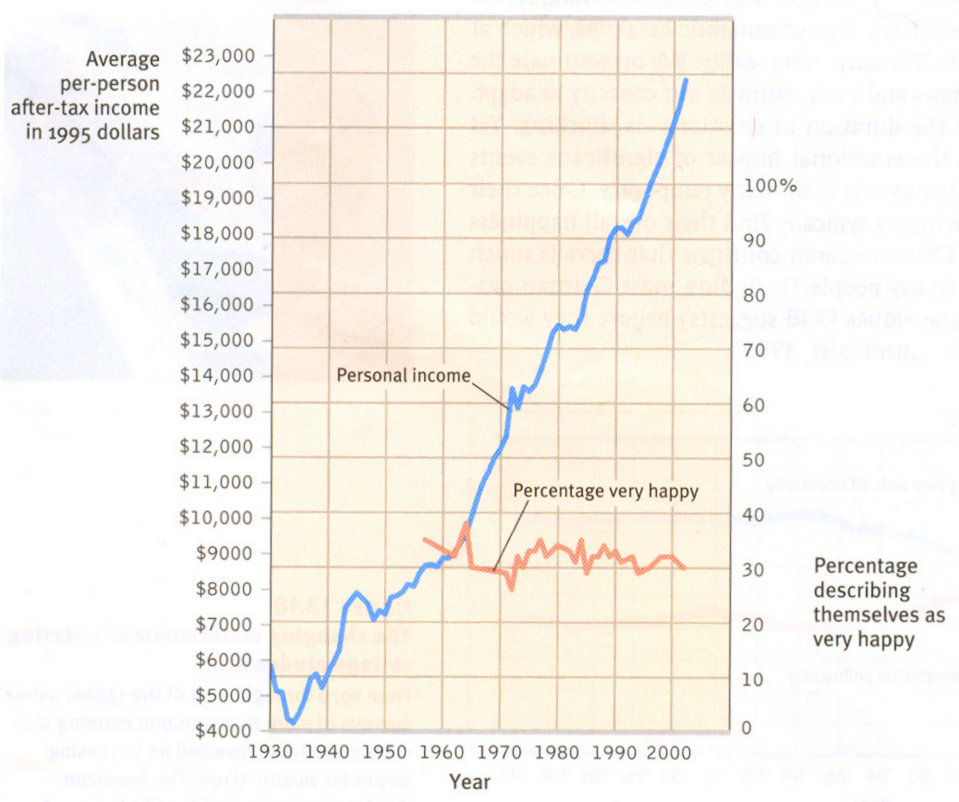
Wealth and happiness
Income and happiness in the USA, 1950-90.
Myers and Dieners (1996)

Slide 23


Motivation
Intrinsic: for the love of the activity which is its own reward. Amateur love of the activity.
Extrinsic: for some external benefit, like money. People are prepared to take part in the activity because they are compensated by some benefit (the most preferred of which is money).

Slide 24
Money awards are very simple and effective ☺ ☺ ☺
Money motivates people, and extra money motivates people to work extra.
Employees compete, when rewarded to raise productivity or standards.
It is not always possible to promote people, so money is a simple, effective, equitable way to reward workers.
Money is accepted for all workers, at all times, everywhere.

Slide 25
Money is sometimes effective ☺ ☹
If employees are highly paid, money may not be sufficient: beyond a level it has no effect.
Money rewards may set employees against each other, leading to conflict in the office: openness leads to conflict.
It is often difficult to determine the standard or basis for the decision to award the employee money.

Slide 26
Money is not effective ☹ ☹
Money trivialises work, which for many professional employees should be its own reward.
The amount received may not bear relation to what the employee does.
If the employer finds it motivating to award money, perhaps the salaries are too low.
It can paradoxically reduce intrinsic motivation.
There are many other ways to motivate employees.

Slide 27





Money as a motivator
Money has very short-term effects because:
Adaptation
effect rapidly disappears
Comparison
now against a different groups
Alternatives
other things (i.e., security) matter more
Increased Worry
taxation, inflation
vs.

Slide 28







Can money demotivate
Pay has only a short-term impact on motivation
Rewards punish because they are manipulative
Rewards rupture relationships
Rewards ignore reasons
Rewards discourage risk-taking
Rewards make people feel bribed

Slide 29
Intrinsic motivation
Carrot-and-stick motivation does not work anymore.
Businesses should adopt a revised approach to motivation which fits more closely with modern jobs and businesses, one based on self-determination theory.
Human beings have an innate drive to be autonomous, self-determined and connected to one another, and that when that drive is liberated, people achieve more and live richer lives.
Organisations should focus on these drives when managing their human capital by creating settings which focus on:
  our innate need to direct our own lives (Autonomy),
  to learn and create new things (Mastery),
  to do better by ourselves and our world (Purpose).

Slide 30
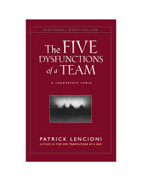
The five dysfunctions of a team
Avoidance of Accountability
Lack of Commitment
Fear of Conflict
Absence of Trust
Inattention to Results

Slide 31
Five dysfunctions of a team
Absence of Trust – unwilling to be vulnerable to the group.
Fear of Conflict – seeking artificial harmony over constructive passionate debate.
Lack of Commitment – feigning buy-in for group decisions creates ambiguity throughout the organization.
Avoidance of Accountability – ducking the responsibility to ‘call’ peers on counterproductive behaviour that sets low standards.
Inattention to results – focusing on personal success, status and ego before team success.

Slide 32

1. Create sense of urgency
Present change as needed.
Complacency: failing to read the signs that change is necessary.
False urgency: working hard but overlooking the primary goal.
How to:
  think thoroughly whether the change is possible;
  create a rationale that appeals to the heart of the team;
  connect it to the company’s values;
  inspire using imaginative messages.

Slide 33

2. Form the appropriate team
Teams are more effective than individuals.
Team members must share trust and objectives.
How to:
  identify true leaders and place them in the team watch out for any weaknesses of the team;
  choose representatives from different departments and levels within the company;
  have enough people so opposing sides cannot influence progress.

Slide 34

3. Develop a vision
Simplifies.
Motivates.
Co-ordinates.
How to:
  easily explains the aims (communicable);
  provides a clear picture of the future (imaginable);
  contains realistic and attainable goals (feasible);
  offers clear guidance (focused);
  allows space for initiative and modification (flexible);
  appeals to the long-term benefits of those involved (desirable).

Slide 35

4. Communicate the vision
In order to get people to commit, they first need to understand the vision.
The vision must be constantly communicated through various means.
How to:
  keep it simple and short;
  use imagery and figurative speech;
  repeat it as frequently as possible;
  invite people to communicate it themselves;
  take actions and let them speak for themselves.

Slide 36

5. Remove obstacles
People, structures or processes etc.
Resisting forces will prevent change therefore need to be dealt with.
Those in favour of change must be unleashed to do their best.
How to:
  identify the source of resistance;
  try to persuade them on the benefits of the change;
  change the resisting supervisors;
  take quick action towards eliminating barriers.

Slide 37

6: Create shor.t-term wins
Nothing motivates more than actual positive results.
To provide evidence for progress, create and accomplish short-term targets that can be made visible to the staff.
That way, negative critique is avoided.
How to:
  choose and implement projects that are sure to succeed without the help of the opposing side;
  these projects should not be expensive so that investment in each goal is justified;
  reflect upon the chosen sure-fire projects because if they fail it can hurt the ultimate goal;
  involve people and reward them.

Slide 38

7. Elaborating on change
Do not declare victory too early.
Build on the newly-made change by adding projects.
Make sure the change has been rooted in all aspects of the company.
Leaders must continue supporting the change.
How to:
  analyse the strong and weak areas of each win;
  keep the momentum by adding goals;
  involve more people every time;
  improve continuously (the idea of ‘kaizen’).

Slide 39

8. Establish the change in the culture
Change must be rooted in the values of the company.
Daily practices should embrace the change.
Success must be communicated.
How to:
  mention the progress at every chance;
  tell the success story of the change to new members when hiring them;
  publicly praise those who helped in successfully implementing the change;
  plan on replacing those people when they move on.

Slide 40
Advice for new leaders
1. Create and communicate a clear picture.
2. Be brave and courageous.
3. Take a holistic view.
4. Drive up the energy and creativeness.
5. Be tough but fair.
6. Listen to clients and get an external view.
7. Use expertise of others.
8. Get support.
9. Retain your client focus.
10. Lead by example.

