Slide 1
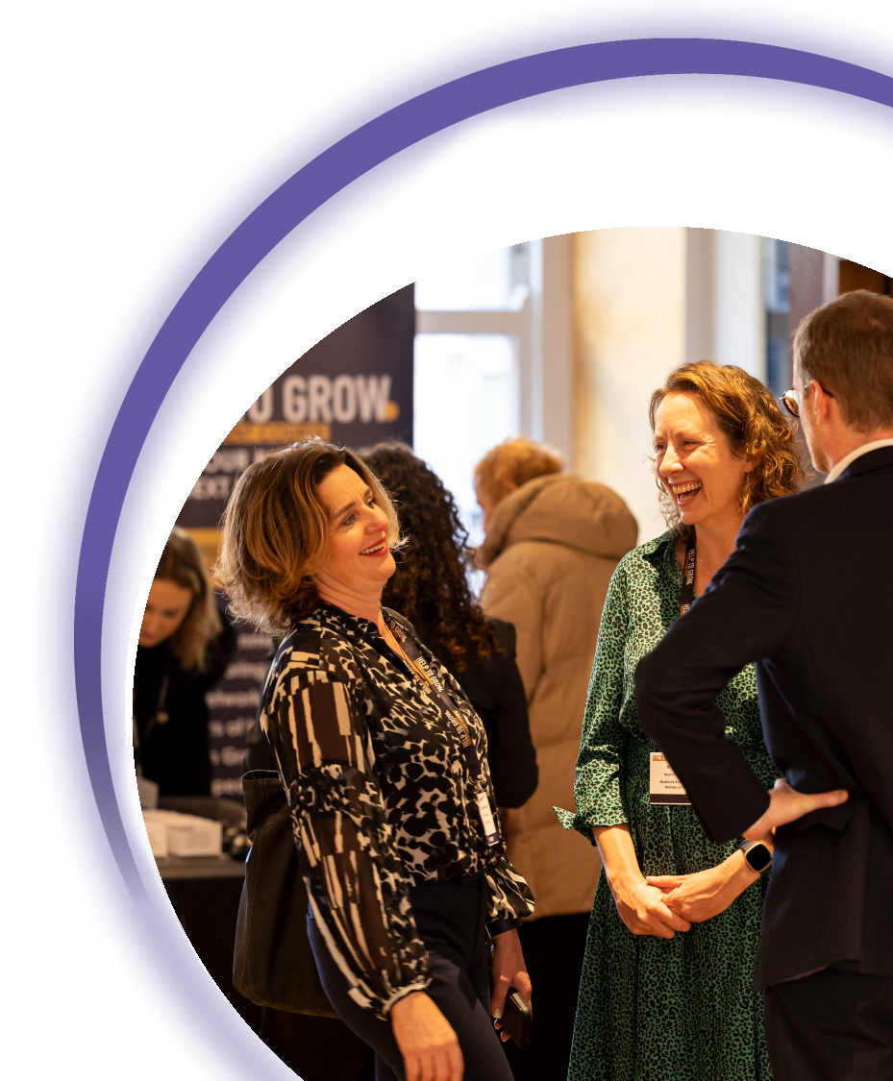
#helptogrow
Leadership: Avoiding the cult of personality

Slide 2
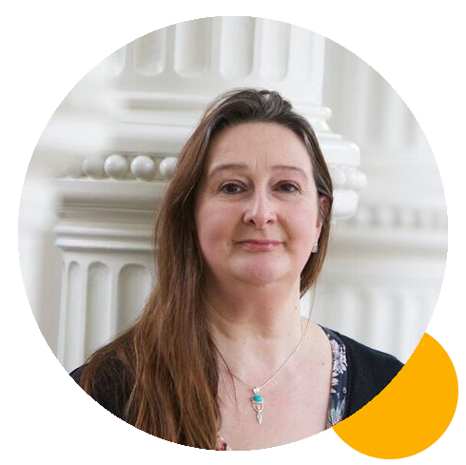
#helptogrow
Dr Suzanne ross
Principal Lecturer, SME Short Courses, Nottingham Business School

Slide 3
Help To Grow Live 23rd November 2023
Leadership: Avoiding the cult of personality
Dr Suzanne Ross

Slide 4
Aims of the session
Recognise the risks of personality led businesses
Understand how culture impacts organisational resilience
Identify and create a sustainable and long-term company culture
Understand how leadership behaviours impact culture and business success.

Slide 5
The risks of personality led businesses

Slide 6
At the start of the journey…
The business revolves around the founder and early influencers
Often the brand and the personality of the founder become synonymous. More likely if the founder is charismatic or influential
Founders are passionate about the product and service, know the sector, know the client and often have a vision about delivering the product or service differently.

Slide 7
Personality led businesses
Richard Branson and Virgin
Elon Musk and X (formerly Twitter)
Steve Jobs and Apple
Jeff Bezos and Amazon
Reed Hastings and Netflix
James Watt and Brewdog
…and others?

Slide 8
The impact of Growth
Size of organisation
Large
Phase 1
Growth through Creativity
Phase 2
Growth through Direction
Phase 3
Growth through Delegation
Phase 4
Growth through Co-ordination
Phase 5
Growth through Collaboration
Phase 6
Growth through Alliances
Crisis of internal growth
Crisis of x?
Crisis of red tape
Crisis of control
Crisis of autonomy
Crisis of leadership
Evolution
Revolution
Small
Young
Age of organisation
Mature
(Greiner’s Curve)

Slide 9
The leadership challenge:
Making the shift from entrepreneurial founder(s) to leading an organisation.

Slide 10
Risks to the business
A scaling business needs organisational leadership. The entrepreneurial personality of the founder is no longer enough.
Inability to translate the vision into a strategy a growing business can execute on
Lack of clear priorities communicated to an increasing number of people in the business
Bottle necks created in the business as all roads lead to the founder or select few. Lack of knowledge sharing and mentoring. Founder burn out
Team and interpersonal dynamics impact efficiency, effectiveness and performance
Entrepreneurial, charismatic leaders can be hard to work for!

Slide 11
How culture impacts
organisational resilience

Slide 12
What is organisational culture?
The way we do things round here!
Culture is to the organisation, what personality is to an individual: How we do things and why we do things that way
A product of shared learning
Evolves over time: You will have a culture whether you want it or not!

Slide 13
From personality to culture
Driven by a need to:
Communicate the business to stakeholders through strategy statements e.g., mission, purpose, vision
Create an employer brand to recruit effectively
Begin to communicate to new hires ‘the way we do things’
Create structure, functions, teams and align them around shared goals.
As the organisation gets bigger, culture becomes the ‘glue’ that binds people together.

Slide 14
Organisational resilience
“Organizational resilience is the ability of an organization to anticipate, prepare for, respond to and adapt to incremental change and sudden disruptions in order to survive and prosper” (Denyer 2017).

Slide 15
Progressive
(Achieving results)
Organisational resilience
Performance Optimisation
(Improving and Exploiting)
Adaptive Innovation
(Imagining and Creating)
Consistency
(Goals, processes, routines)
Flexibility
(Ideas, views, actions)
Preventative Control (Monitoring and Complying)
Mindful Action
(Noticing and Responding)
Defensive
(Protecting results)
(Denyer 2017)

Slide 16
Performance Optimisation
(Improving and Exploiting)
Adaptive Innovation
(Imagining and Creating)
Organisational resilience: Managing the tensions.
Where is your focus?
Ability to anticipate, prepare for, respond to and adapt to incremental change and sudden disruptions.
Preventative Control
(Monitoring and Complying)
Mindful Action
(Noticing and Responding)
(Denyer 2017)

Slide 17
Identifying and creating a sustainable and long-term company culture

Slide 18
Stories
Symbols
Johnson and Scholes Culture Web
Where are you now?
Where do you want to be?
What sort of culture do you want to create?
Power
Routines and Rituals
Paradigm
Controls
Organisation

Slide 19
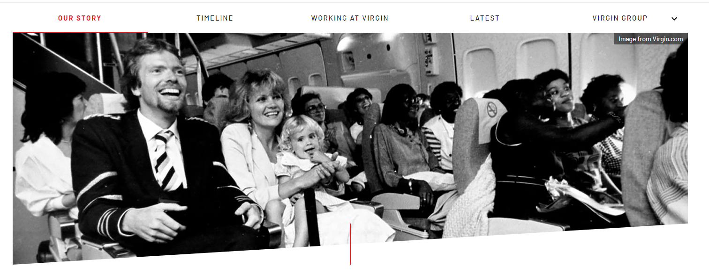
From personality to culture: Storytelling
The Virgin Group
https://www.virgin.com/about-virgin/our-story

Slide 20
From personality to culture: Identifying values
Virgin Group Values
Insatiable curiosity
Smart disruption
Straight up
Heartfelt service
Delightfully surprising
Red hot relevance.
https://www.virgin.com/about-virgin/our-story

Slide 21
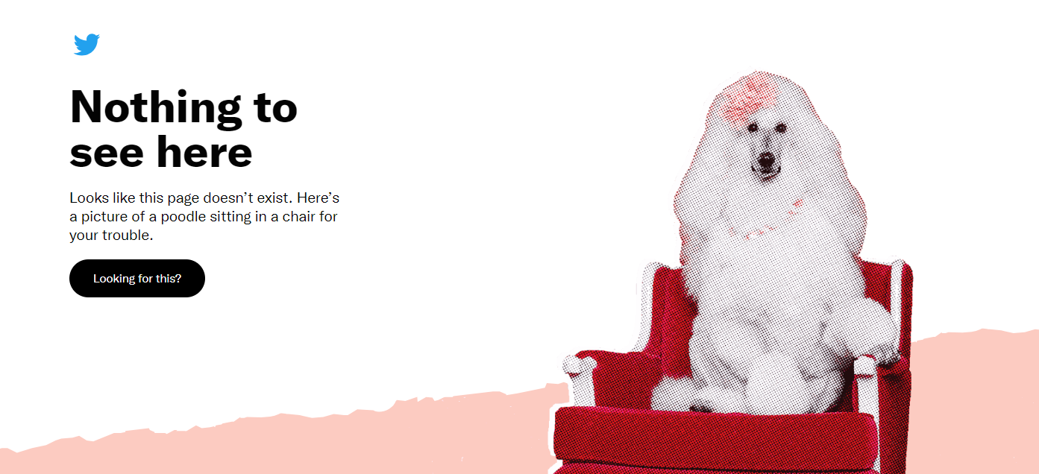

Slide 22
The great resignation
Talented people leave toxic cultures

Slide 23
How leadership behaviours impact culture and business success

Slide 24
Engaging your people
Strategic narrative
Visible, empowering leaders with a clear story around where the organisation has come from and is going
Engaging managers
Support, coach, treat as individuals
Employee voice
Employee seen as central to the solution, involved, listened to, invited to contribute their experience, expertise and ideas
Organisational integrity
Values on the wall are reflected in day-to-day behaviours. There is no ‘say-do’ gap. Promises made and promises kept, or an explanation given as to why not.
https://engageforsuccess.org/the-four-enablers/

Slide 25
Leaders are role models!

Slide 26
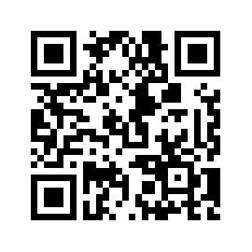
#helptogrow
Leave your feedback for the Help to Grow: Management Alumni Network team.

Slide 27
sales: understanding
your customer BREAKOUT ROOM #1
employee engagement BREAKOUT ROOM #3
strategy: a practical
masterclass Finsbury suite
international sales BREAKOUT ROOM #4

