Slide 1
#helptogrow
Marketing case studies

Slide 2
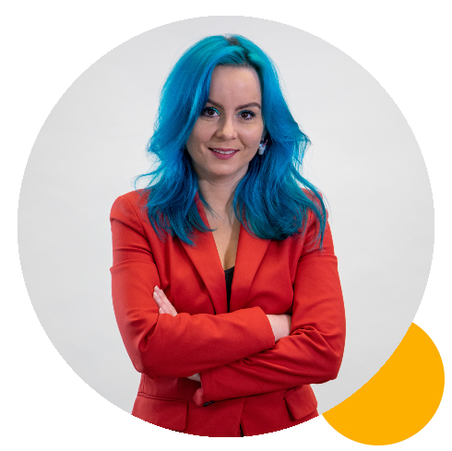
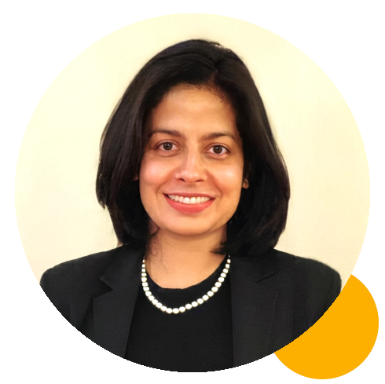
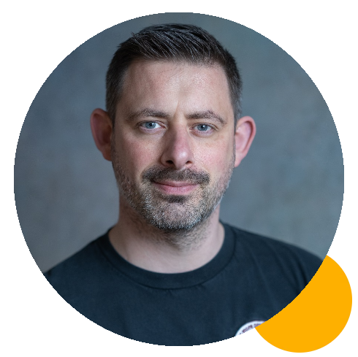
#helptogrow
Emma connor
Programme Leader of MSc Digital Marketing Management, University of Greenwich
Medha dixit
Director SEO, Digital Chakra
Chris london
Founder and CEO,
Chris London Online

Slide 3
Marketing Case Studies Introduction
Emma Connor Programme Leader and Teaching Fellow in Digital Marketing
Greenwich Business School

Slide 4
Agenda
11:15 – 11:30 Introduction to Digital Marketing Emma Connor
11:30 – 11:45 SEO & organic search Medha Dixit
11:45 – 12:00 Ad strategy- paid and organic Chris London
12:00 – 12:15 Q&A from audience to panel

Slide 5
What this introduction will cover
The Digital Marketing Landscape and its importance for SMEs
Integrated Marketing Communications
The setting and fulfilling strategic commercial and marketing objectives

Slide 6
Digital marketing can be simply defined as: Achieving marketing objectives through applying digital media, data and technology
(Chaffey and Ellis-Chadwick, 2022)

Slide 7
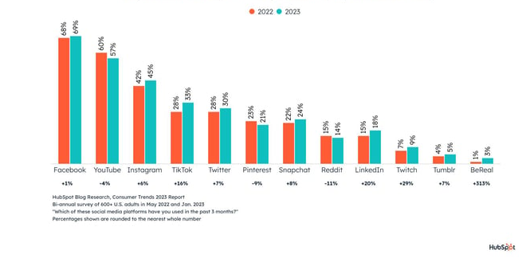
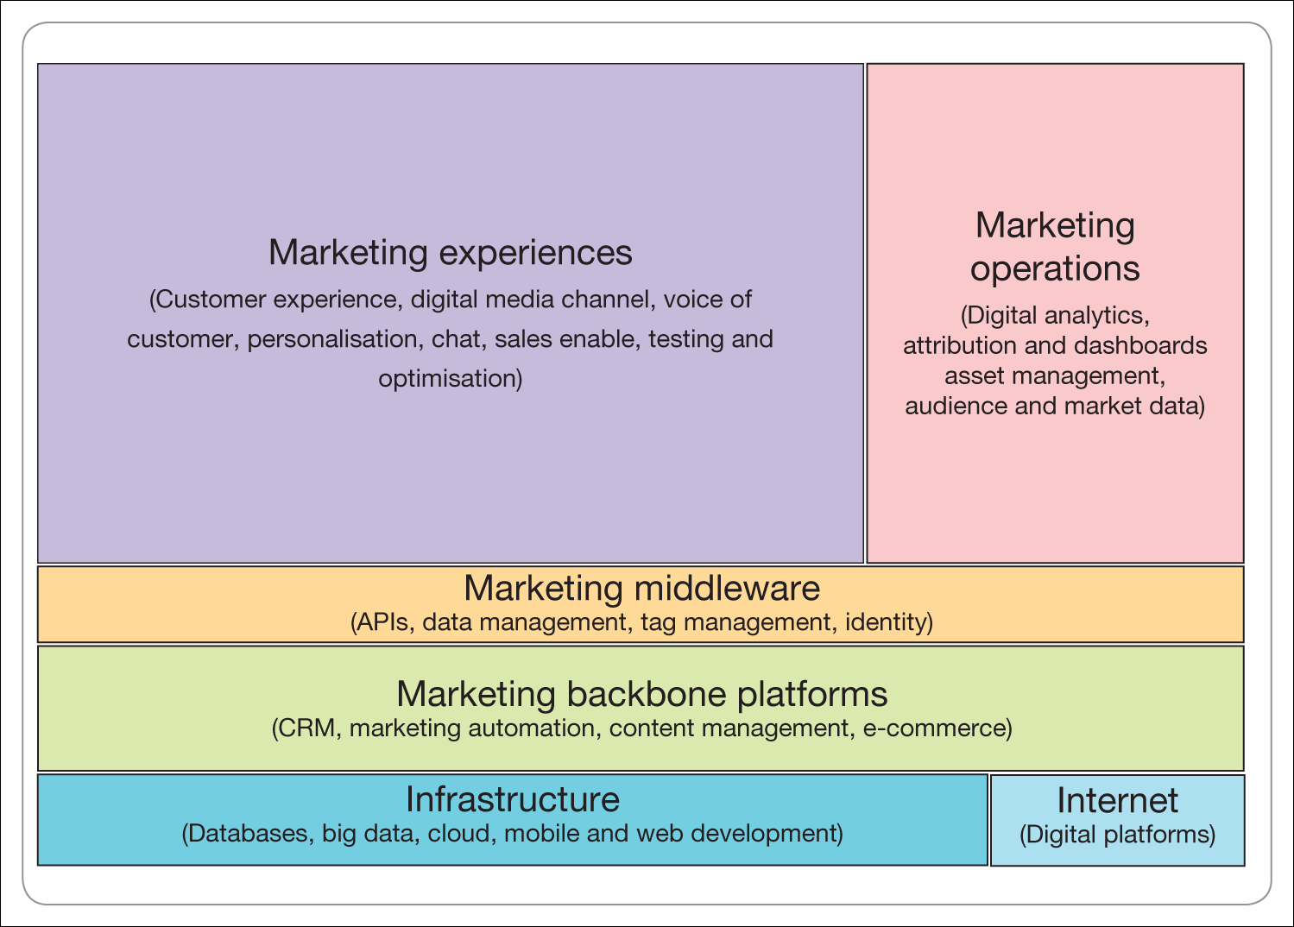
Digital and social platforms
(Chaffey and Ellis-Chadwick, 2022)
Notes:
While Facebook is the most popular social media platform for people over the age of 25, Instagram, TikTok, and YouTube are the most popular among ages 18-24. Social platforms need to utlise shorter video formats, currently being embraces by youtube shorts.
Brands can interact with consumers in a short duration. BeReal is the newest contender and is yet to include branded content- something to watch out for in the future

Slide 8
Trends in Digital
Test and learn measurement strategy for web, email and app-based platforms
Customer experience
Behavioral data analytics
Creativity
Embracing new tools for personalization and automation
Broadcast vs engagement communications
(McKinsey, 2023) (Chaffey and Ellis-Chadwick, 2022)
Notes:
It is vital that digital marketers are skilled in multidisciplinary competencies:
elationship marketing, direct marketing and databasemarketing have combined to enable customer relationship management (CRM). CRM sys-tems are popular for supporting the following applications that develop relationships withprospects and customers, particularly in B2B organisations:1 Marketing automation. Marketing automation and CRM systems such as Salesforce andEloqua can be used to nurture prospects by sending a sequence of targeted email com-munications after they show initial interest in a service, for example after they downloada case study or attend a webinar.

Slide 9
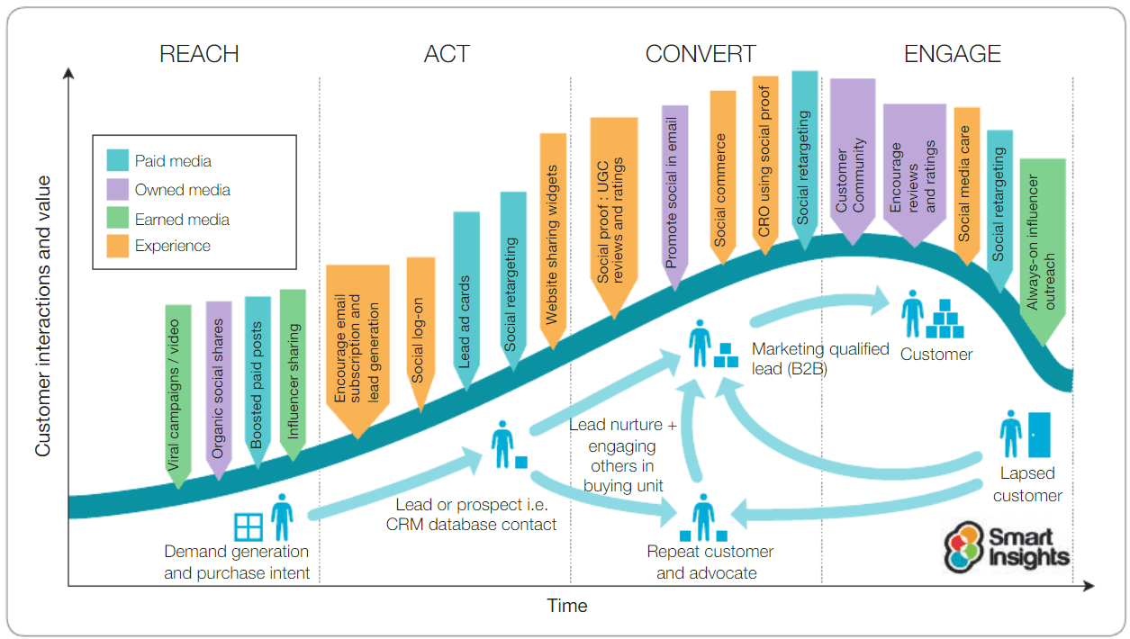
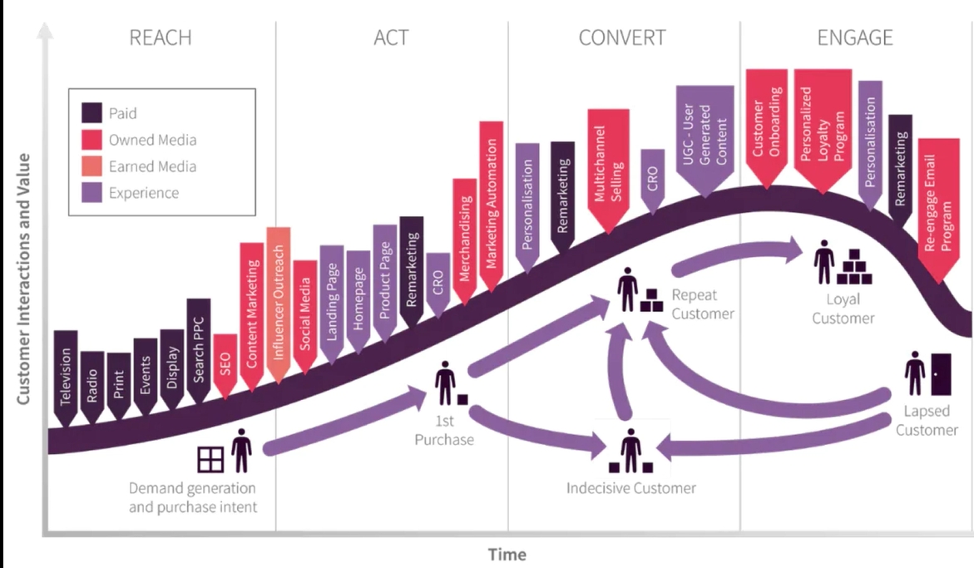
(Chaffey and Ellis-Chadwick, 2022)
Notes:
Capture, engage and retain customers The aim of any communications campaign should be to get the right message, value proposition, to the right customers at the right time and frequency.
Reach- increase awareness and grow an audience using paid, owned and earned media
Act – prompt interactions, subscribers and leads:, to really take effect, permission marketing (whereby data is able to be captured and analysed) is possible in some social channels
Convert – achieve sales online or offline: nurture stage
Engage – encourage repeat business by developing customer satisfaction, loyalty andadvocacy:
Limitations- This type of strategy supports the idea of segmenting based on shared characteristics rather than that of the individual

Slide 10
Which comes first?
Acquisition?
Retention?

Slide 11
A planning process designed to assure that all brand contacts received by a customer or prospect for a product, service, or organization are relevant to that person and consistent over time. American Marketing Association (AMA)
I
M
C
Notes:
The concept of integrated marketing communication (IMC) was introduced in the 1980s (Schultz and Schultz, p. 19) and has since changed the way communicators and marketers interact and conduct business. The American Marketing Association defines IMC as “a planning process designed to assure that all brand contacts received by a customer or prospect for a product, service, or organization are relevant to that person and consistent over time.”

Slide 12
Developing your SMP
Key business problem
Objectives
Where am I now?
Where do we
want to be?
How do I know
I am getting there?
How are we
going to get
there?
Measurement
How will we get
there?
They will be answered in your strategies
Tactics

Slide 13
Final thoughts
By retaining just 5% more customers, online companies can boost their profits by between 25 and 95%
Provide value based on what users prefer, delight them to be relevant and rankable
Test robustly, yet relevantly
Embrace new technologies to become more personalised and cost effective

Slide 14
Thank you.

Slide 15
References
Chaffey, D. and Ellis-Chadwick, F. (2022) Digital Marketing, 8th Edn. Pearson, Harlow
Checa, A. Heller, C, Stein, E and Wilkie, J. (2023) Modern marketing: Six capabilities for multidisciplinary teams. Available at : https://www.mckinsey.com/capabilities/growth-marketing-and-sales/our-insights/modern-marketing-six-capabilities-for-multidisciplinary-teams (Accessed 17 May 2023)
Hilken T., de Ruyter K., Chylinski M., Mahr D., Keeling D.I. (2017) ‘Augmenting the eye of the beholder: Exploring the strategic potential of augmented reality to enhance online service experiences’, Journal of the Academy of Marketing Science, 45(6), pp. 884–905
Hoyer, W. D. Kroschke and Shankar, V. (2022) ‘Transforming the Customer Experience through New Technologies’, American Marketing Association, 51(1), pp.51-71
Iab uk (2023) Measuring Digital Advertising in a Multi-Media Context A Guide and Toolkit. Available at: https://www.thedrum.com/industryinsights/2019/02/21/how-should-video-ad-effectiveness-be-measured-0 (Accessed 17 May 2023)
Landsburg, N (2023) Best Content Marketing Platforms For 2023. Available at: https://influencermarketinghub.com/content-marketing-platforms/ (Accessed 17 May 2023)
Libai B., Bart Y., Gensler S., Hofacker C., Kaplan A., Kötterheinrich K. (2020) ‘Brave new world? On AI and the management of customer relationships’, Journal of Interactive Marketing, 51, pp.44–56
Neher, K (2022) Digital Marketing Trends To Take Advantage of Now. Available at : https://www.forbes.com/sites/forbescoachescouncil/2022/11/15/2023-digital-marketing-trends-to-take-advantage-of-now/?sh=73a16b8661f4 (Accessed 17 May 2023)

Slide 16
Rank On Page #1 of Google: A 5-Step Process
Presented By: MEDHA DIXIT, Founder, Digital Chakra
23.11.2023
Notes:
Hi Everyone, It’s great to see you all here today. My name is Medha Dixit, and today I’ll be talking to you about improving your website’s online presence with Search Engine Optimisation, also called SEO. The goal for this presentation is 3-fold:

Slide 17
Presentation Outline
SEO Explained
5 Step SEO Process
SEO Case Study
Free Giveaways
Notes:
- First, simplify What SEO is & what it involves, - Second, give you a 5-step actionable process that you can use to optimise your own site - Third, share a real World SEO case study to show you the potential of SEO
- In the end, there are some free giveaways that I hope you’ll find useful

Slide 18
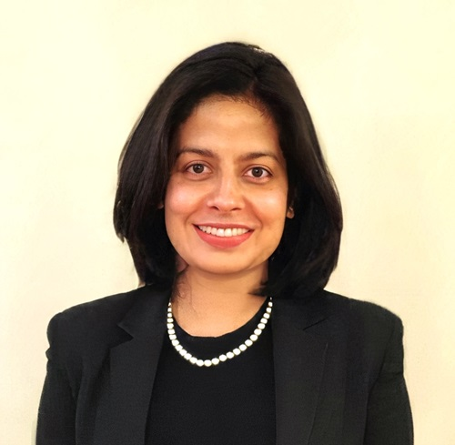
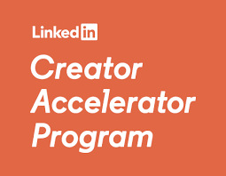
About Me
Founder and Senior SEO Strategist at Digital Chakra. We’re a Birmingham based SEO Agency, focused on helping D2C ecommerce Brands attract relevant traffic and make more money online.
I’m a Top LinkedIn Search Engine Optimisation Voice, and have featured in leading international publications.
Notes:
I’m the Founder of Digital Chakra, a Birmingham based SEO Company. We’re focused on helping D2C ecommerce Brands, attract more traffic and sales online, through SEO. I’m a Top LinkedIn Search Engine Optimisation Voice, a Google For Entrepreneurs awardee, and have been featured in some leading international publications.

Slide 19
Quick Quiz #1:
How Does Google Decide Which Results To Show First?
Google ranks Sites based on 200+ Ranking Signals
If you pay for Google Ads, you’ll rank higher in Search
Google ranks a Site based on the number of backlinks
Notes:
I wanted to open up the presentation with a short quiz, and would invite your participation: When doing a web search, how does Google decide which results to show first?

Slide 20
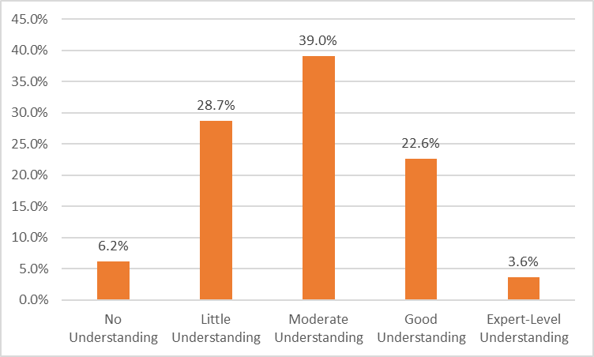
Survey Of 394 Business Owners
26%
Notes:
Based on a Research Survey, when this question was posed to 394 Small Business Owners, only 26% believed they had a good or expert level understanding. Which means 74%, a large majority had a limited understanding of what it takes to rank high in search engines. Even though Google has been around for 20 years, its surprising how many Businesses don’t fully understand or leverage the power of SEO in their Marketing.

Slide 21
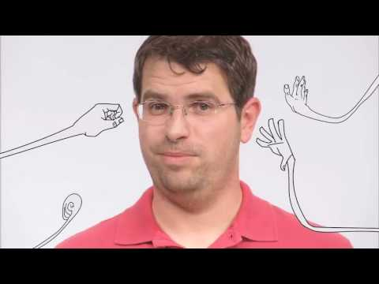
How Search Works?
Notes:
So, let’s find out exactly how search works - straight from Google.

Slide 22
What Is SEO? (Search Engine Optimisation)
The Process Of Optimising Your Website, To Rank Organically For Keywords, Relevant To Your Business
SITE DESIGN
CONTENT
LINKS
Notes:
Definition
I want to emphasise the fact that SEO is a Process:It is a long term investment into your Brand’s online presence and takes time and consistent effort.
SEO is done By Making Consistent Improvements To 3 areas: a Site’s Design, content & Link Structure

Slide 23
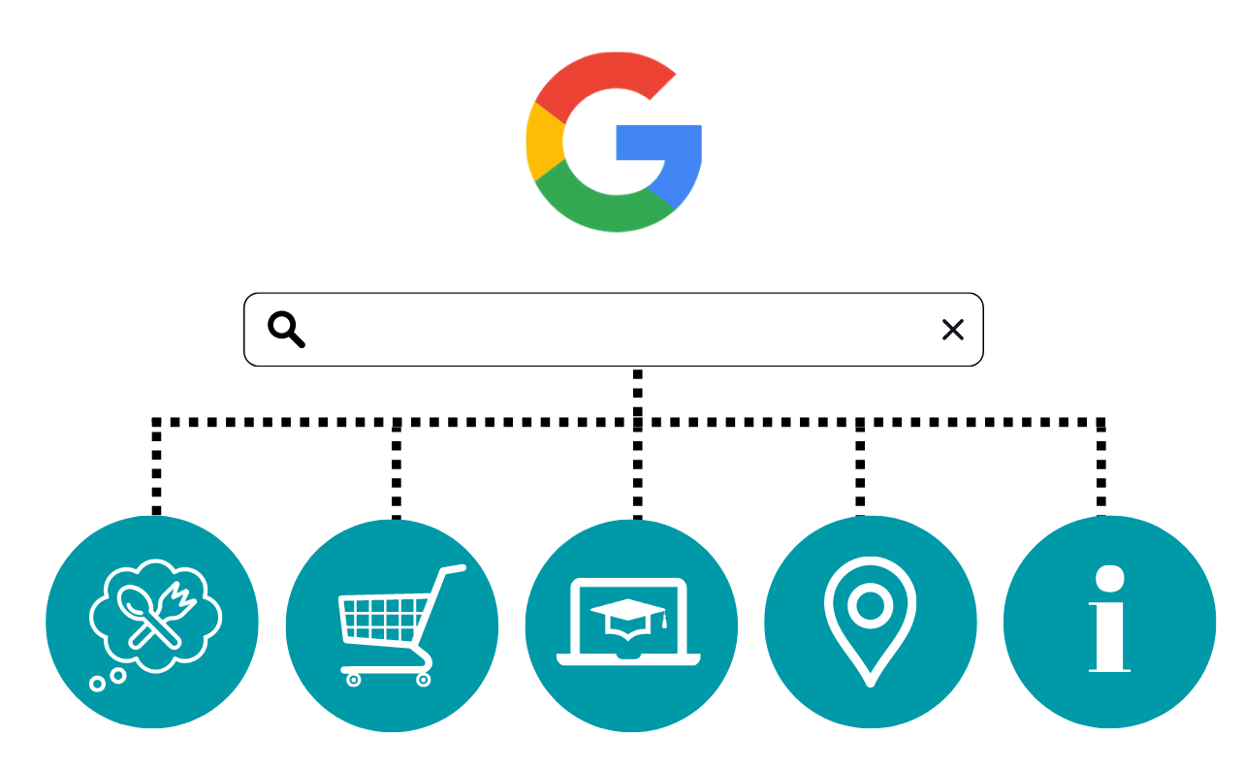
Why Invest In SEO?
8.6 Billion
Eat
Buy
Study
Travel
Get Info
Notes:
Why should you invest in SEO?
Well, Search has become the default gateway for everything we do online, and with the explosion of devices -there’s no end to when and where we can search.
Whether someone wants to eat, buy, study, get somewhere or seek information - Google is where they go. If your Business is not visible in search, it is difficult for your target customers to find you.

Slide 24
5-Step SEO Process
Notes:
This brings us to the 5 step process to optimise your Site.

Slide 25
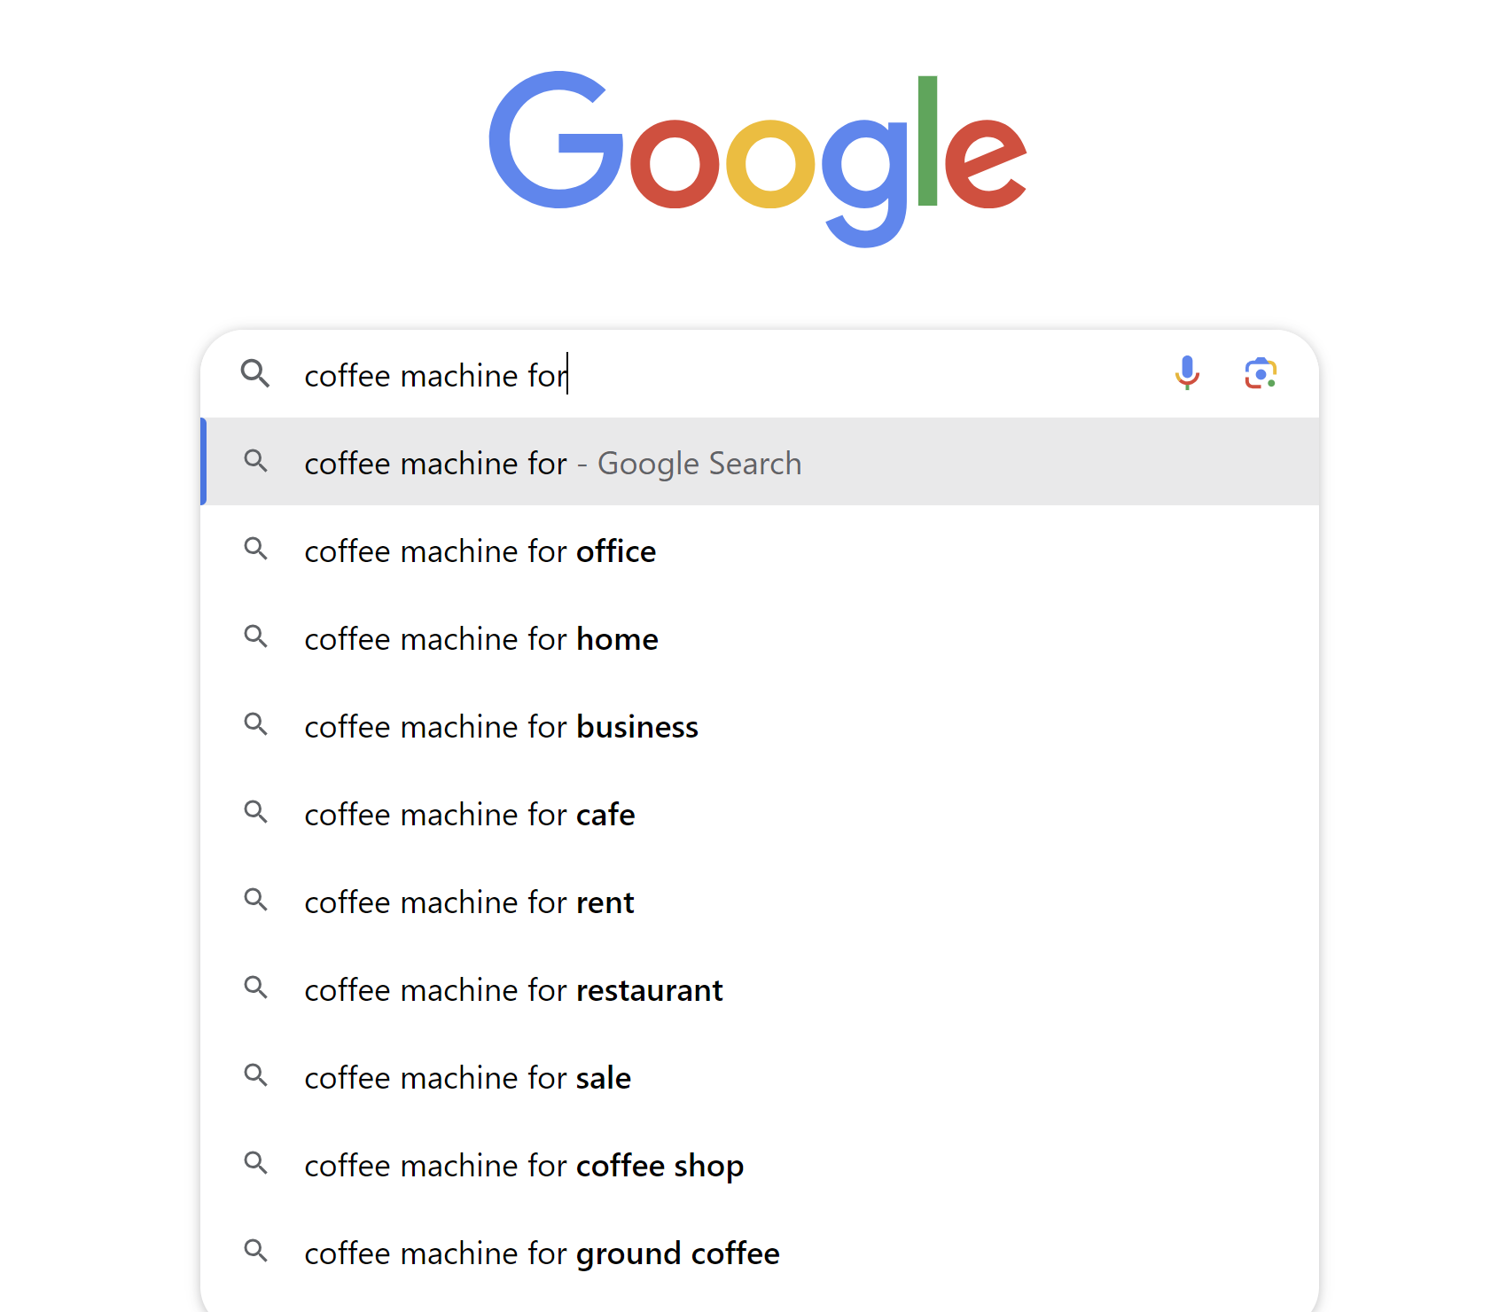
Step 1: Find 5 Keywords
Notes:
The 1st step is to find keywords
SEO is all about keywords. The basic principle is to get discovered for keywords your customers search for. There are lots of ways to find keywords but the easiest one is to use Google Autocomplete. All you have to do is go to Google and type your main business keyword
Google Autocomplete is great for 2 reasons: - First, It give you a good idea about the type of searches happening for your niche - Second, These keywords are long phrases that are much less competitive than what most people go after, and

Slide 26
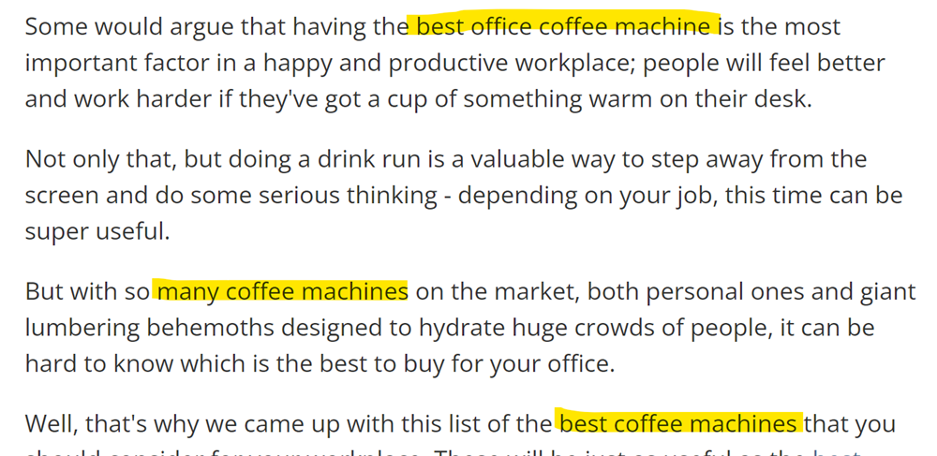
Step 2: Optimise For On-Page SEO
Title
Headings
First 100 Words
Notes:
Next, you want to optimise your pages using the keywords you’ve discovered. This process is called On-Page SEO and I want you to remember a few basic things to get started:
Use the keywords in your page Title
Headings
Within the first 100 words or so
This helps the Google algorithms understand that your page is about that topic.

Slide 27
Step 3: Optimise For Unique Content
Create Effective Content, Keeping in Mind Searcher Intent
I Want To Know
I Want To Go
I Want To Do
I Want To Buy
Notes:
Step 3 is to Optimise your Site for Unique Content, keeping in mind the Searcher’s Intent. Search Intent means that when someone searches for something there's a specific intent or reason behind it. There are 4 types of Intent: To Know, To Go, To Do, To Buy
So each of the keywords you’ve picked will basically have a specific search intent and the better your content can satisfy search intent the higher you rank in Google.

Slide 28
Quick Quiz #2: What’s The Intent?
Best Office Coffee Machines
Buy Office Coffee Machines Online
To Know
To Go
To Do
To Buy
Notes:
I’d invite you to look at the keyword phrases and tell me what you think is the Search Intent:
Best office coffee machines” - This person is likely in browsing mode, comparing what different options they have available. If your web page does a good job of comparing the pros cons of different coffee machines it's likely to perform well.
Buy Office Coffee Machine online - This person is clearly looking to buy. They’re further down the sales funnel so your Page needs to be designed with that intent in mind.
I’d urge you to take this concept and think more deeply about your User’s Search Intent.

Slide 29
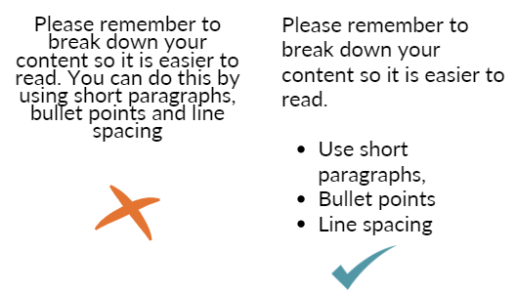
Step 4: Optimise For User Experience
Use An Easy To Read Font
Improve Content Layout
Notes:
The 4th step is to optimise for User experience. Google measures how people interact with your Website - do they stay for long or do they leave within 5 seconds of landing?
Some easy tips you can follow:
Please Use Easy To Read Fonts instead of fancy new-age fonts,
Improve content layout by using short paragraphs, bullet points, and appropriate line spacing

Slide 30
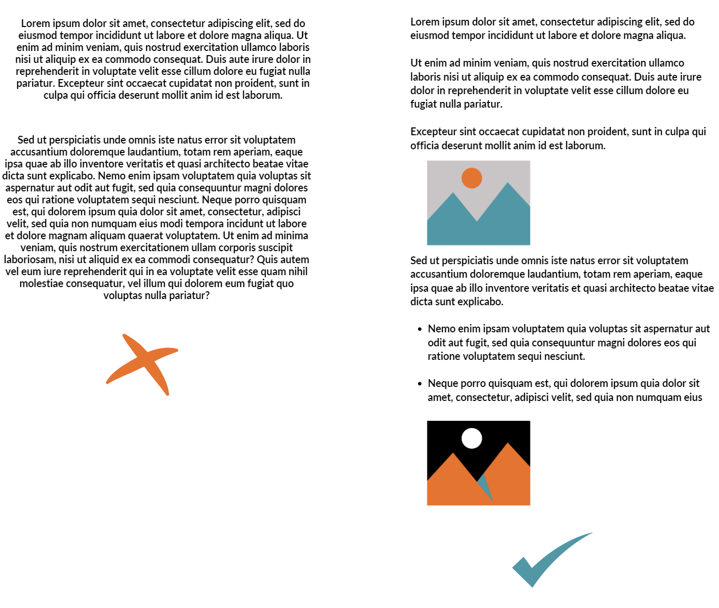
Step 4: Optimise User Experience (UX)
3. Use Images To Avoid Text Fatigue
Notes:
Finally, use Images and screenshots to avoid text fatigue. These may sound like very simple tips, but I’m constantly surprised by how many businesses miss out on them.

Slide 31
Step 5: Build Backlinks
“Lead With a Hero Piece Of Content”
Find a niche-specific fact or statistic,
Optimise For On Page SEO & UX Attract links from reporters
Notes:
The final step is to build backlinks. A backlink is when one website links to another with an anchor text.
Google still uses backlinks to figure out which sites are trustworthy and authoritative. Many businesses pay their way to backlinks. I recommend a method that I call “Lead With a Hero Piece of Content”. Here’s how you do it: 1. Find a specific statistic or angle about your niche and build a Hero piece of Content around it. For our earlier example, this could be something like: UK Coffee Trends in 2024
2. Next, Provide as much detail and optimize the content for On-Page SEO & UX
3. Now, when reporters or journalists are looking for this information, they’re very likely to find you and link to you.

Slide 32
SEO Case Study
Notes:
This brings us to the SEO Case Study

Slide 33
Case Study: Business Details
One of the oldest Furniture Showroom Retailers in the UK.
Factory Showroom in the West Midlands.
Notes:
They are an existing client. They’re one of the oldest Bathroom Furniture Retailers in the West Midlands. They have less than 50 employees and an annual turnover of £10 Million+ now. Around 2018, they’d hit a plateau in terms of their Search Visibility in Google. Their revenue was down. They were struggling to improve their bottomline with Google Ads, which were costing them a ton of money with very low conversions.
I started working with them in early 2019.

Slide 34
Case Study: Site Audit Issues
Poor On-Page SEO Technical SEO Issues
Confusing User Navigation
Low Quality Content With Exceptionally High Bounce Rate
No Consistency In Content Publishing
Notes:
I started with a Comprehensive Site Audit:
They had Poor On-Page Optimisation for the Home Page and Important Category Pages
The User Navigation was confusing and it wasn’t always easy to find products on the site
There was a ton of poor quality content across the site, with very low engagement metrics
No consistency in the content publishing calendar - There would be months when they published nothing, and then they would suddenly publish 10 articles all at once.

Slide 35
Case Study: SEO Plan & Execution
On Page SEO Optimisation
Improving User Experience Signals
Consistent Publishing Calendar
Google My Business Optimisation
Notes:
The first thing I actioned was to improve On Page SEO for the Site, targeting relevant keywords
Next was User Experience signals such as - Site Navigation, Page Design, Page Performance
I implemented a consistent Content strategy, focused on answering questions that their target audience were asking ,
Finally, I optimised for local, location based searches, especially Google My Business

Slide 36
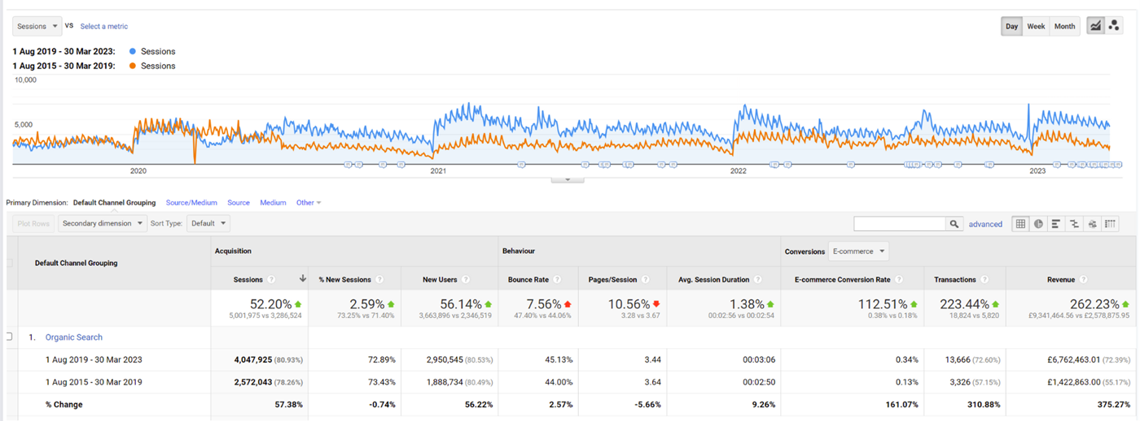
Case Study: SEO Results
223% increase in transactions £6.8 Million in additional revenue
Notes:
The results speak for themselves! They’ve seen massive improvements in organic search and have made £6.8 million plus in additional revenue since 2019, and they continue to grow.

Slide 37
FREE Giveaway
On Page SEO Checklist
https://bit.ly/htg-checklist
Notes:
I’ve given you some basic pointers about On-Page SEO. If you’d like a more detailed breakdown of the steps, please use this On Page SEO Checklist.

Slide 38
Connect With Me
20-Minute Discovery Meet
https://bit.ly/discovery-meet-medha
Email: medha@digitalchakra.co.uk
Notes:
I’ve covered a lot of Content in this presentation while barely skimming the surface. If you’d like to discuss anything from the presentation today or discuss your Business’s SEO strategy, please do get in touch with me.

Slide 51
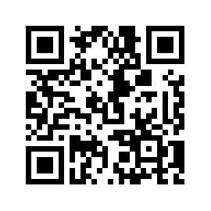
#helptogrow
Leave your feedback for the Help to Grow: Management Alumni Network team.

Slide 52
sales: understanding
your customer BREAKOUT ROOM #1
employee engagement BREAKOUT ROOM #3
strategy: a practical
masterclass Finsbury suite
international sales BREAKOUT ROOM #4

