Slide 1
#helptogrow
Strategy:
a practical masterclass

Slide 2
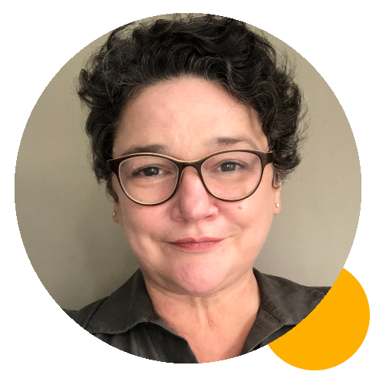
#helptogrow
Dawn shand
Business Consultant, Enterprise Educator, Project Manager, Robert Gordon University
Melanie Archbould
Founder, Cloud-Busting

Slide 3
Strategy Masterclass
Cloudbusting Creations Ltd 2023 Copyright

Slide 4
How to Build Your Strategy
How to Implement Your Strategy
How to Track Your Strategy
Notes:
Confidence comes from practice.
Quite simply, the more we have a go, the familiar it feels, the less anxious we are.

Slide 5
Mel Archbould
Former MD for over 17 Years
Shareholder in family-owned business
Growth Strategies to:
Take the business International
Enter new sectors with existing products
New products for existing markets
Establish long-lasting Customer Relationships
Develop Operational Excellence
Take solve significant problems for significant customers
Notes:
Briefly, in case you are not too sure who I am, and why I am here, I was an MD in an engineering business for over 17 years.
The business was formed by my parents back in 1985.
We sold the business in January 2022 and at the beginning of this year I launched Cloud-Busting. Working with busy business leaders who are navigating their journey towards growth, or it could be towards stepping back from their role, or it could be towards exiting the business.
Whichever journey they are on, I've learned so much from running a family-owned business that if I had a pound for every lesson-learned, I could start a whole new business to share my valuable lessons and help others make some decent money!
And that is exactly what I did!

Slide 6
Mel Archbould
Established Cloud-Busting in 2022
Support SME Business Owners & Leaders
Growth
Succession
Exit
Educate : Empower : Excite
Notes:
Briefly, in case you are not too sure who I am, and why I am here, I was an MD in an engineering business for over 17 years.
The business was formed by my parents back in 1985.
We sold the business in January 2022 and at the beginning of this year I launched Cloud-Busting. Working with busy business leaders who are navigating their journey towards growth, or it could be towards stepping back from their role, or it could be towards exiting the business.
Whichever journey they are on, I've learned so much from running a family-owned business that if I had a pound for every lesson-learned, I could start a whole new business to share my valuable lessons and help others make some decent money!
And that is exactly what I did!

Slide 7
What is a Strategy?

Slide 8
Definition
A plan of action designed to achieve a long-term or overall aim

Slide 9
Plan of Action
Game Plan
Master Plan
Roadmap
Approach

Slide 10
The Importance of Having a Strategy

Slide 11
The difference between
SURVIVING & THRIVING

Slide 12
Notes:
Innovation is a key driving force behind progress, economic growth, and the improvement of human living standards.
We have climate change and the race to protect our planet for future generations.

Slide 13
How to Build Your Strategy
How to Implement Your Strategy
How to Track Your Strategy
Notes:
Confidence comes from practice.
Quite simply, the more we have a go, the familiar it feels, the less anxious we are.

Slide 15
Vision
We start here
Then here

Slide 16
Timescale
Months
Months
Months
Months
Months
Months

Slide 17
How to Build Your Strategy
How to Implement Your Strategy
How to Track Your Strategy
Notes:
Confidence comes from practice.
Quite simply, the more we have a go, the familiar it feels, the less anxious we are.

Slide 18
STAGE 1
6 Steps to Building Your Draft Plan
Team
Ideas
Research
Refine
Budget
Draft Plan

Slide 19
Team

Slide 20
Ideas

Slide 21
STAGE 2
6 Steps to Building Your Final Strategy
Vision
Obstacles
Priorities
Milestones
Reconfirm
Strategy

Slide 22
Obstacles

Slide 23
Order of
Priority

Slide 24
Milestones

Slide 25
How to Build Your Strategy
How to Implement Your Strategy
How to Track Your Strategy
Notes:
Confidence comes from practice.
Quite simply, the more we have a go, the familiar it feels, the less anxious we are.

Slide 26
Separate
Strategy
Plan
Plan
Plan
Plan
Plan
Plan
Plan
Plan
Plan
Plan

Slide 28
Communicate

Slide 29
Notes:
Innovative thinking links the left hand brain with the right hand brain

Slide 30
Delegate

Slide 31
Delegate
Top 3 in USA
< 3 years
Sales Director?
Export Sales Manager?
USA
Mkt
USA Product
Technical Director?
Outsource?
Location & Set-Up
Team
R&D
Customer Research
Distribution
Training
VR testing
Branding

Slide 32
Celebrate
Notes:
Innovative thinking links the left hand brain with the right hand brain

Slide 33
How to Build Your Strategy
How to Implement Your Strategy
How to Track Your Strategy
Notes:
Confidence comes from practice.
Quite simply, the more we have a go, the familiar it feels, the less anxious we are.

Slide 34
Notes:
We really have to revisit the period of our lives when everything was novel and
and we were learning through play and using our imagination.
Not everything had a use, in fact much of what we made back then was useless.
Divergent thinking
Things didn't have to make sense. As we hadn't formed an appreciation of what was sensible or not.
Kids do it naturally as part of how they start to fill up their filing cabinet.
Convergent thinking
Adults do it naturally, it usually arrives at a solution to a problem quickly.

Slide 35
Notes:
We really have to revisit the period of our lives when everything was novel and
and we were learning through play and using our imagination.
Not everything had a use, in fact much of what we made back then was useless.
Divergent thinking
Things didn't have to make sense. As we hadn't formed an appreciation of what was sensible or not.
Kids do it naturally as part of how they start to fill up their filing cabinet.
Convergent thinking
Adults do it naturally, it usually arrives at a solution to a problem quickly.

Slide 36
Where are we going to be
in 90-days time?
90 Day Goals
Notes:
We really have to revisit the period of our lives when everything was novel and
and we were learning through play and using our imagination.
Not everything had a use, in fact much of what we made back then was useless.
Divergent thinking
Things didn't have to make sense. As we hadn't formed an appreciation of what was sensible or not.
Kids do it naturally as part of how they start to fill up their filing cabinet.
Convergent thinking
Adults do it naturally, it usually arrives at a solution to a problem quickly.

Slide 37
Celebrate Milestones
Weekly Scorecards
Keeping Everyone Focused
Weekly Meetings
KPIs
Notes:
We really have to revisit the period of our lives when everything was novel and
and we were learning through play and using our imagination.
Not everything had a use, in fact much of what we made back then was useless.
Divergent thinking
Things didn't have to make sense. As we hadn't formed an appreciation of what was sensible or not.
Kids do it naturally as part of how they start to fill up their filing cabinet.
Convergent thinking
Adults do it naturally, it usually arrives at a solution to a problem quickly.

Slide 38
Lessons Learned
“Failure is simply the opportunity to begin again, this time more intelligently.”
– Henry Ford
Notes:
There are many ways to carry out a lessons-learned process.
Post-it notes often get used when I facilitate such sessions for my clients.
The main point is you DO carry one out.
The learning and understanding you gain is part of your growth mindset.
I don't talk about failure at all with my clients, only learning.
What went really well, and we should repeat?
What could have gone better, if...?
What do we not want to ever do again?

Slide 39
How to Build Your Strategy
How to Implement Your Strategy
How to Track Your Strategy
Lessons Learned
Notes:
Confidence comes from practice.
Quite simply, the more we have a go, the familiar it feels, the less anxious we are.

Slide 40
Notes:
We really have to revisit the period of our lives when everything was novel and
and we were learning through play and using our imagination.
Not everything had a use, in fact much of what we made back then was useless.
Divergent thinking
Things didn't have to make sense. As we hadn't formed an appreciation of what was sensible or not.
Kids do it naturally as part of how they start to fill up their filing cabinet.
Convergent thinking
Adults do it naturally, it usually arrives at a solution to a problem quickly.

Slide 41
Mel’s LinkedIn Profile
Link to www.cloud-busting.com
melanie.archbould@cloud-busting.com
Cloudbusting Creations Ltd 2023 Copyright

Slide 42
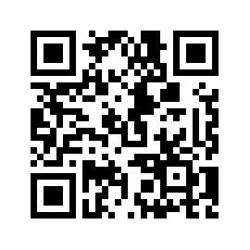
#helptogrow
Leave your feedback for the Help to Grow: Management Alumni Network team.

Slide 43
how can mentoring empower your business? BREAKOUT ROOM #1
social media marketing Finsbury suite
tax and accounting
fundamentals BREAKOUT ROOM #3
sustainability BREAKOUT ROOM #4

