Slide 1
#helptogrow
How mentoring
can empower
your business

Slide 2
#helptogrow
Ben Jacobs
Help to Grow: Management Project Lead, Association of Business Mentors
Simon Fordham
Help to Grow: Management Project Director, Association of Business Mentors

Slide 3
Business Mentoring
Super-charge your business
Simon Fordham, ABM Chair
Ben Jacobs, ABM Programme Lead, Help to Grow: Management Course
23rd November 2023

Slide 4
The ABM is the voice of Professional Business Mentoring in the UK & Ireland
We champion the impact of professional business mentoring
We continually learn, improve and innovate
We ensure business mentoring is a vital part of the business support landscape
We are the “go to” organisation for businesses looking for a professional business mentor
Notes:
The ABM is the professional body for business mentoring in the UK and Ireland.
We are focused on promoting and maintaining the highest standards in professional business mentoring.
To do this, we continually learn, improve and innovate, supporting our members as they deliver mentoring excellence that benefits UK, Ireland and overseas businesses.
We also champion the impact of professional business mentoring, ensuring that business mentoring is recognised as a vital part of the business support landscape by business leaders, political leaders and policy decision makers.

Slide 5
Later this session we will ask for a volunteer for a live business mentoring demonstration.
This is a fun way to experience business mentoring for yourself.
Please think about one area where you would like to grow or develop your business.
A fun opportunity for you to gain free business support.

Slide 6
What Is Business Mentoring?
A Professional Business Mentor supports business leaders through the highs and lows of running a business
Mentors combine skill, expertise and experience to help clients tackle challenges and achieve business objectives
Goal setting, accountability and knowledge exchange are key features of professional business mentoring

Slide 7
How can a Business Mentor help?
Business Mentors support businesses in many ways:
A listening ear & sounding board
Business Planning with an expert
Refining business purpose and personal aspirations
Strategy – marketing, operations, HR
Business Performance coaching
AND… many other ‘hats’
Together, these help you get more from your business;
increasing turnover, maximizing profitability and
planning for the future.

Slide 8
What is the Impact Of Professional Business Mentoring?
of business owners say mentoring has been important to their business growth.
find their mentor from a recommendation from a trade body or professional body.
76%
19%
of business owners agreed that mentoring has been crucial in helping their business to survive.
66%
89%
Of SMEs believe that mentoring can help them succeed.
Sources: Mentoring Matters, Enterprise Nation (2022), Sage.com (2017)

Slide 9
What is the Impact Of Professional Business Mentoring?
Companies with mentors had profits that were 18% better than average (Forbes 2022)
+18%
Businesses with a mentor are twice as likely to survive beyond 5 years (Federation of Small Businesses)
200%
Less than 25% of businesses currently have a business mentor (sage)
66%
<25%

Slide 10
10 minutes with a neighbour:
What is the most profound way that a mentor has helped or supported you in your business? What challenge were you overcoming - how did you grow as a result?
If you had a business mentor – what ‘big and hairy’ audacious aspiration would you like to achieve? What’s your dream in business?
Association of Business Mentors (ABM)

Slide 11
15-minute Mentoring Masterclass
A Professional Business Mentor supports business leaders through the highs and lows of running a business
Mentors combine skill, expertise and experience to help clients tackle challenges and achieve business objectives
Goal setting, accountability and knowledge exchange are key features of professional business mentoring
Association of Business Mentors (ABM)

Slide 12
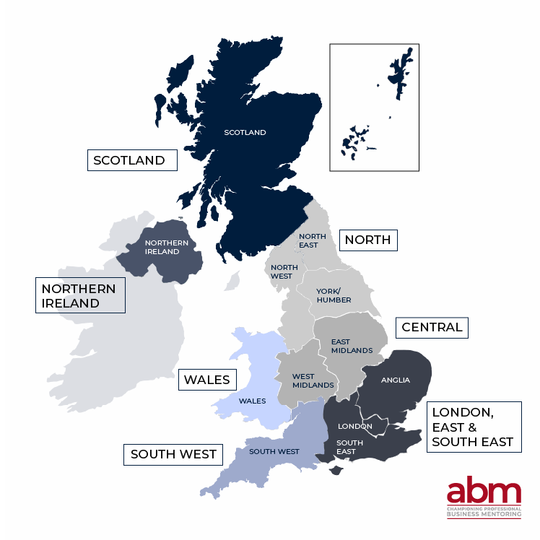
The ABM UK Network
The ABM Network has Chairs throughout the UK and Ireland
The ABM Network provides opportunities for ABM members to meet and share mentoring best practice within the nations and regions within which they live and/or work.
The map shows how we are organised into seven regions representing all of the UK and Ireland.​ ​
Notes:
The ABM is the professional body for business mentoring in the UK and Ireland.
We are focused on promoting and maintaining the highest standards in professional business mentoring.
To do this, we continually learn, improve and innovate, supporting our members as they deliver mentoring excellence that benefits UK, Ireland and overseas businesses.
We also champion the impact of professional business mentoring, ensuring that business mentoring is recognised as a vital part of the business support landscape by business leaders, political leaders and policy decision makers.

Slide 13
Why Do Professional Business Mentors Join The ABM?
Our members benefit from an engaged and highly skilled community of 2000+ members
We connect through regional networks, events & special interest groups
The ABM supports members to continually improve professional skills with CPD, qualifications, tools and resources
Business leaders increasingly recognise the value of an ABM accredited mentor

Slide 14
Why Do Business Owners Choose an ABM Mentor?
ABM membership reassures business leaders that their mentor is experienced & knowledgeable
Clients know they are engaging with a highly professional individual, operating to rigorous professional standards
ABM mentors are experienced business leaders, committed to continuous learning & development
Association of Business Mentors (ABM)

Slide 15
The Joining Process
Our application process invites member to demonstrate their skills and competency:
Business experience
Corporate experience
Mentoring experience
Successful applicants commit to the highest professional standards, including codes of conduct and ethics

Slide 16
THANK YOU.
For more information visit our website.
associationofbusinessmentors.org
Notes:
About the ABM The Association of Business Mentors (ABM) is the voice of professional business mentoring in the UK and Ireland.
The ABM has established standards of professional business mentoring, facilitating access for every business owner in the UK and Ireland to trusted, experienced and knowledgeable business mentors.
ABM members are experienced business leaders, spanning all business sizes and sectors. Each member goes through a rigorous application process. They are required to have business ownership or c-suite experience and to demonstrate their personal commitment to continuous learning and development.
Their work empowers businesses to grow and succeed, helping them through the highs and lows of running a business.

Slide 17
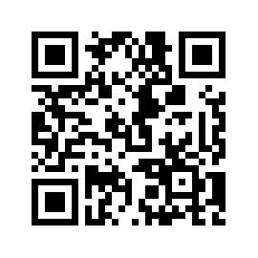
#helptogrow
Leave your feedback for the Help to Grow: Management Alumni Network team.

