Slide 1
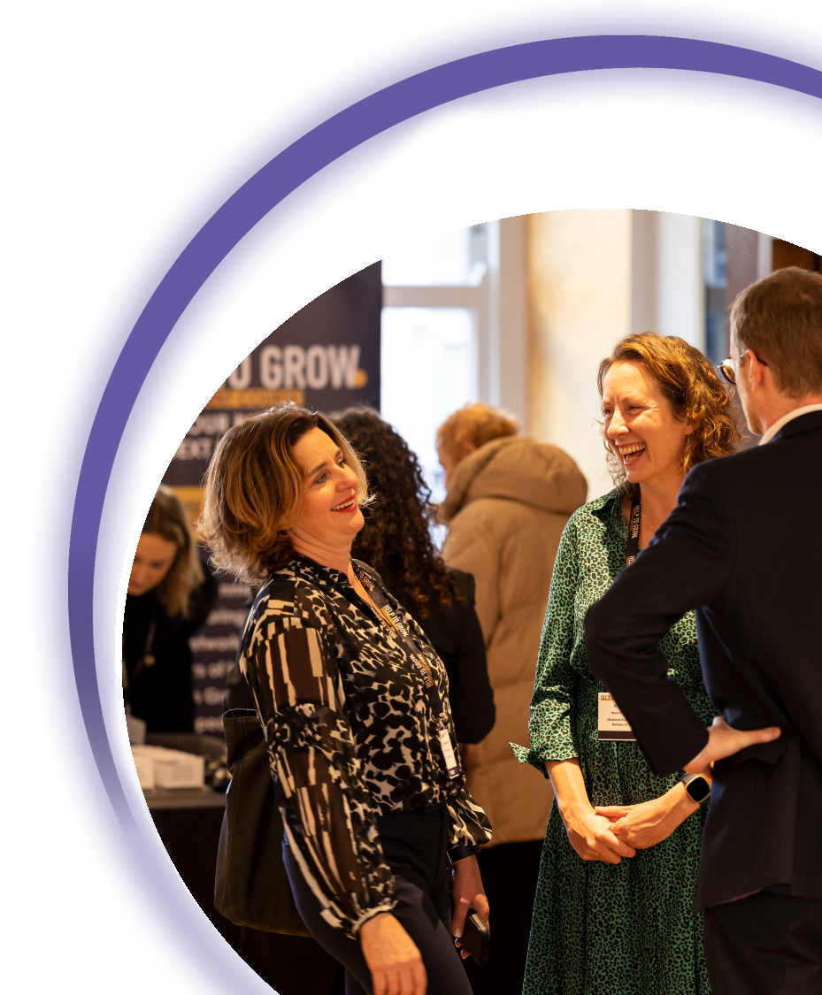
#helptogrow
Social media marketing

Slide 2
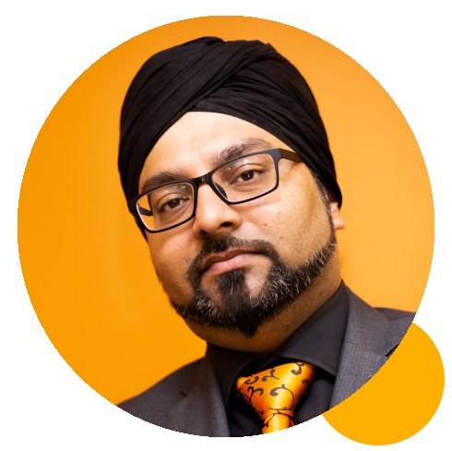
#helptogrow
Gus Bhandal
Founder, The M Guru

Slide 3
HELP TO GROW
23RD NOVEMBER 2023
Social Media Marketing
Streamline your social media for sustainable success
GUS BHANDAL
The M Guru
Search online for @MGuruUK

Slide 4
GUS
GUS
BHANDAL
BHANDAL

Slide 5
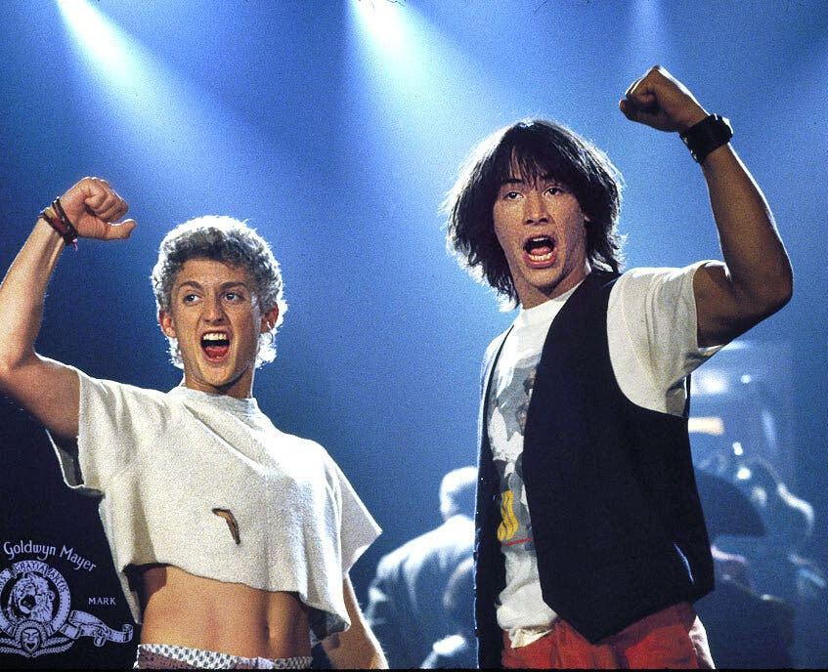
The original TED Talk
It was most excellent

Slide 6
Streamline your social media for sustainable success
WHAT WE'LL COVER IN THIS SESSION
Optimise your profiles
Finding ideal clients
Creating content they want to read
The purpose of two-way communication
Bonus: the offline strategy

Slide 7
THE SOCIAL SUPERSTAR STRATEGY
Brand
Social Media
Network
YOU
Clients
Marketing

Slide 8
Before you start...

Slide 9
Google Business Profile
Google Analytics

Slide 12
Website / Blog / Facebook / LinkedIn
Facebook / Twitter / Emails / Google / Threads
Instagram / Pinterest / Facebook / LinkedIn
YouTube / LinkedIn / Website
TikTok / Instagram Reels / YouTube Shorts
Clubhouse / Twitter Spaces / LinkedIn Audio
Whatsapp / Messenger / Telegram
Long form content
Short form content
Photos / images
Long videos
Short videos
Audio
Messaging

Slide 13
ONE
Optimise your profile

Slide 14
Check your bios
Are you saying the right things?

Slide 15
The famous
GUS BHANDAL
HEADLINE TEMPLATE

Slide 16
TWO
Your ideal clients

Slide 17
Your Ideal Client
Age, location
Socio-economic status
Hobbies and interests
Where they hang out
Pain points (+caveats)

Slide 18
THREE
Content strategy

Slide 19
Who likes the content?
What content do your audience prefer?
What content do you like creating?
Are you providing a solution to their pain points?

Slide 20
Content Foundations
Find the pain
Agitate the pain
Deliver the solution
Back it up

Slide 21
Content
Pillars

Slide 24
FOUR
Two-way communication

Slide 26
Time to get engaged
Create brand advocates and ambassadors.
Give value, be supportive, and reciprocate.
Be consistent.

Slide 27
FIVE
Offline strategy

Slide 28
Customers
The Digital Marketing Ecosystem
Google Business Profile
Website / Blog
Partners / Referrals
Social Media (organic)
Social Media (advertising)
Email Marketing
Offline

Slide 30
You do NOT need to be everywhere!
Avoid choice paralysis in your audience

Slide 31
Takeaways
Optimise your profiles
Think about your ideal clients (and their pains)
Create awesome content
Be social
Don’t forget the offline

Slide 32
Search online for @MGuruUK
(social media platform) / mguruuk
Gus Bhandal

Slide 33
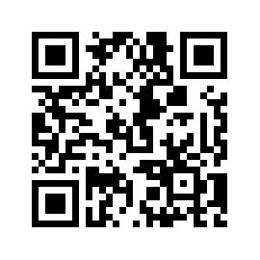
#helptogrow
Leave your feedback for the Help to Grow: Management Alumni Network team.

