Slide 1
#helptogrow
Sustainability: first steps and carbon auditing

Slide 2
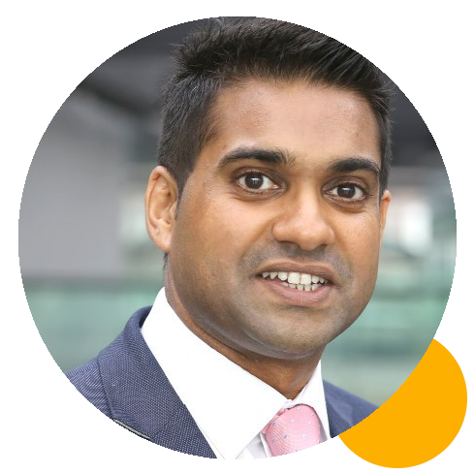
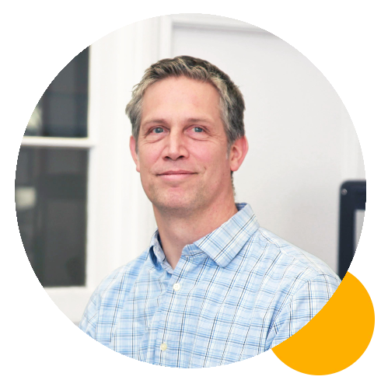
#helptogrow
Claire pattison
Senior Lecturer of Enterprise in Practice, Leadership and Growth Lead at the Centre for Enterprise, Manchester Metropolitan University
Navin Rauniar
Sustainability Partner, Tata Consultancy Services
Christoph geppert
Director, Grain Sustainability

Slide 3
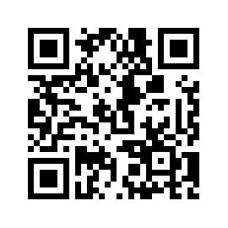
#helptogrow
Leave your feedback for the Help to Grow: Management Alumni Network team.

