Slide 1
#helptogrow
Tax and accounting fundamentals

Slide 2
#helptogrow
Sylvia kotarba-harris
Managing Director, Foster Chapman
James Lindley
Founder and CEO,
Castell Wealth Management

Slide 3
Future Proof Your Business

Slide 4
Where is your business taking you, or
Where are you taking your business?

Slide 5
Business Stages

Slide 6
What are your goals, what does your future perfect look like?
If we were having this discussion three years from today, and you were looking back over those three years, what has to have happened in your life, both personally and professionally, for you to feel happy with your progress?
Specifically, what dangers do you have now that need to be eliminated, what opportunities need to be captured and what strengths need to be maximised?

Slide 7
Start up phase
1) Setting Up – Start with end in mind - systems & processes
2) Company Benefits – sort out
3) Tax Credits - R&D tax credits – lack of knowledge
4) SEIS Funding
5) Shareholder protection

Slide 8
Growth Phase
1) EXCESS CASH IN THE BUSINESS:
• Company Investment
• Cash Management
• Capital Extraction
2) KEY PEOPLE:
• Key person insurance & plan

Slide 9
Growth Phase
• Cashflow: planning and forecasting
• Funding
• Review of business plan
• Staff

Slide 10
Established Business
Dividend Tax Rate | Rate | From | To
Basic Rate | 8.75% | £1,000 | £36,700
Higher Rate | 33.75% | £36,701 | £125,140
Additional Rate | 39.35% | £125,140+
TAKING DIVIDENDS
• Not Monthly/dividend voucher
• Use thresholds
• What about my tax return

Slide 11
Established Business
Retention of staff +premises – maybe buying commercial property though pension /JV personal +business
Extraction Cash from your business

Slide 12
Divided Efficiency?

Slide 13
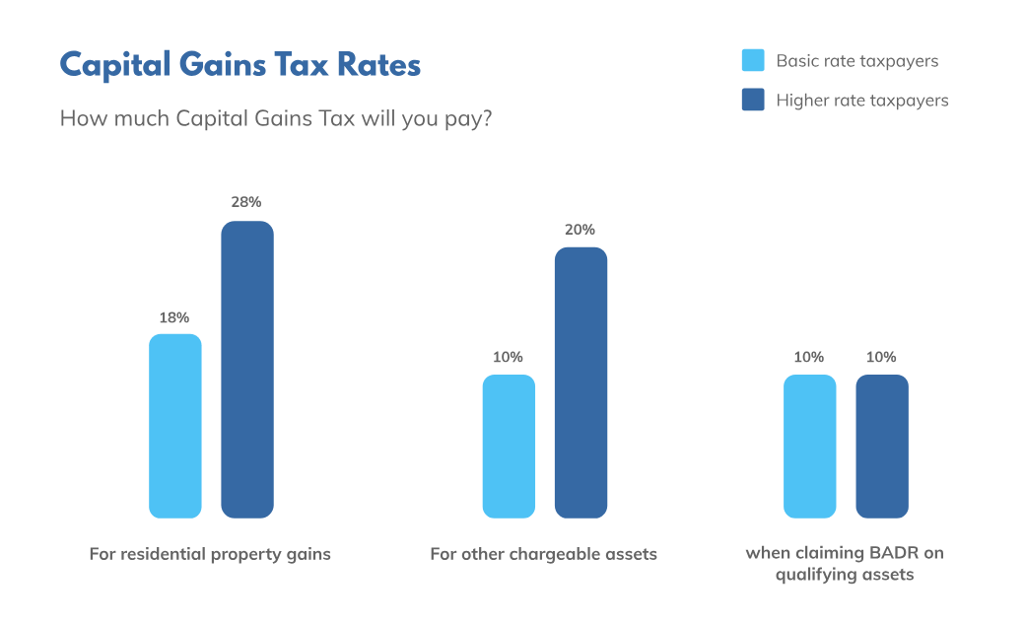
Pre-Exit
FINANCIALS AGAIN!
• Company valuation
• Sale v merger v listing
PERSONAL FINANCES
• BADR =Entrepreneurs' relief
• Capital gains tax on sale
• Shares to trusts/family and impact?

Slide 14
Contact details:
James Lindley
07962 424 150
enquiries@castellwm.co.uk
.
Sylvia Kotarba-Harris
07891 411 981
info@fosterchapman.com
.

Slide 15
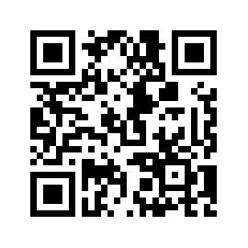
#helptogrow
Leave your feedback for the Help to Grow: Management Alumni Network team.

