Slide 1
North-east ALUMNI NETWORK
Webinar series
Challenging the traditional notions of leadership
#helptogrow
helptogrowalumni.org

Slide 2
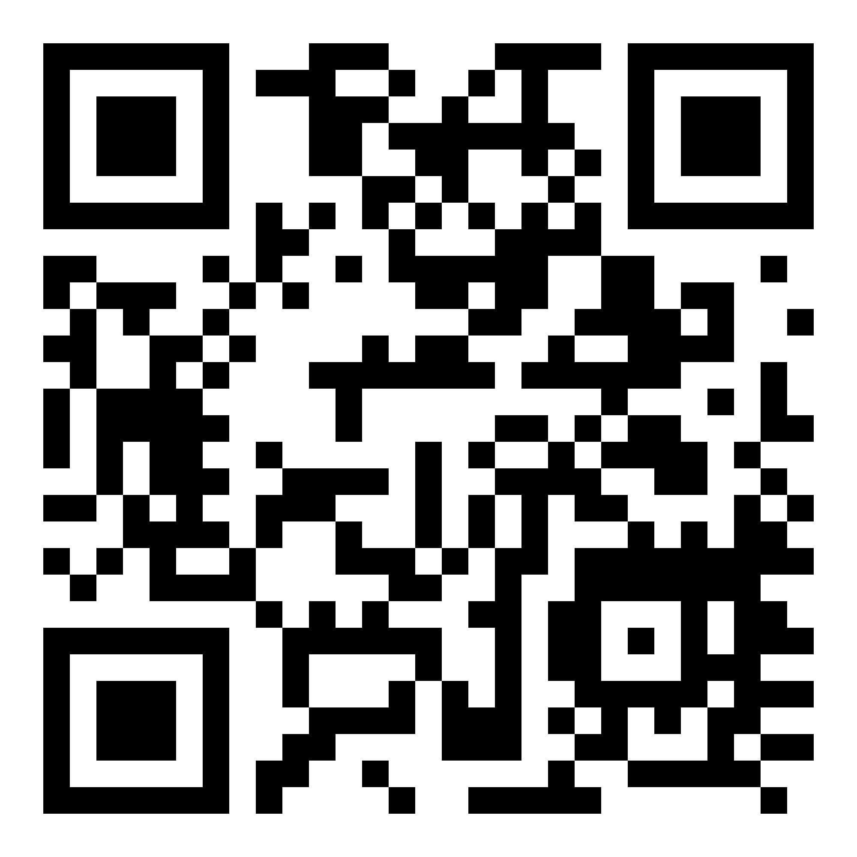
Keynote masterclass Leadership Transformation
Blaire Palmer,
Authority on the future of work

Slide 3
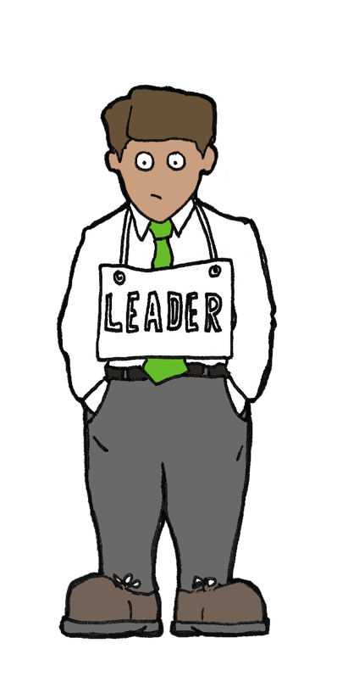
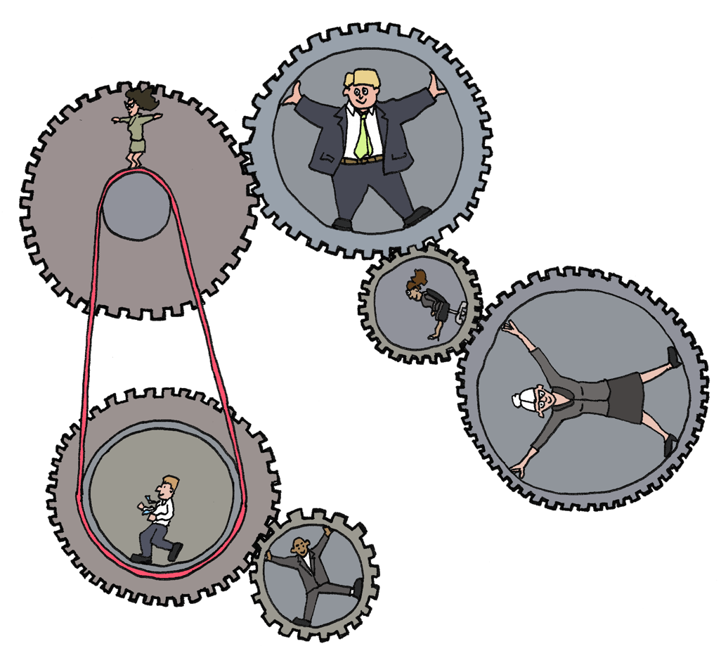
Working Group:
Strong, clearly focused leader
Individual accountability
Individual work products
Efficient meetings
Discusses, decides, delegates
Team:
Shared leadership
Individual AND mutual accountability
Specific team purpose that the team delivers
Collective work products
Open discussion and problem solving together
Discussed, decides and does real work together
Notes:
trends

Slide 4
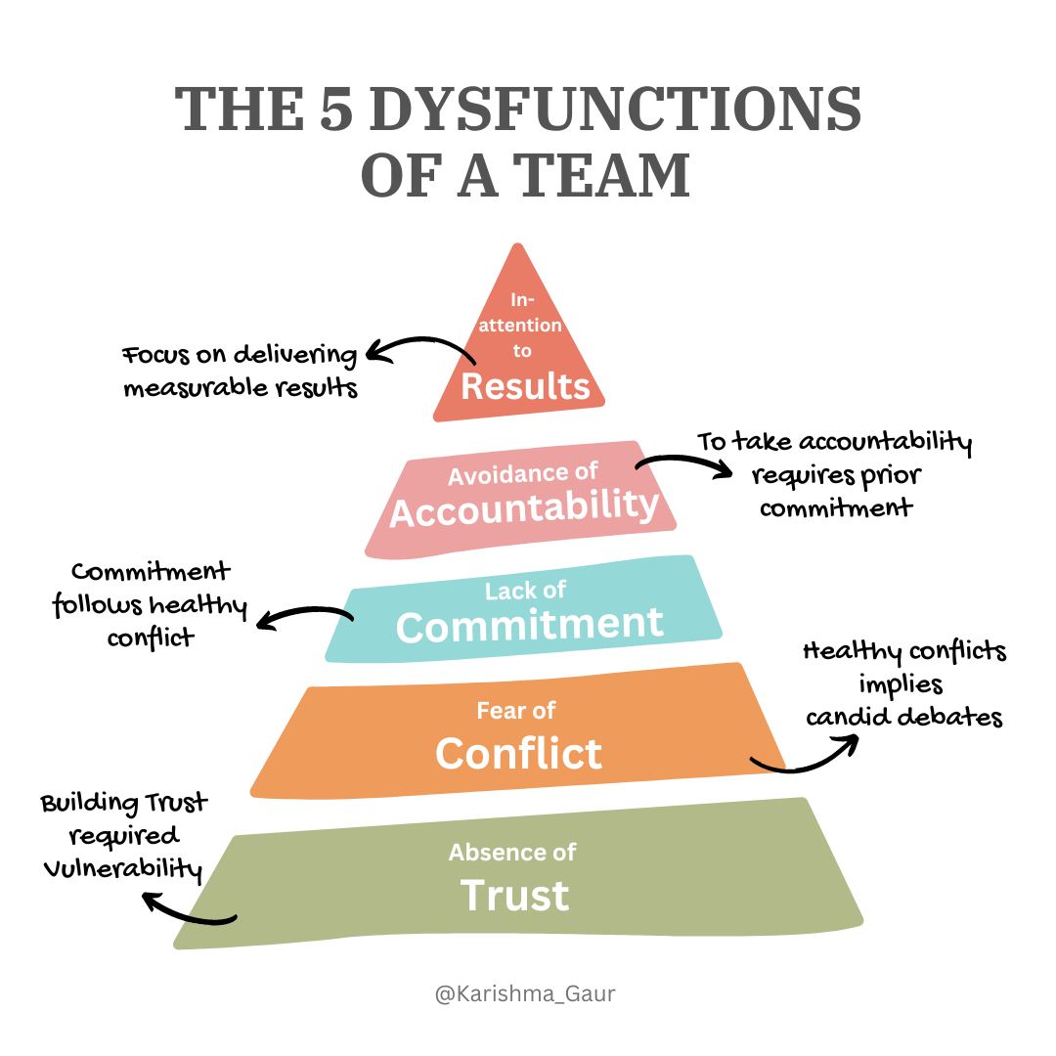
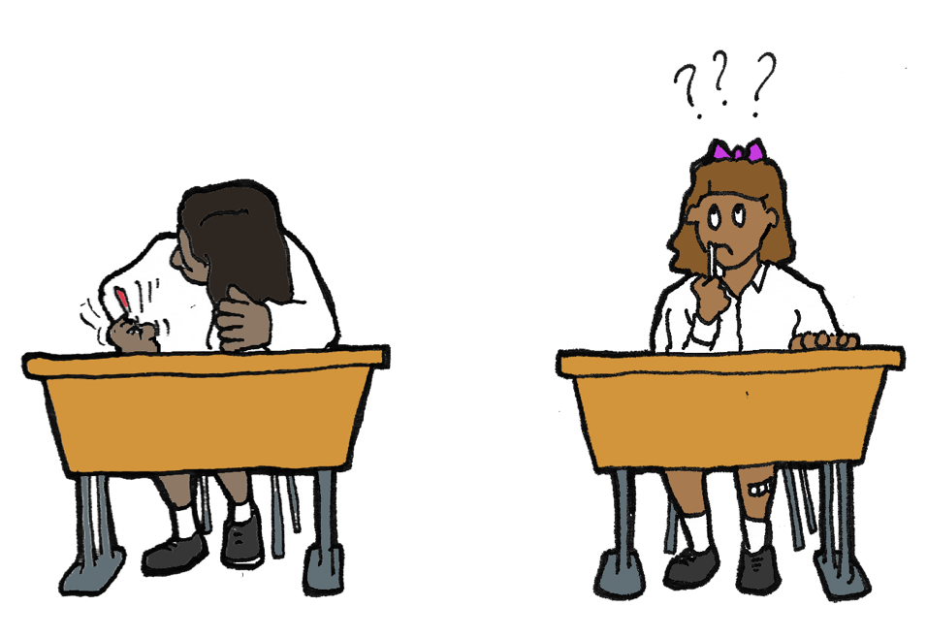
Notes:
siloes

Slide 5
Thank you!

Slide 6
See you on the 6th of February for
part 2: alternative and updated leadership approaches
Please register at https://helptogrowalumni.org/events/webinar-north-east-webinar-series/
helptogrowalumni.org

