Slide 1
Unlocking Employee Engagement & Motivation ‘A Motivated Workforce is a Productive Workforce’
Organised By
Panel Members:
Steve Jones – MD, Skills For Business Training Ltd
Jessica Comolly – Jones – Director, Rubicon People Partnership
Harry Pocknell – Strategy & Creative Diretor, Salad
Sandeep Sesodia – CEO Parity Trust

Slide 2
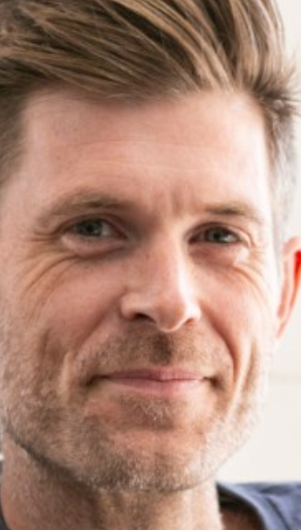
Thanks to the Panel Members
Sandeep Sesodia
Steve Jones FCMI
Jessica Comolly-Jones
Harry Pocknell
CEO, Parity Trust
MD, Skills for Business Training Ltd
Director at Rubicon People Partnership
Strategy & Creative Director Strategy & Creative Director
Salad

Slide 3
Department for Business Innovation and Skills consultation (Sept 2010) reinforced research that has shown that:

Slide 4
Number 1.
Visible Empowering Leadership
Provide Strong, Strategic Narrative About The Organization – the story about:
Where you Came From
Where You are Now
And Where you are going.
‘Companies with unusually clear visions
outperform their competitors by a factor of 10’
According to Harvard Business School

Slide 5
Number 2. Engaging Managers
Focus On People, Give Them Scope
Treat People As Individuals
Coach, Motivate And Stretch Their People
‘People Don’t Quit their jobs they quit their bosses’

Slide 6
Number 3. Employee Voice
Reinforcing And Challenging Views, Between Functions And Externally
Employees Seen As Central To The Solutions
Richard Branson Employs People so they can tell him what to do. Do you listen to your people?

Slide 7
Number 4.
Organisational Integrity
Integrity &
Values on the Wall are
Reflected in Day to Day
Behaviours –
No “say/do” Gap
Does everyone know, live and
breathe your values?

Slide 8
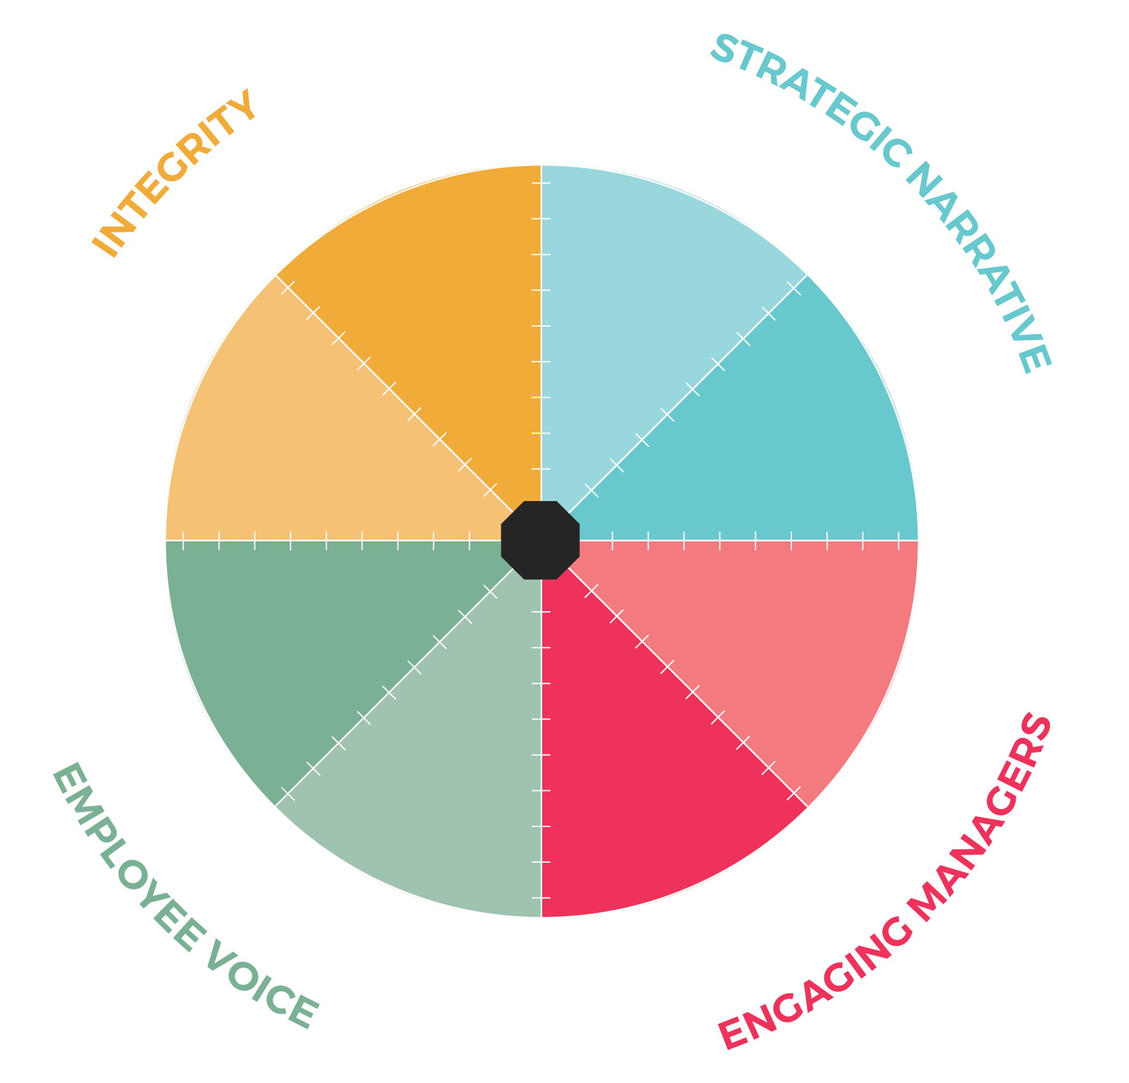
WHAT’S
YOUR SCORE?

Slide 10
IF YOUR WORFORCE WAS FULLY MOTIVATED WOULD YOU AS A LEADER NEED TO WORRY ABOUT:
The Great Resignation?
The War On Talent?
Hybrid Working?
The Cost Of Living Rise?
Mental Health?
Sustainability and productivity?
Diversity & Inclusion?
The Pandemic & Recent Impacts?
Presenteeism/Quiet Quitting?
Learned Helplessness?
‘A Motivated Workforce is a Productive Workforce’

Slide 11
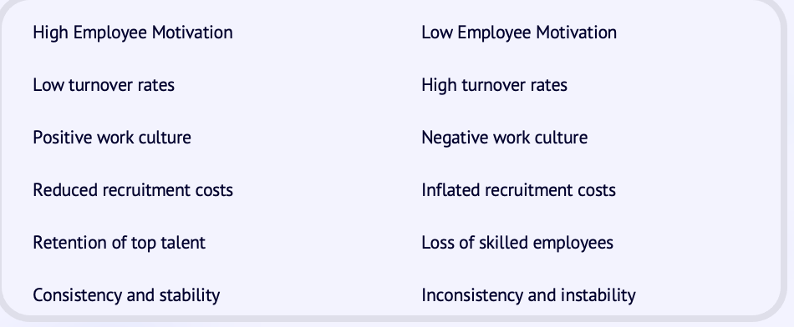
The Impact of Employee Motivation
on Employee Turnover
‘A Motivated Workforce is a Productive Workforce’

Slide 12
Performance Triangle
DIRECTION
SKILLS
MOTIVATION

Slide 13
What is the difference between:
Personality and Motivation?

Slide 14
PEOPLE DON’T QUIT THEIR JOBS
THEY QUIT THEIR BOSSES!!

Slide 15
Performance…
Performance Quadrants in Your Organisation…
HIGH MOTIVATION
LOW SKILLS
Coach Mentor Retain
HIGH MOTIVATION
HIGH SKILLS
Up to 16 times more productive!
Recruit Train
Motivation 100%
Extremely Costly if Not Resolved!
Release?
Coach Mentor Retain?
LOW SKILLS
LOW MOTIVATION
HIGH SKILLS
LOW MOTIVATION
0% Skills 100%
Notes:
15
Remember that approximately it takes a year to eighteen months to move from one quadrant to the next. In the first it is a learning process- slow but meticulous with a high level of enthusiasm. Individuals and teams are here placed very much in the present. In the second we are looking at efficiency in the range of 80%+ and this needs to be maintained through assessing the changing motivational needs. Individuals and teams here are placed very much in the future and have a positive high success culture. In the third quadrant, conversation is based in the present and past, clock watching, low level involvement. The third is for the pathologically insane: they are on a downward spiral and want to take others down with them- it is a lonely state and they want to share their misery. Responses to change are negative, critical to others and foulmouth the organisation.

Slide 16
Performance…
Performance Quadrants in Your Organisation…
HIGH MOTIVATION
LOW PRODUCTIVITY
HIGH MOTIVATION
HIGH PRODUCTIVITY
Up to 16 times more productive!
Coach Mentor Retain
Recruit Train
Motivation 100%
Extremely Costly if Not Resolved!
Release?
HIGH SKILLS
LOW/HIGH PRODUCTIVITY
Coach Mentor Retain?
LOW SKILLS
LOW PRODUCTIVITY
0% Skills 100%
Notes:
16
Remember that approximately it takes a year to eighteen months to move from one quadrant to the next. In the first it is a learning process- slow but meticulous with a high level of enthusiasm. Individuals and teams are here placed very much in the present. In the second we are looking at efficiency in the range of 80%+ and this needs to be maintained through assessing the changing motivational needs. Individuals and teams here are placed very much in the future and have a positive high success culture. In the third quadrant, conversation is based in the present and past, clock watching, low level involvement. The third is for the pathologically insane: they are on a downward spiral and want to take others down with them- it is a lonely state and they want to share their misery. Responses to change are negative, critical to others and foulmouth the organisation.

Slide 17
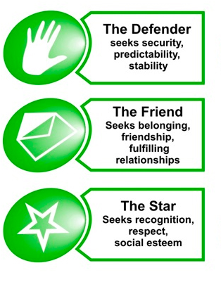
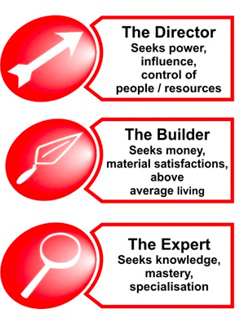
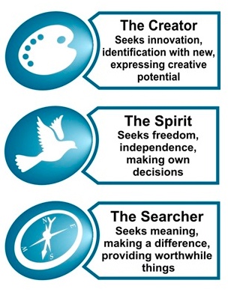
9 Key Motivators
RELATIONSHIP MOTIVATORS
ACHIEVEMENT MOTIVATORS
GROWTH MOTIVATORS
‘A Motivated Workforce is a Productive Workforce’

Slide 18
QUESTION TO ASK YOURSELF:
Does your current role fulfil your top three
MOTIVATIONS?

Slide 19
Personal Motivation Audit
Name: JOE BLOGGS Company: XYZ LTD
Motivational Maps Results | Current Score (out of 10) | How to Improve (Job Enrichment)
Motivation No. 1 SEARCHER (x3) - - - - - - - - - - - - - - - | 7 (x3)
Motivation No. 2 EXPERT - - - - - - - - - - - - - - | 7
Motivation No. 3 CREATOR - - - - - - - - - - - - - - | 7
Total: (Out of 50) |  | 70% Motivated
Explore opportunities to make more of a difference with clients/staff
Make time to maintain knowledge & expertise
Greater involvement in development work and problem solving
35 x2 for score
70%

Slide 20
90 Day Motivational Action Audit – page 13
Motivational Maps Results | Current Score (out of 10) | Actions to be taken
Motivation No. 1 (x3)
Total: (Out of 50)
x2 for score
© Copyright 2009 Steve Jones

Slide 21
PERFORMANCE Four types of People in the Organisation
HIGH MOTIVATION
LOW SKILLS
HIGH MOTIVATION
HIGH SKILLS
16 times more productive
0 Motivation 100%
LOW SKILLS
LOW MOTIVATION
LOW MOTIVATION
HIGH SKILLS
0 Skill 100%
© Copyright 2007 Steve Jones
Notes:
Remember that approximately it takes a year to eighteen months to move from one quadrant to the next. In the first it is a learning process- slow but meticulous with a high level of enthusiasm. Individuals and teams are here placed very much in the present. In the second we are looking at efficiency in the range of 80%+ and this needs to be maintained through assessing the changing motivational needs. Individuals and teams here are placed very much in the future and have a positive high success culture. In the third quadrant, conversation is based in the present and past, clock watching, low level involvement. The third is for the pathologically insane: they are on a downward spiral and want to take others down with them- it is a lonely state and they want to share their misery. Responses to change are negative, critical to others and foulmouth the organisation.

Slide 22
90 DAY PROGRAMME FOR INDIVIDUALS & TEAMS
MOTIVATIONAL ACTION PLAN
Studies show that companies with continuous performance management processes (monthly and/or quarterly) are 1.5 times more effective at engaging and retaining employees compared to companies with annual/one-off performance processes.

Slide 23
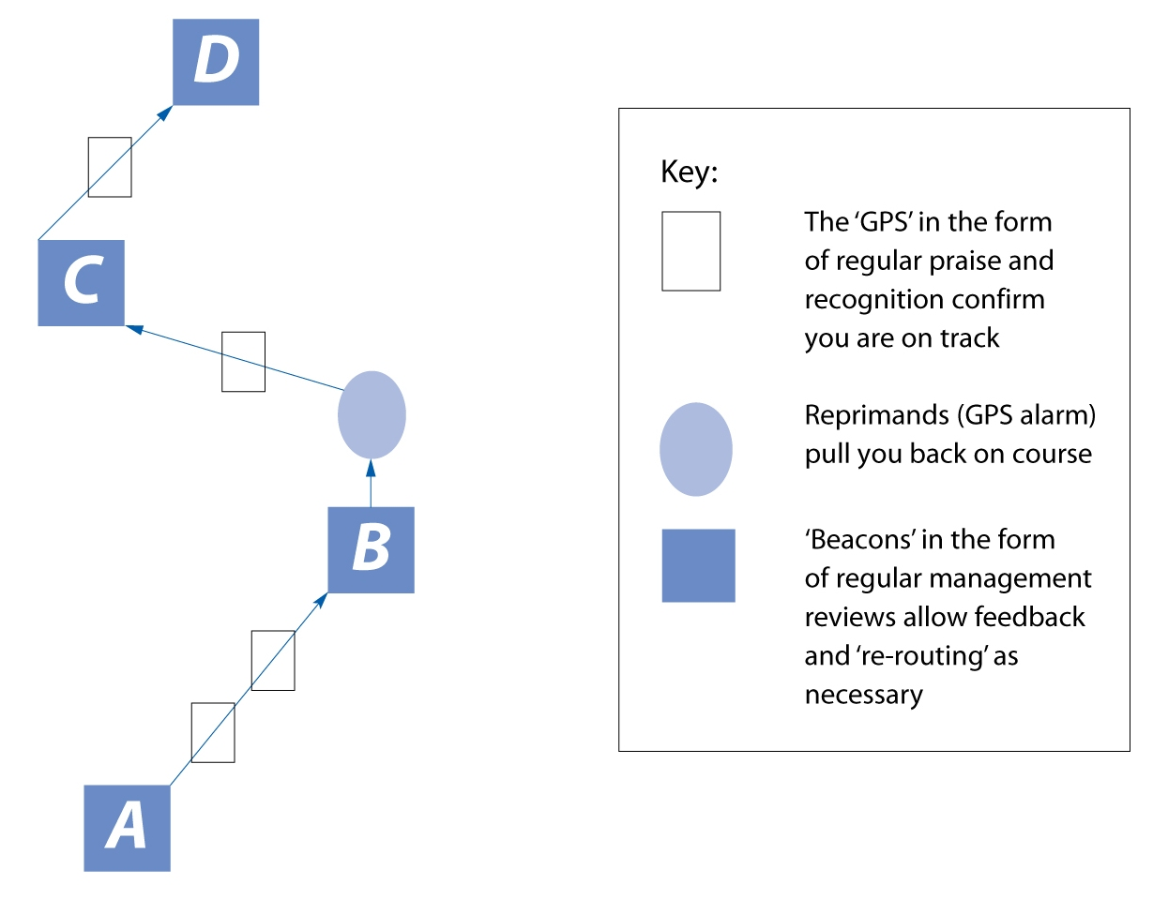
‘Flight Plan Analogy’
Maximising People’s Potential with a
90 Day Motivational Action Plan (MAP)
Through Feedback
4th 90 Day MAP
3rd 90 Day MAP
2nd 90 Day MAP
1st 90 Day MAP

Slide 24
For The Sceptics who think this is fluffy and unnecessary A REMINDER:
‘A Motivated Workforce is a Productive Workforce’
CONSIDER THESE FACTS

Slide 25
‘A Motivated Workforce is a Productive Workforce’
It cost an average of £7,500 to recruit, onboard and train a new employee.
If they join an organisation with low motivation:
‘How long will they stay and what will it cost you?’
A Motivated Workforce doesn’t quit!

Slide 26
‘A Motivated Workforce is a Productive Workforce’
According to the CBI, sickness and absenteeism cost a business £750 per day per employee in lost productivity and sickness cover.
The average sickness levels in the UK are:
7 days per employee – private sector = £5,250 per employee
17 days per employee – public sector = £12,750 per employee
A Motivated Workforce rarely takes sickness!

Slide 27
‘A Motivated Workforce is a Productive Workforce’
Companies on the Glassdoor 12 Best Places to Work list outperform the overall stock market by 115%.
Best places to work are, by definition, places where employees are motivated, so from a purely financial point of view motivation is surely desirable?
A Motivated Workforce grows the business!

Slide 28
‘A Motivated Workforce is a Productive Workforce’
In the UK, 82% of senior managers regard disengaged employees as one of the three greatest threats facing their business. In other words, engagement is a strategic issue.
A Motivated Workforce can be achieved!

Slide 29
‘A Motivated Workforce is a Productive Workforce’
As many as 47% of employees stay in a job they dislike for fear of having no other option.
Question: Do we want to be the kind of business or manager who presides over misery and fear?
Motivated Workforces don’t consider leaving!

Slide 30
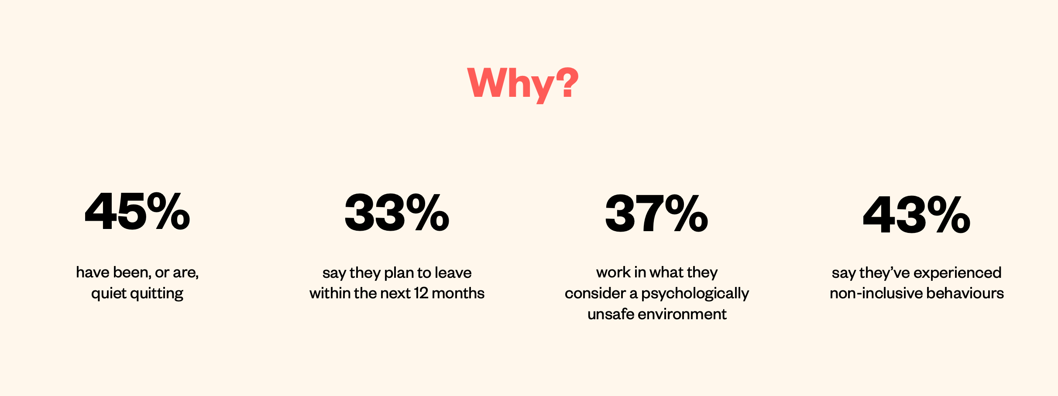
‘A Motivated Workforce is a Productive Workforce’

Slide 31
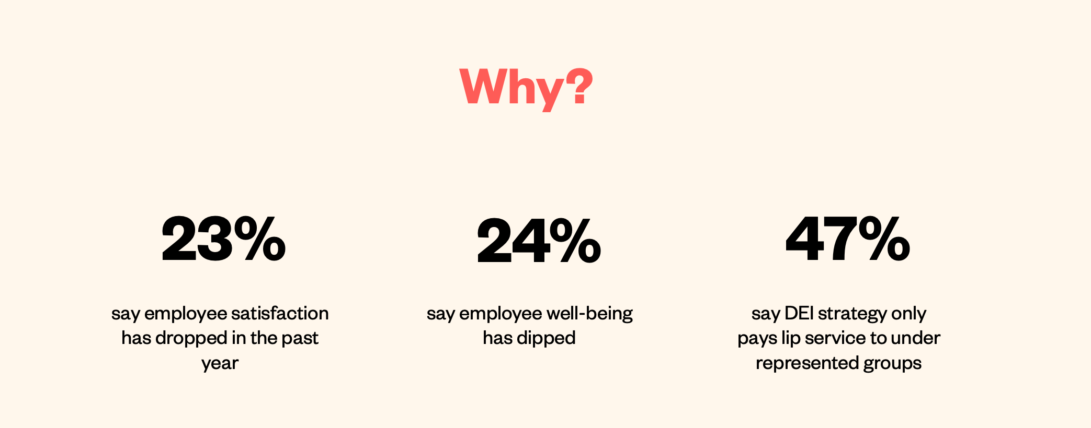
‘A Motivated Workforce is a Productive Workforce’

Slide 32
CMI’s Better Managed Britain Campaign
CMI’s Better Managed Britain Campaign
Key Findings (October 2023)
82% are “accidental managers” and a third don’t have formal management training
Bad management has prompted one in three UK workers to quit.
Ineffective managers have a deep impact on employees including on their motivation, satisfaction and likelihood to leave their job

Slide 33
CMI’s Better Managed Britain Campaign
CMI’s Better Managed Britain Campaign
CMI’s findings assert that raising your management and leadership standards will support Employee Engagement and Motivation:
Great managers engender loyalty in their people. A large majority (72%) of those workers who rated their manager as effective felt valued and appreciated.
This figure dropped to just 15% when the manager was rated as ineffective.
Good management and leadership practices leads to better performance including greater retention, a more positive work environment and improved business outcomes

Slide 34
“We have found the training input we received from Steve highly valuable. It is both practical and scalable. “We have even built the motivational maps tools and techniques into our team appraisal process, which has been recognised and praised by the legal practice accrediting body Lexcel.
Law Firm Ellis Jones
Managing Partner
Nigel Smith
Adam Lewis, BBD BOOM Founder & Director
Steve Jones has helped us introduce motivational mapping and I would say it is the best HR tool I have ever seen.
It’s turned out to be an excellent predictive tool to help us get ahead of things.
"Wow, that was so up my street and I found it incredibly interesting and helpful."
"When Steve was talking about some of my motivation factors and what motivates/demotivates people, I could really resonate with what he was saying"
‘A Motivated Workforce is a
Productive Workforce’

Slide 36
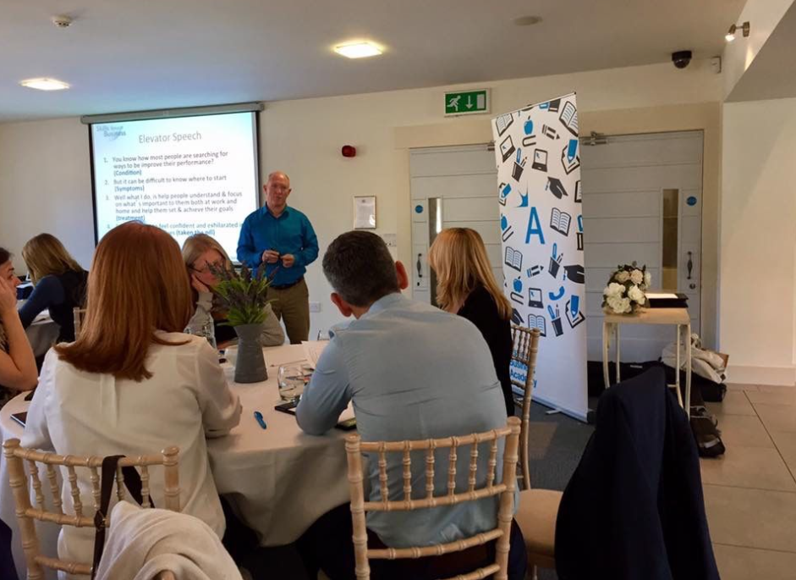
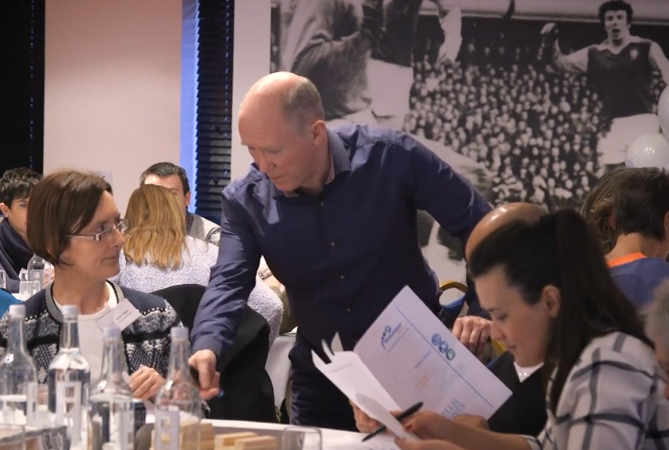
Thank you for Listening!
‘A Motivated Workforce is a
Productive Workforce’

Slide 37
Panel Members
Sandeep Sesodia
Steve Jones FCMI
Jessica Comolly-Jones
Harry Pocknell
CEO, Parity Trust
MD, Skills for Business Training Ltd
Director at Rubicon People Partnership
Strategy & Creative Director Strategy & Creative Director
Salad

Slide 38
Q & A Session

Slide 39
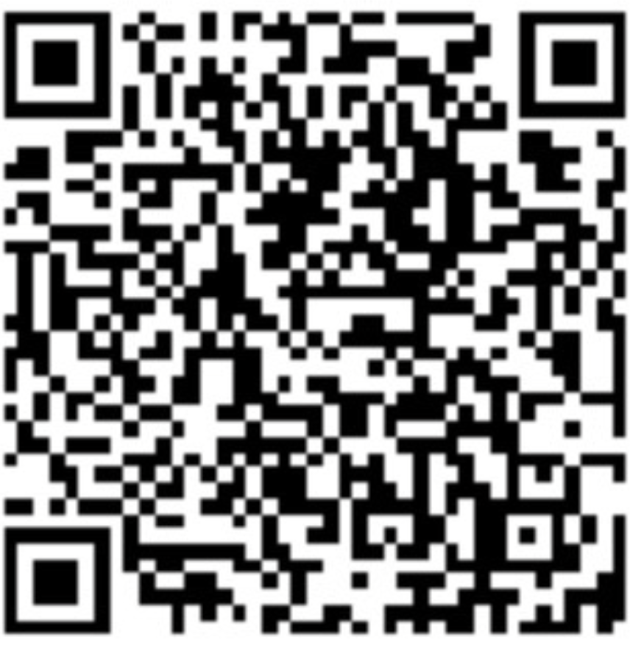
‘A Motivated Workforce is a Productive Workforce’
Thank you for Listening!
Steve Jones –
Skills for Business Training Ltd.
Email: steve@skillsforbusinesstraining.co.uk
Website: www.skillsforbusinesstraining.co.uk
LinkedIn: https://www.linkedin.com/in/stevejonesmotivation
Twitter: @skills4business
steve@skillsforbusinesstraining.co.uk
Tel: 07971 882628

