Slide 1
Growing a Small Firm – The Penderyn Whisky example
Professor Brian Morgan
Cardiff School of Management
Cardiff Metropolitan University
2024

Slide 2
Entrepreneurs: Born or Made?
According to research, about 40% of the traits of entrepreneurs are "inherited” i.e. it’s in the DNA
But 60% of business skills will need to be acquired
e.g. marketing, HR, finance
Also they must have a passion for the business
And they will need good financial and technical support to produce a robust business plan

Slide 3
Importance of Planning
Failure to plan is like planning to fail !
The Plan:
Where is your business now?
Your product, competitors, customers
Where do you want the business to be in three years time?
Vision, some ‘smart’ objectives
How are you going to get there?
Marketing plan, financial plan and funding strategy
Notes:
1. Specific – Objectives should specify what they want to achieve. 2. Measurable – You should be able to measure whether you are meeting the objectives or not. 3. Achievable - Are the objectives you set, achievable and attainable? 4. Realistic – Can you realistically achieve the objectives with the resources you have? 5. Time – When do you want to achieve the set objectives?

Slide 4
A Contingency Plan
A contingency plan is vital because of:
P.E.S.T.s
Political,
Economic (+ environmental),
Social, (and legal)
and Technological …………..factors you never thought would happen …..
Like Brexit or the Pandemic

Slide 5
Main Risk - Over optimism
Entrepreneurs tend to be over-optimistic
They under-estimate the investment and finance needed at the planning stage
To be successful entrepreneurs need to focus on some key things

Slide 6
Characteristics of Success
Firms must :
Be keen to innovate
Be well networked /export oriented
Be focused on marketing / branding
Make good use of IT (and now AI)
Have sound financial controls
Invest in skills
Develop ‘strategic leadership’
Notes:
12

Slide 7
A Successful growth company
In 1998 we started up a whisky company, laid-down some whisky and, in 2004, invented the ‘Penderyn’ brand
But, how could a small firm develop, design and market a successful new brand - against the global whisky brands?
Also, how could we fund it?

Slide 9
Design and Branding
We maximised our brand assets: –
Bottle design and packaging – made it look different from Scotch or Irish
Created a contemporary, creative, confident design – we crafted a brand.
To support a premium price of around £35
And entice new investors into the business

Slide 10
Iinitial Bottle Design and Unique Packaging

Slide 11
The Still
We also had to ensure the taste was different to Scotch (and also Irish)
We had to differentiate the product - couldn’t sell the ‘best Scotch made in Wales’!
We developed unique distillation and maturation processes

Slide 12
New Bottle Design 2018
Glenn – our designer

Slide 13
The Result:
‘Astonishing stuff!’
‘Absolutely staggering arrival on the palate’‘
'Almost the stuff of erotic dreams'
‘. it‘s the best thing from Wales I have ever got my lips around...(!) And I say that will full apologies to a lovely girl from Cardiff, but it‘s true, you see’
‘One of the easiest drinking
whiskies in the world‘

Slide 14
Funding 1
We were incredibly over optimistic
We planned for £1 million to get it to market
We were hit by PESTs –
unexpected events and changes in the law
couldn’t sell over the internet
the duty free market in Europe was withdrawn
needed another £1 million to market the whisky and launch it
But we raised only £250,000

Slide 15
Funding 2
Put some invoice discounting in place
Got a small Firms Loan Guarantee
But still needed another injection of cash
Lucky to find a ‘business angel’ ……….
He invested over £1million - because he came to believe in us and in the product

Slide 16
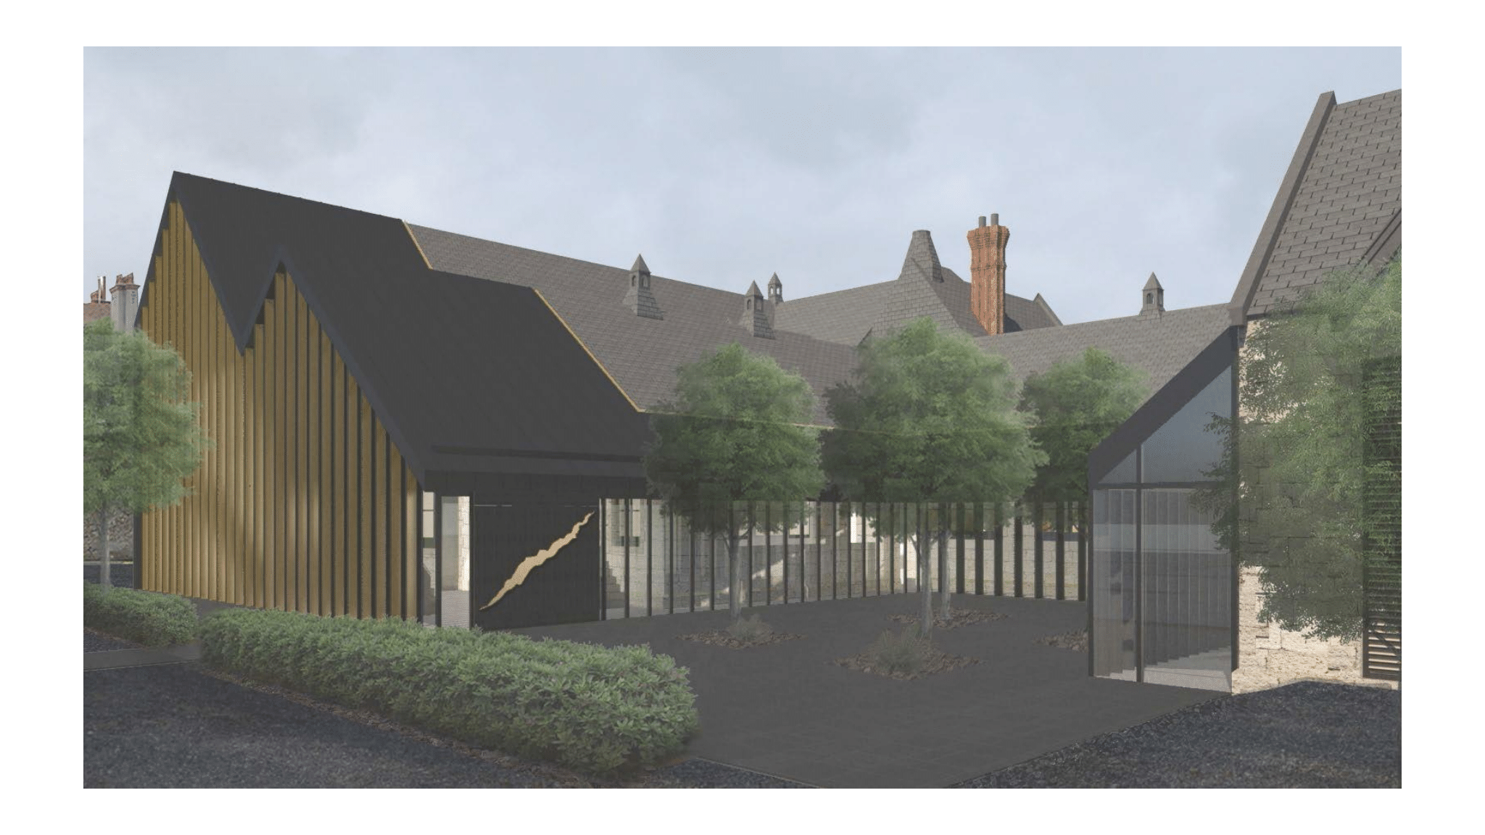
Llandudno Distillery 2022

Slide 17
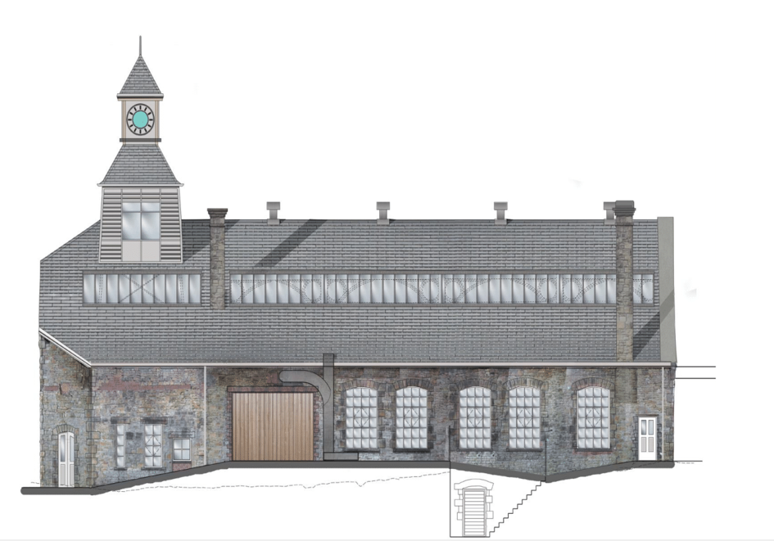
Swansea 2023

Slide 18
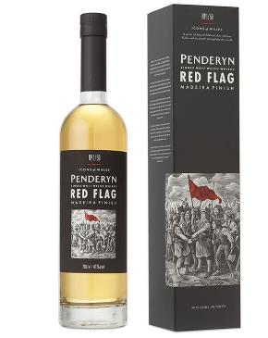
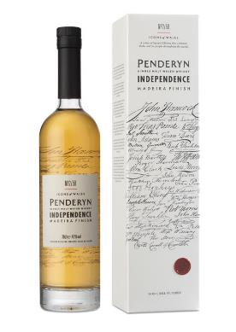
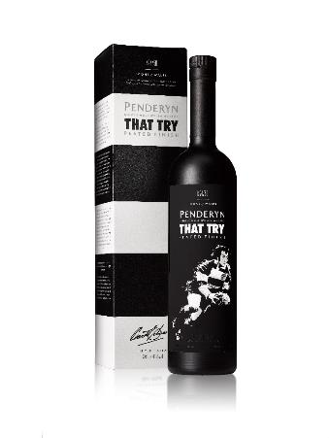
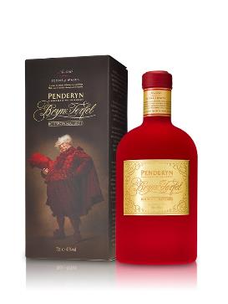
Bryn Terfel, Special Edition
Rating : 96.5 out of 100
Bottled at 59.2% ABV
Icons Of Wales editions
Notes:
A RANGE OF SINGLE MALT WELSH WHISKIES
(MADEIRA FINISH, PEATED, SHERRYWOOD & PORTWOOD)
THE NEW RICH OAK

Slide 19
The Right Team
Creating a great whisky product needed the right people
We invested in skills development, team building, networking and marketing
Used excellent designers
Penderyn is now a successful whisky brand :
3 distilleries and
1 million bottles p.a.
We made mistakes !!
But, we got there in the end !

