Slide 1



Practicial Masterclass:
Strategic Time Management
Cloudbusting Creations Ltd 2024 Copyright

Slide 2





Carving out time for executing your leadership role.
Achievable goal-setting framework
Self-assessment tools
Case studies
Notes:
Confidence comes from practice.
Quite simply, the more we have a go, the familiar it feels, the less anxious we are.

Slide 3

Mel Archbould
  Former MD for over 17 Years
  Shareholder in family-owned business
Growth Strategies to:
  Take the business International
  Enter new sectors with existing products
  New products for existing markets
  Establish long-lasting Customer Relationships
  Develop Operational Excellence
  Take solve significant problems for significant customers
Notes:
Briefly, in case you are not too sure who I am, and why I am here, I was an MD in an engineering business for over 17 years.
The business was formed by my parents back in 1985.
We sold the business in January 2022 and at the beginning of this year I launched Cloud-Busting. Working with busy business leaders who are navigating their journey towards growth, or it could be towards stepping back from their role, or it could be towards exiting the business.
Whichever journey they are on, I've learned so much from running a family-owned business that if I had a pound for every lesson-learned, I could start a whole new business to share my valuable lessons and help others make some decent money!
And that is exactly what I did!

Slide 4

Mel Archbould
  Established Cloud-Busting in 2022
  Support SME Business Owners & Leaders
  Growth
  Succession
  Exit
Educate : Empower : Excite
Notes:
Briefly, in case you are not too sure who I am, and why I am here, I was an MD in an engineering business for over 17 years.
The business was formed by my parents back in 1985.
We sold the business in January 2022 and at the beginning of this year I launched Cloud-Busting. Working with busy business leaders who are navigating their journey towards growth, or it could be towards stepping back from their role, or it could be towards exiting the business.
Whichever journey they are on, I've learned so much from running a family-owned business that if I had a pound for every lesson-learned, I could start a whole new business to share my valuable lessons and help others make some decent money!
And that is exactly what I did!

Slide 5


Slide 6


Slide 7



Slide 8
Leader Responsibilities
  Implements the company strategy
  Implements daily business operations
  Develops growth strategies
  Leads the team to meet and exceed goals and objectives
  Oversees [a department, a division, or multiple departments] and directly manages senior staff
  Presents strategies and results to executives, the board, and other stakeholders
  Adheres to state and local business laws and regulations and company policies

Slide 9
62.5 hours each week!
At least one day most weekends
Continue working throughout their vacation days.

Slide 10



Slide 11


Slide 12
So how much TIME do you spend on your leadership role?

Slide 13
% Implementation
Time
% Strategy
Time
% Leadership
Time
% Everything Else

Slide 14
Micro Businesses
sub 10 employees
10hrs
20%
10hrs
20%
% Implementation
Time
% Strategy
Time
% Leadership
Time
% Everything Else
5hrs
50%
25hrs
50%

Slide 15
Small Businesses
10-49 employees
10hrs
20%
15hrs
20%
% Implementation
Time
% Strategy
Time
20hrs
40%
% Leadership
Time
% Everything Else
5hrs
10%

Slide 16
Medium Businesses
50-249 employees
15hrs
30%
10hrs
10%
% Implementation
Time
% Strategy
Time
% Leadership
Time
% Everything Else
25hrs
50%
Zerohrs
0%

Slide 17

Next Two Full Working Weeks
Log TOTAL Hours worked
Log Time Allocation
Analyse EE

Slide 18


Doing someone elses work (because you don’t trust)
Re-doing someone elses work
Problem-Solving
EE
Another Role
Trouble-Shooting
Attending Meetings that are not yours

Slide 19


Slide 20

Other Roles
Delegate
Automate
Recruit & Train

Slide 21
The ART of Delegation

Slide 22
Consequences
1.Overburdening Yourself
2.Underutilising Team Members
3.Micromanagement
4.Missed Deadlines and Poor Quality
5.Lack of Skill Development

Slide 23
Doing someone elses work (because you don’t trust)
Re-doing someone elses work
Problem-Solving
EE
Another Role
Trouble-Shooting
Attending Meetings that are not yours

Slide 24
Delegation Done Well
1.Clear Communication
2.Selecting the Right Person
3.Provide Adequate Training and Support
4.Establish Trust and Empowerment
5.Set Clear Expectations
6.Monitor Progress and Provide Feedback
7.Be Willing to Let Go
8.Encourage Initiative and Ownership
9.Celebrate Success and Learn from Mistakes
10.Evaluate and Adjust

Slide 25
Time Blocking

Slide 26





Time Blocking

Slide 27


 | Sunday | Monday | Tuesday | Wednesday | Thursday | Friday | Saturday
06.00
07.00
08.00
09.00
10.00
11.00
12.00
13.00
14.00
15.00
16.00
17.00
18.00
91 Hours
54% of Week

Slide 28
 | Sunday | Monday | Tuesday | Wednesday | Thursday | Friday | Saturday
06.00
07.00
08.00
09.00
10.00
11.00
12.00
13.00
14.00
15.00
16.00
17.00
18.00
My Target for Q2 2024
42 Hours Work
25% of Week
19 Hours “Me”
11% of Week
56 Hours Sleep
33% of Week
51 Hours ??
33% of Week

Slide 29
Download a Time Blocking App
Colour code your time for the week ahead
Screen Shot
Adjust during the week
Compare
Learn and Continue to Plan

Slide 30
% Implementation
Time
% Strategy
Time
% Leadership
Time
% Everything Else

Slide 31
Strategy Time

Slide 32
Build Your Strategy
Implement Your Strategy
Track Your Strategy
Notes:
Confidence comes from practice.
Quite simply, the more we have a go, the familiar it feels, the less anxious we are.

Slide 33


Vision
We start here
Then here

Slide 34


Notes:
Innovative thinking links the left hand brain with the right hand brain

Slide 35








Timescale
Months
Months
Months
Months
Months
Months

Slide 36
STAGE 1
6 Steps to Building Your Draft Plan
Team
Ideas
Research
Refine
Budget
Draft Plan

Slide 37
STAGE 2
6 Steps to Building Your Final Strategy
Vision
Obstacles
Priorities
Milestones
Reconfirm
RoadMap

Slide 38
Implementation Time

Slide 39

Obstacles

Slide 40

Order of
Priority

Slide 41



Decision-Making Table
High
Plan
Immediate
Typically worth doing Create Plan
Set deadline
Cost / Benefit
Crack on and get it done
Set deadline
Measure effect
Impact
Drop
Consider
Not worth wasting time
Set date to review again Do more research
or discussion
Low
Hard
Ease of Implementation
Easy

Slide 42
Leadership Time

Slide 43
What do employees want from their leader?

Slide 44

Excellent Communicator
Integrity
Want to feel heard
Deliver - action speaks louder than words
Feel valued

Slide 45

Avoid giving Feedback
Ignore Employee Issues
Micromanager
Disrespectful
Disorganised

Slide 46





Communicate
&
Develop
Employees

Slide 47

Where am I
going to be
in 90-days time?
90 Day Goals
Notes:
We really have to revisit the period of our lives when everything was novel and
and we were learning through play and using our imagination.
Not everything had a use, in fact much of what we made back then was useless.
Divergent thinking
Things didn't have to make sense. As we hadn't formed an appreciation of what was sensible or not.
Kids do it naturally as part of how they start to fill up their filing cabinet.
Convergent thinking
Adults do it naturally, it usually arrives at a solution to a problem quickly.

Slide 48


Slide 49
% Implementation
Time
% Strategy
Time
% Leadership
Time
% Everything Else

Slide 50
Carving out time for executing your leadership role.
Achievable goal-setting framework
Self-assessment tools
Case studies
Notes:
Confidence comes from practice.
Quite simply, the more we have a go, the familiar it feels, the less anxious we are.

Slide 51


Slide 52

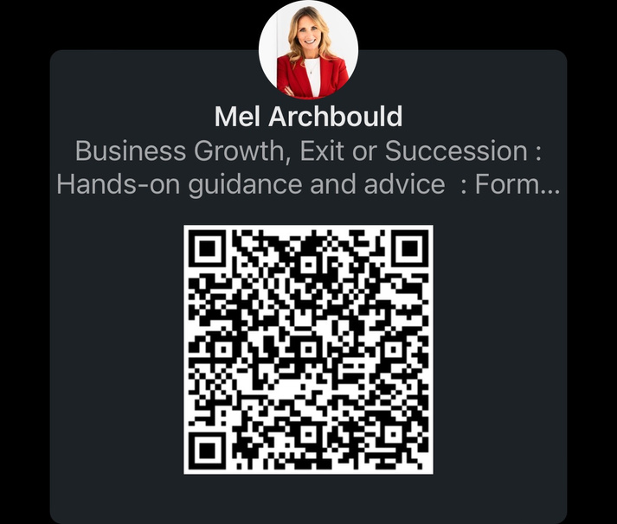
Link to www.cloud-busting.com
melanie.archbould@cloud-busting.com
Cloudbusting Creations Ltd 2023 Copyright

