Slide 1
The Journey Of
CLEVERCHEFS
Help To Grow.
Cardiff. Feb 29th 2024

Slide 2
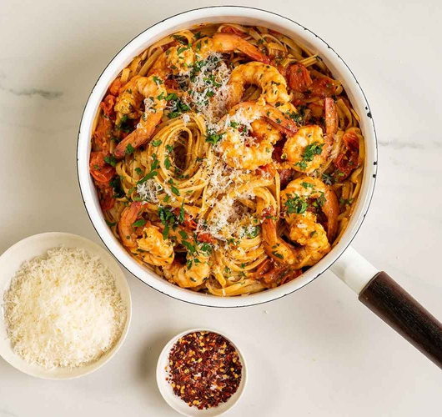
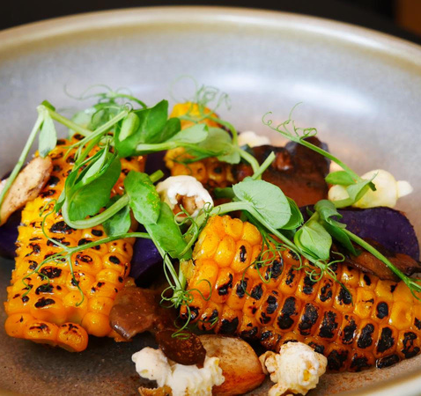
A PASSION TO BE DIFFERENT
Bringing something new & exciting to market is a good start.
GREAT FOOD
FLEXIBILITY
WELL EXECUTED

Slide 3
Creativity
Will Lead The Way

Slide 4
TIMELINE
WEDDING EVENT STAGE
THE COVID PIVOT
NATIONAL CONTRACT CATERER
Where we started
How covid shaped the company outlook.
2021- onwards

Slide 5
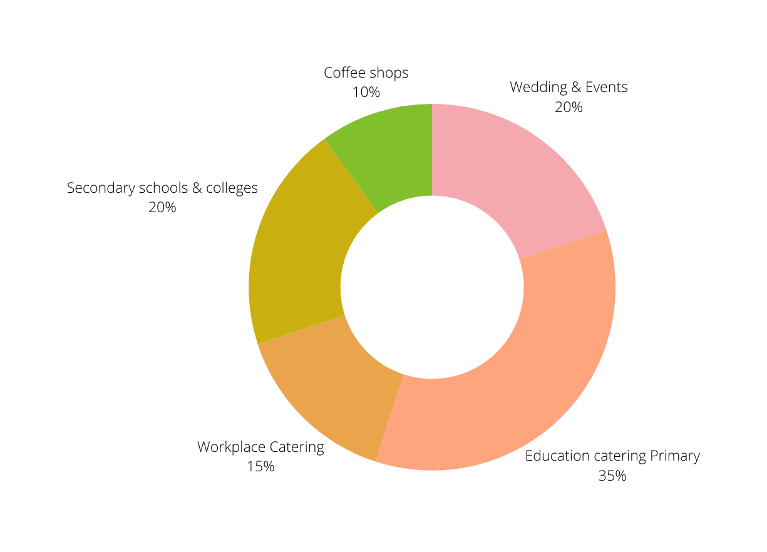
CLEVERCHEFS
OVERVIEW

Slide 6
£16,039,009
£11,980,361
TURNOVER GROWTH
£6,745,414
Projected but on target
How Cleverchefs has grown year on year.
£2,074,796
£2,415,133
£1,058,593
£986,758
2017-18
2018-19
2019-20
2020-21
2021-22
2022-23
2023-24

Slide 7
GROWTH CHALLENGES
COMPETITIVE SECTOR
Bigger companies have more resources and cash to grow.
A SECTOR WITH A SKILL SHORTAGE
Hospitality is not attracting enough quality people since Brexit & covid.

Slide 8
GROWTH CHALLENGES
GEOGRAPHICAL
LOGISTICS
How to grow across the UK in different areas.
GOING FROM ME TO US
How the vision needed to change to a collective approach.

Slide 9
GROWTH CHALLENGES
SELLING THE DREAM
How to get the passion and message across to new clients.
DELIVERING THE
DREAM
Do what we said we would.

Slide 10
Never
Take it for granted

Slide 11
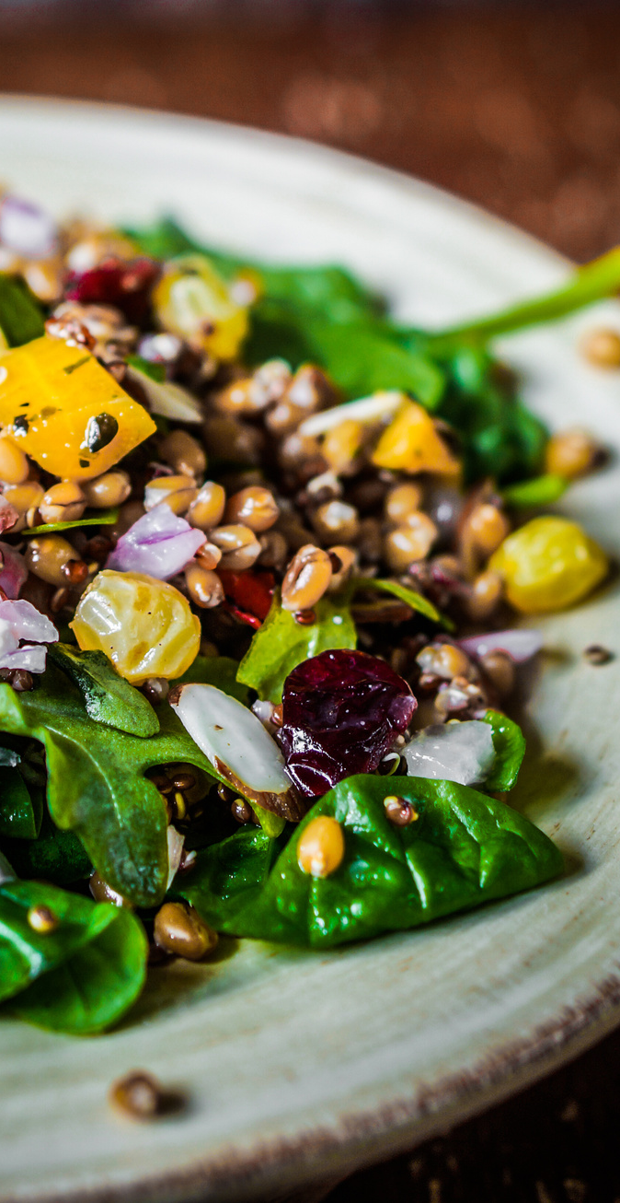
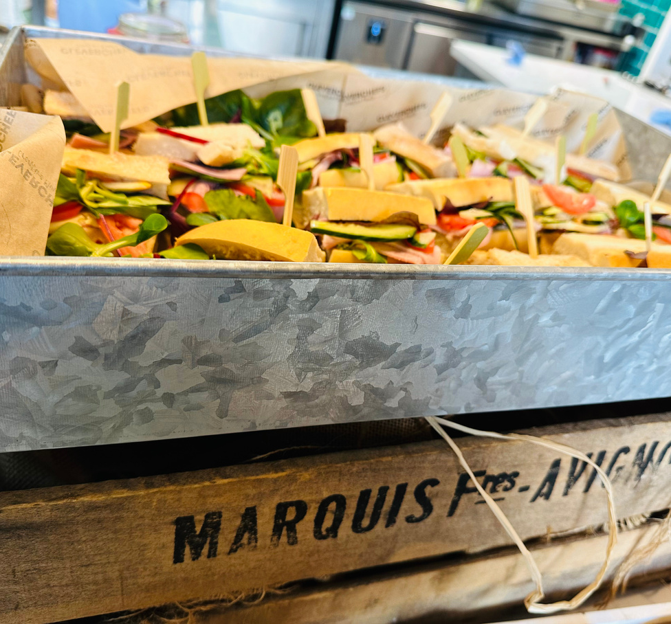
Thank You!

