Slide 1
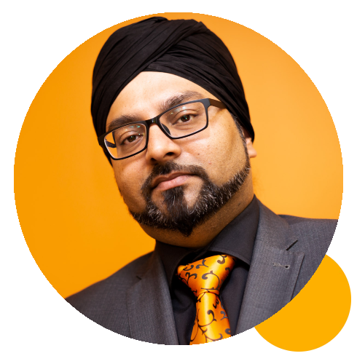
sme masterclass:
Social media marketing
Gus bhandal
Founder, M Guru
www.helptogrowalumni.org

Slide 2
The Social Media Masterclass
HELP TO GROW: REGIONAL EVENT
GUS BHANDAL
THE M GURU
APRIL 2024

Slide 3
GUS
B H A N D A L

Slide 5
Today...
1) Setting clear objectives
2) Reaching our goals
3) Connecting with clients
4) Measuring success

Slide 6
More...

Slide 7
More...
visibility

Slide 8
More...
visibility
leads

Slide 9
More...
visibility
leads
clients

Slide 10
More...
visibility
leads
clients
money

Slide 12
Setting clear objectives
Where do we want to be and how do we get there?

Slide 13
Who is
your ideal
client avatar?

Slide 14
Who is your ideal client?
(age, gender, location, status, interests)
Where do they hang out?
What are their pains?
What is your solution?

Slide 16
What is your value proposition?

Slide 17
A value proposition is a short statement that communicates why buyers should choose your products or services. It's more than just a product or service description — it's the specific solution that your business provides and the promise of value that a customer can expect you to deliver.
- Hubspot

Slide 18
Marketing Strategy
SOSTAC
PESTLE
START
HERE
7 Ps

Slide 19
SOSTAC
Situation
Objectives
Strategy
Tactics
Action
Control
PESTLE
Political
Economic
Sociological
Technological
Legal
Environmental
7 Ps
Product
Price
Place
Promotion
People
Processes
Physical evidence

Slide 20
Assess the environment
Identify your goals
Know your ideal clients
Create your message
Define your budget
Determine your channels
Measure your success

Slide 21
What are your ambitions?

Slide 22
Set your goals
Business vs personal
Financial vs physical
You vs them
Apply SOSTAC + deadlines

Slide 23
Summary
Think about your ICA
Where do they hang out?
What is your value proposition?
Think about the micro, macro, and business environments
Know your goals and ambitions
Set deadlines

Slide 24
Reaching our goals
What are the vehicles to get there?

Slide 25
Vehicles

Slide 26
Customers
The Digital Marketing Ecosystem
Google Business Profile
Website / Blog
Partners / Referrals
Social Media (organic)
Social Media (advertising)
Email Marketing
Offline

Slide 28
Long form content
Short form content
Photos / images
Long videos
Short videos
Audio
Messaging
Website / Blog / Facebook / LinkedIn
Facebook / Twitter / Emails / Google / Threads
Instagram / Pinterest / Facebook / LinkedIn
YouTube / LinkedIn / Website
TikTok / Instagram Reels / YouTube Shorts
Clubhouse / Twitter Spaces / LinkedIn Audio
Whatsapp / Messenger / Telegram

Slide 29
Summary
Know your preferred vehicles
Know if your ideal clients are there
Streamline your ecosystem
Repurpose content across platforms

Slide 30
Connecting to potential clients

Slide 33
How do we find clients?
Create content they want to read
Attract inbound leads
Increased engagement
Don’t forget it’s a two-way conversation

Slide 34
The Content Strategy
Find
Agitate
Solution
Testimonials

Slide 35
66/33

Slide 37
How do we diversify our audience
Be explicit in your desires
Content strategy for each ICA
Networking + search = amplification

Slide 39
Summary
Be the lighthouse
Have two-way conversations
Create your FAST content
Don’t forget personality
Diversify your audience

Slide 40
Measuring success

Slide 41
Should we ignore the vanity metrics?
How many followers should we have?
Is reach better than engagement?
Are impressions better than views?
How much time should we spend on social media?
What is the best metric?

Slide 42
Organic vs paid
Quantifiable content
Brand awareness
Metrics and dashboards
Inbound vs outbound

Slide 43
Summary
Check your bank account
Build the ‘right’ audience
Be efficient and effective
Focus on engagement
Keep an eye on SOSTAC

Slide 44
In conclusion...
1) Set clear objectives with deadlines
2) Reach your goals with the right vehicles
3) Connect with clients using content strategies
4) Measure success and focus on goals and strategy

Slide 45
linkedin.com/in
/mguruuk

