Slide 1
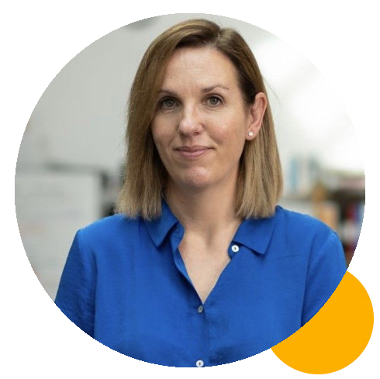
Changing the world with business support
RUTH CHAPMAN
Managing Director, Dulas
www.helptogrowalumni.org

Slide 2
Innovating for people and planet
Notes:
Good afternoon!
My name is Ruth Chapman and I am the EMD of Dulas Ltd. I am also currently a BoT advisor, representing SMEs within the UK who export or are looking to export. The BoT is chaired by the Secretary of State for business and trade who has an ambition to grow British exports to £1 trillion a year by 2023.
Today I’m going to take you through the story of Dulas, our challenges as an SME and how we overcame certain hurdles by accessing various business support along the way. I don’t have all the answers but I hope to provide you with some real life examples of how business support can be accessed to support the specific needs of a business (and in particular an SME).

Slide 3
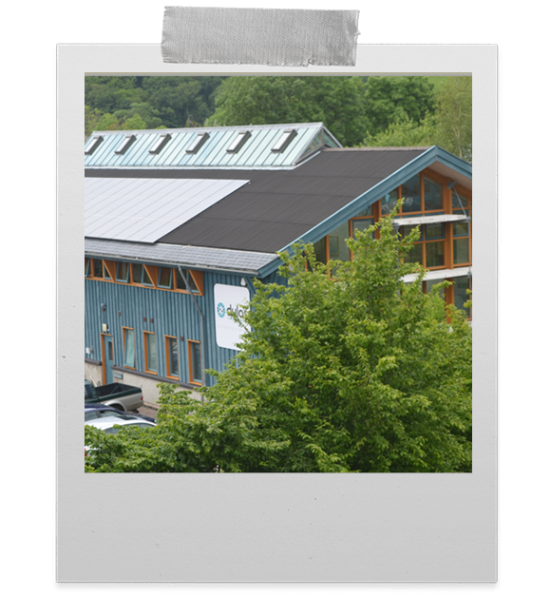
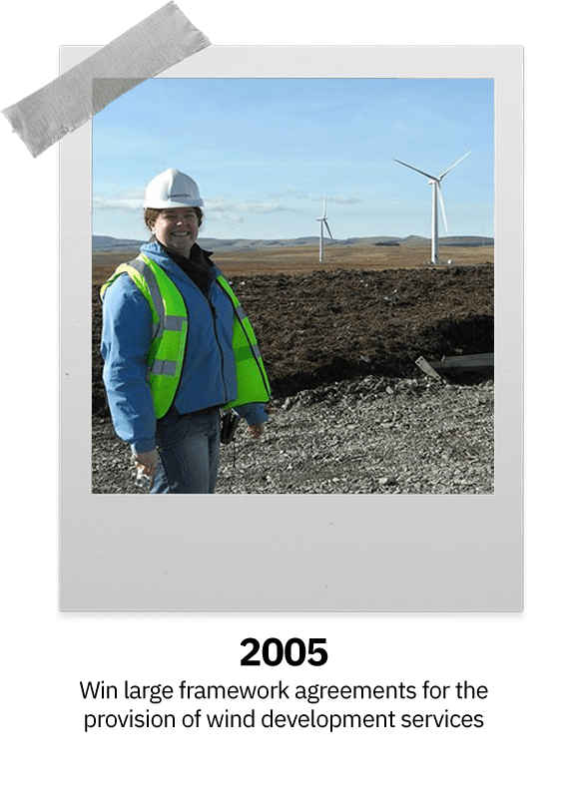
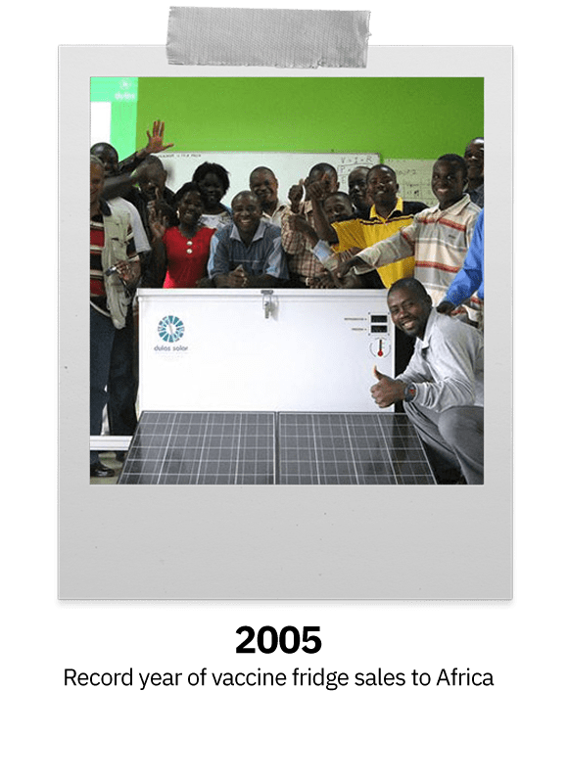
The Dulas story
Our history
Our structure
Our purpose
Notes:
So a bit about Dulas and the company….
Dulas means “black blue” in Welsh and is the colour of the slate in the area and the name of one of the rivers flowing through the Dyfi Valley, the birth place of Dulas. It is pronounced “dih-lass”.
Dulas has been in business for over 40 years. The company was founded in 1982 within the Centre for Alternative Technology. We are a renewable energy company working across Hydro, wind and solar technologies. We
are pioneers in developing innovative uses of renewables and are very proud to have developed the world’s first mass-produced solar-powered vaccine refrigerator.
As a group Dulas employs over 75 people, a mix of engineers, project managers, consultants and medical fridge experts. We’re an employee-owned and governed Cooperative company with around seventy five staff at our HQ in Machynlleth and our our depot in Inverness
We own a separate legal company called Polestar Cooling Ltd which is our manufacturing facility down in Bognor Regis. There are around 30 staff who are experts in the production of specialist medical equipment.
Our purpose is to innovate for the benefit of our people and our planet.

Slide 4
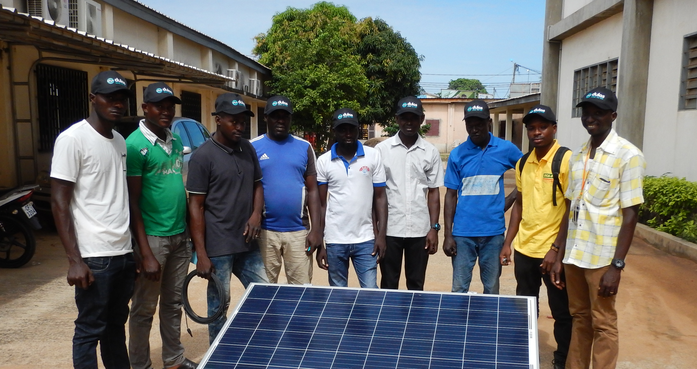
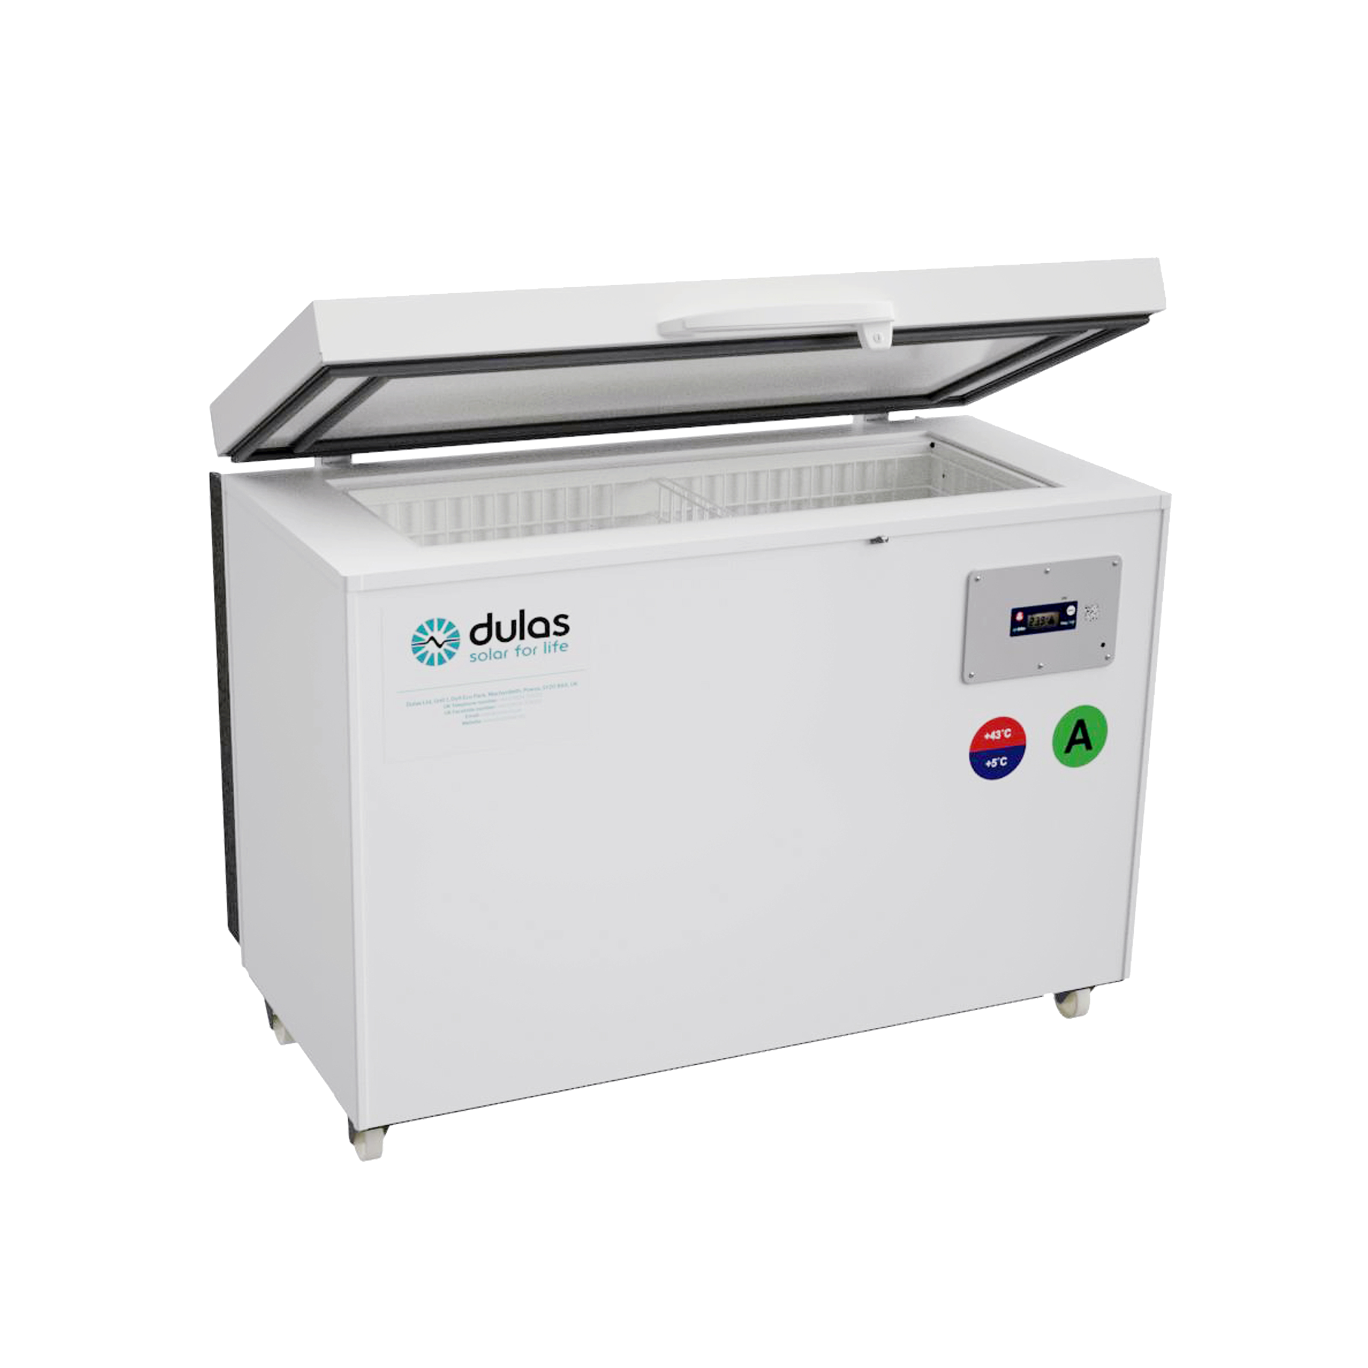
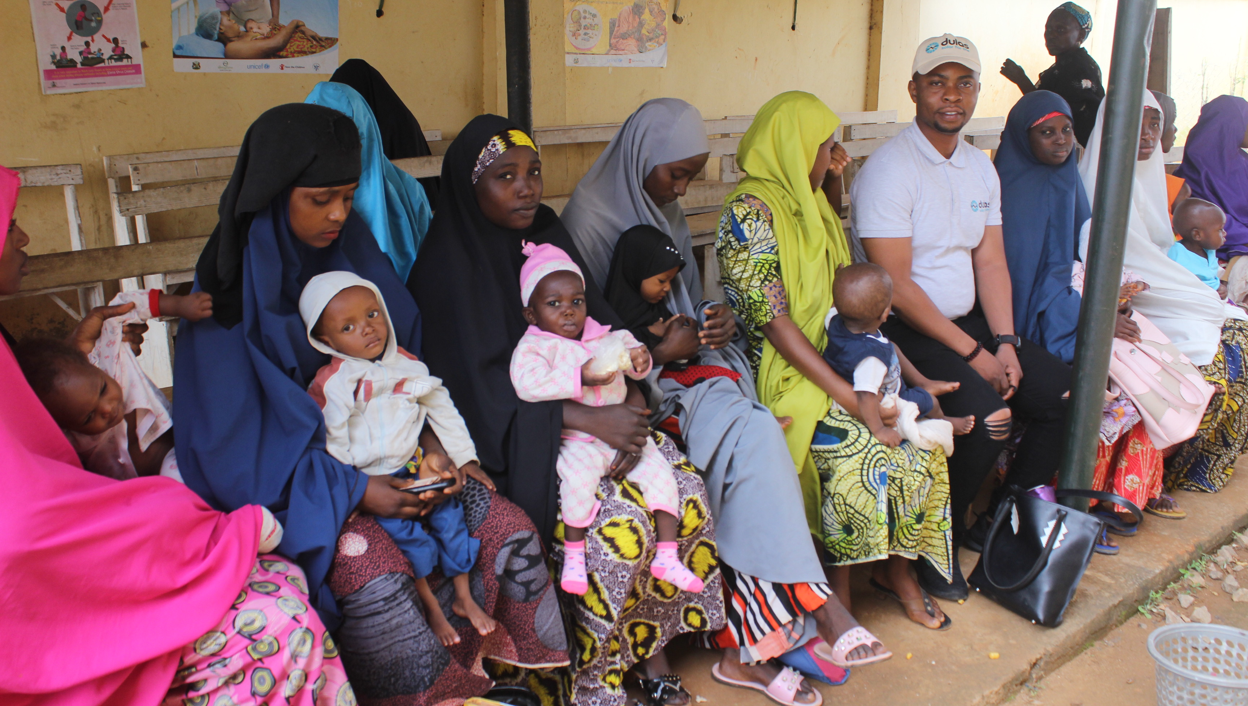
Our work: Around the world
Supporting vital immunization and relief efforts to the last mile.
A single Solar Direct Drive (SDD) 100L refrigerator has the capacity to store vaccines for +10,000 people.
Notes:
Today I’m going to focus on one area of the business only– our solar powered vaccine refrigerators which make up 50% of the Gross Profit of Dulas Ltd and are exported worldwide.
About our product:
This is an entirely off grid product using the power of the solar panels to keep the fridge at the precise temperature required to keep the vaccines viable. We have to meet stringent WHO standards in order to qualify for major frameworks – including how long our fridges will remain at the precise temperature required to keep vaccines stable with solar power (3+ days)
Our product works within the 2-8 degree temperature range which covers most common childhood vaccines such as polio, measles, rubella,
Our fridges contain a PCM liquid which freezes at a slightly higher temperature than water. The PV keeps this liquid frozen during the day, it thaws slightly overnight and then cycles through this process.
The major procurement agency for our product (a key part of the cold chain infrastructure) is Unicef. They administer money made available by organisations such as GAVI to provide the cold chain infrastructure. GAVI has an ambition to eradiate common childhood illnesses such as measles, polio etc.
A single Solar Direct Drive (SDD) 100L refrigerator has the capacity to store enough vaccines to vaccinate 10,000+ people with two doses of AZ
We are the only UK manufacture of WHO approved vaccine refrigerators – we have competitors around the world

Slide 5
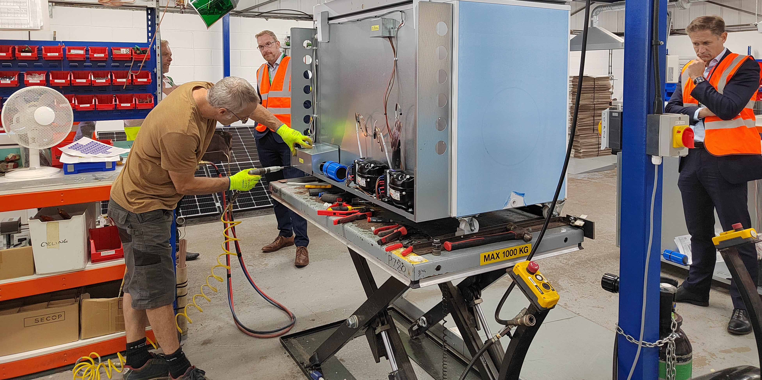
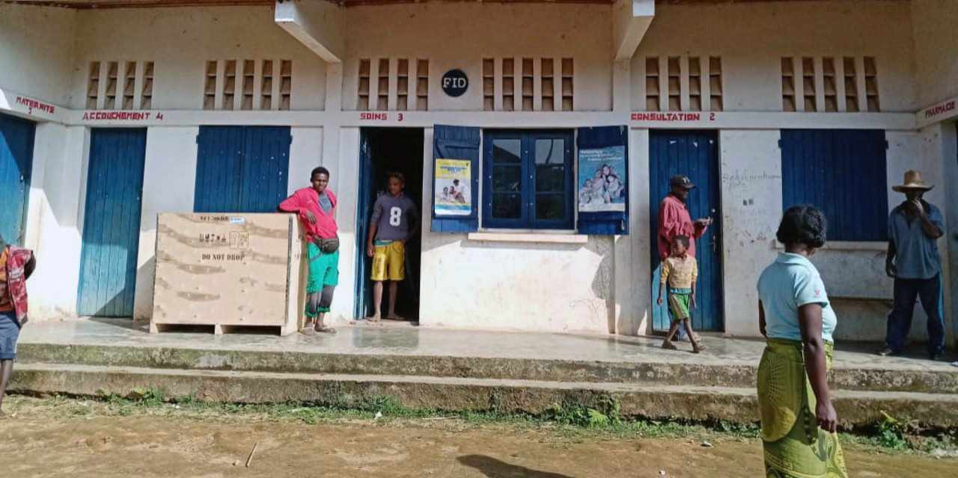
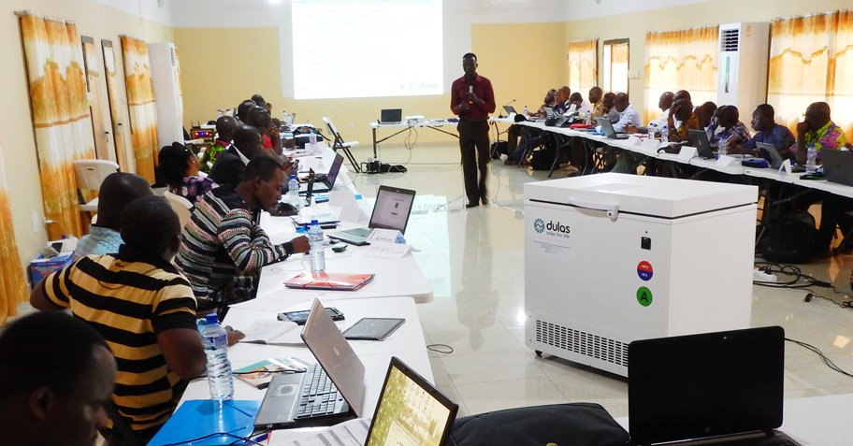
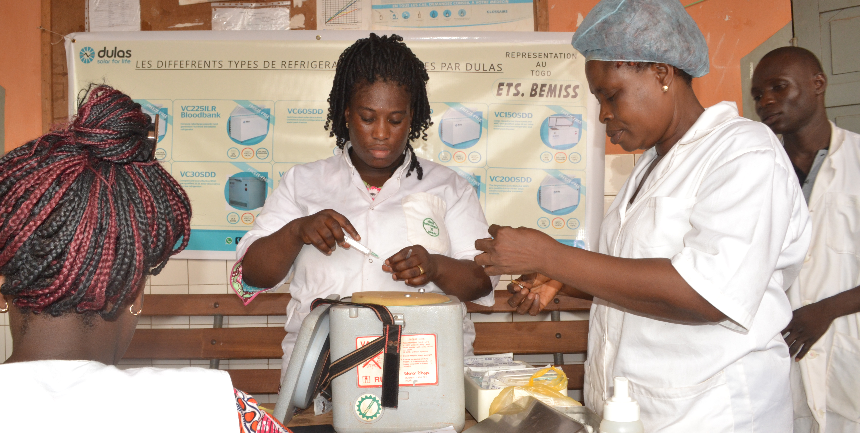
Product journey
►
►
Manufacture
Distribution
Logistics
Refrigerators built at Polestar factory
Packaged and dispatched worldwide
In-country specialists plan route
►
►
Installation
Training
Life-saving
Technicians set up equipment
In-country and/or online training
Reliable and safe vaccine storage
Notes:
An overview of our product journey….
Our fridges are built at our manufacturing facility in Bognor Regis which is entirely owned by Dulas Ltd but operated as a separate legal company,
Fridges are then distributed to our warehouses, either as stock or to be prepared for shipment at Felixstowe,
The logistics of getting a fridge to a rural health centre can be extremely challenging! Our in-house logistics team work with a network of in-country partners to safety deliver the fridges to there final destination,
Dulas train the health centre workers and Ministry of Health technicians to look after the fridge, so that it will operate for 10+ years,
Working with Unicef and GAVI allows us to follow the journey of our fridges.

Slide 6
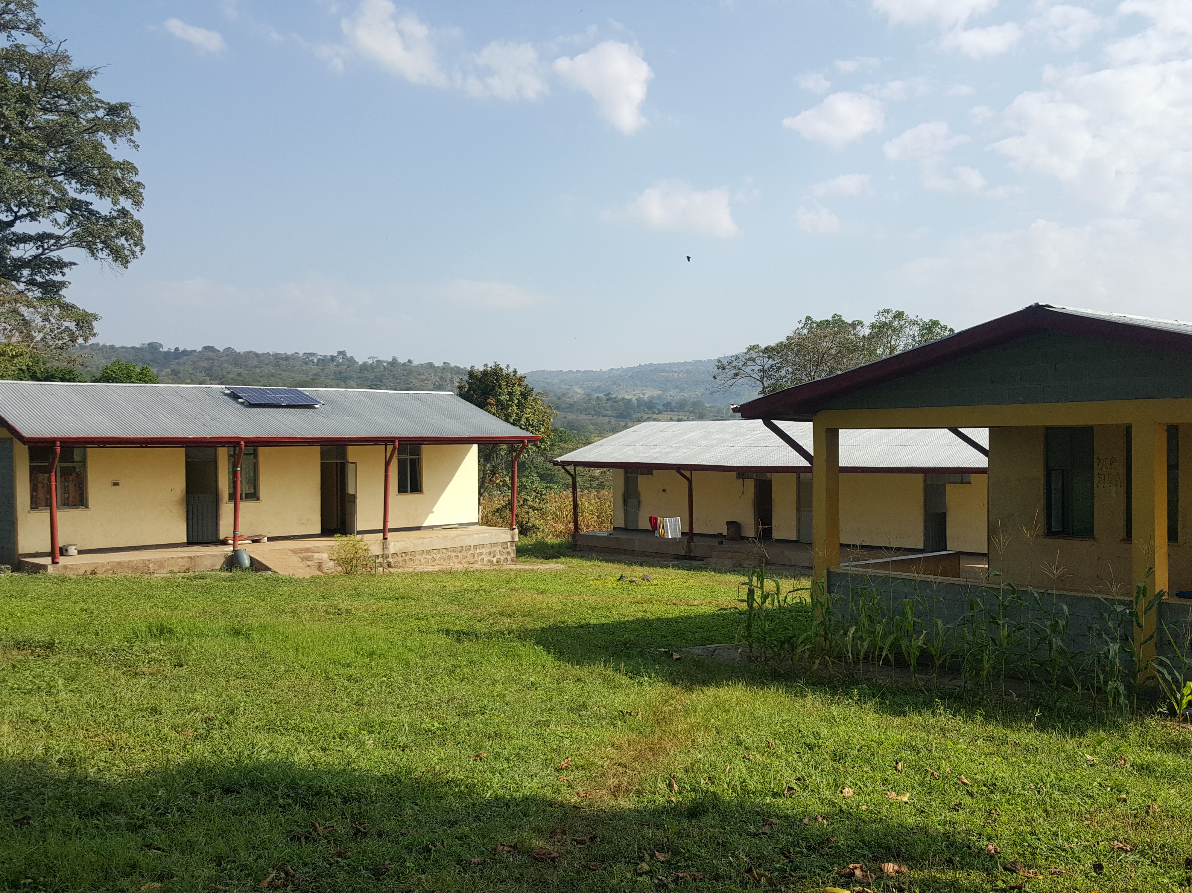
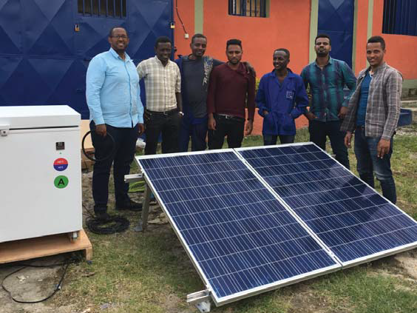
Our projects: Ethiopia
Delivery and installation of 100’s of units across Ethiopia via UNICEF and UNOPS programmes
The dedicated team at Beta Engineering successfully delivered, installed and carried out training on the aftercare and maintenance of solar direct drive refrigerators
Notes:
Just a few examples of recent projects -
Dulas has worked with Beta Engineering for many years, most notably in 2018 on a project contracted by the Federal Ministry of Health in Ethiopia to supply, install and commission 134 of our VC200SDD systems across 4 states in Ethiopia Following this we successfully carried out a further installation project under the Gavi-funded CCEOP, Cold Chai Equipment Optimisation Programme.
With our growing network of local partners we have carried out similar projects in Benin, Togo, Nigeria, Madagascar, India and many more

Slide 7
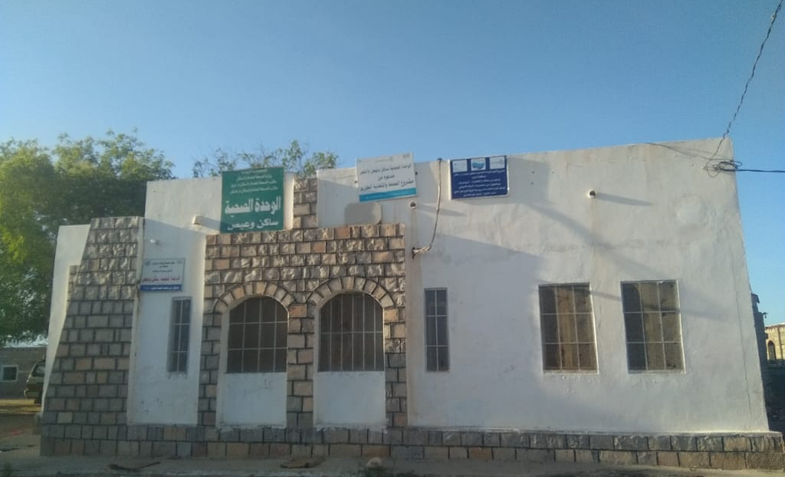
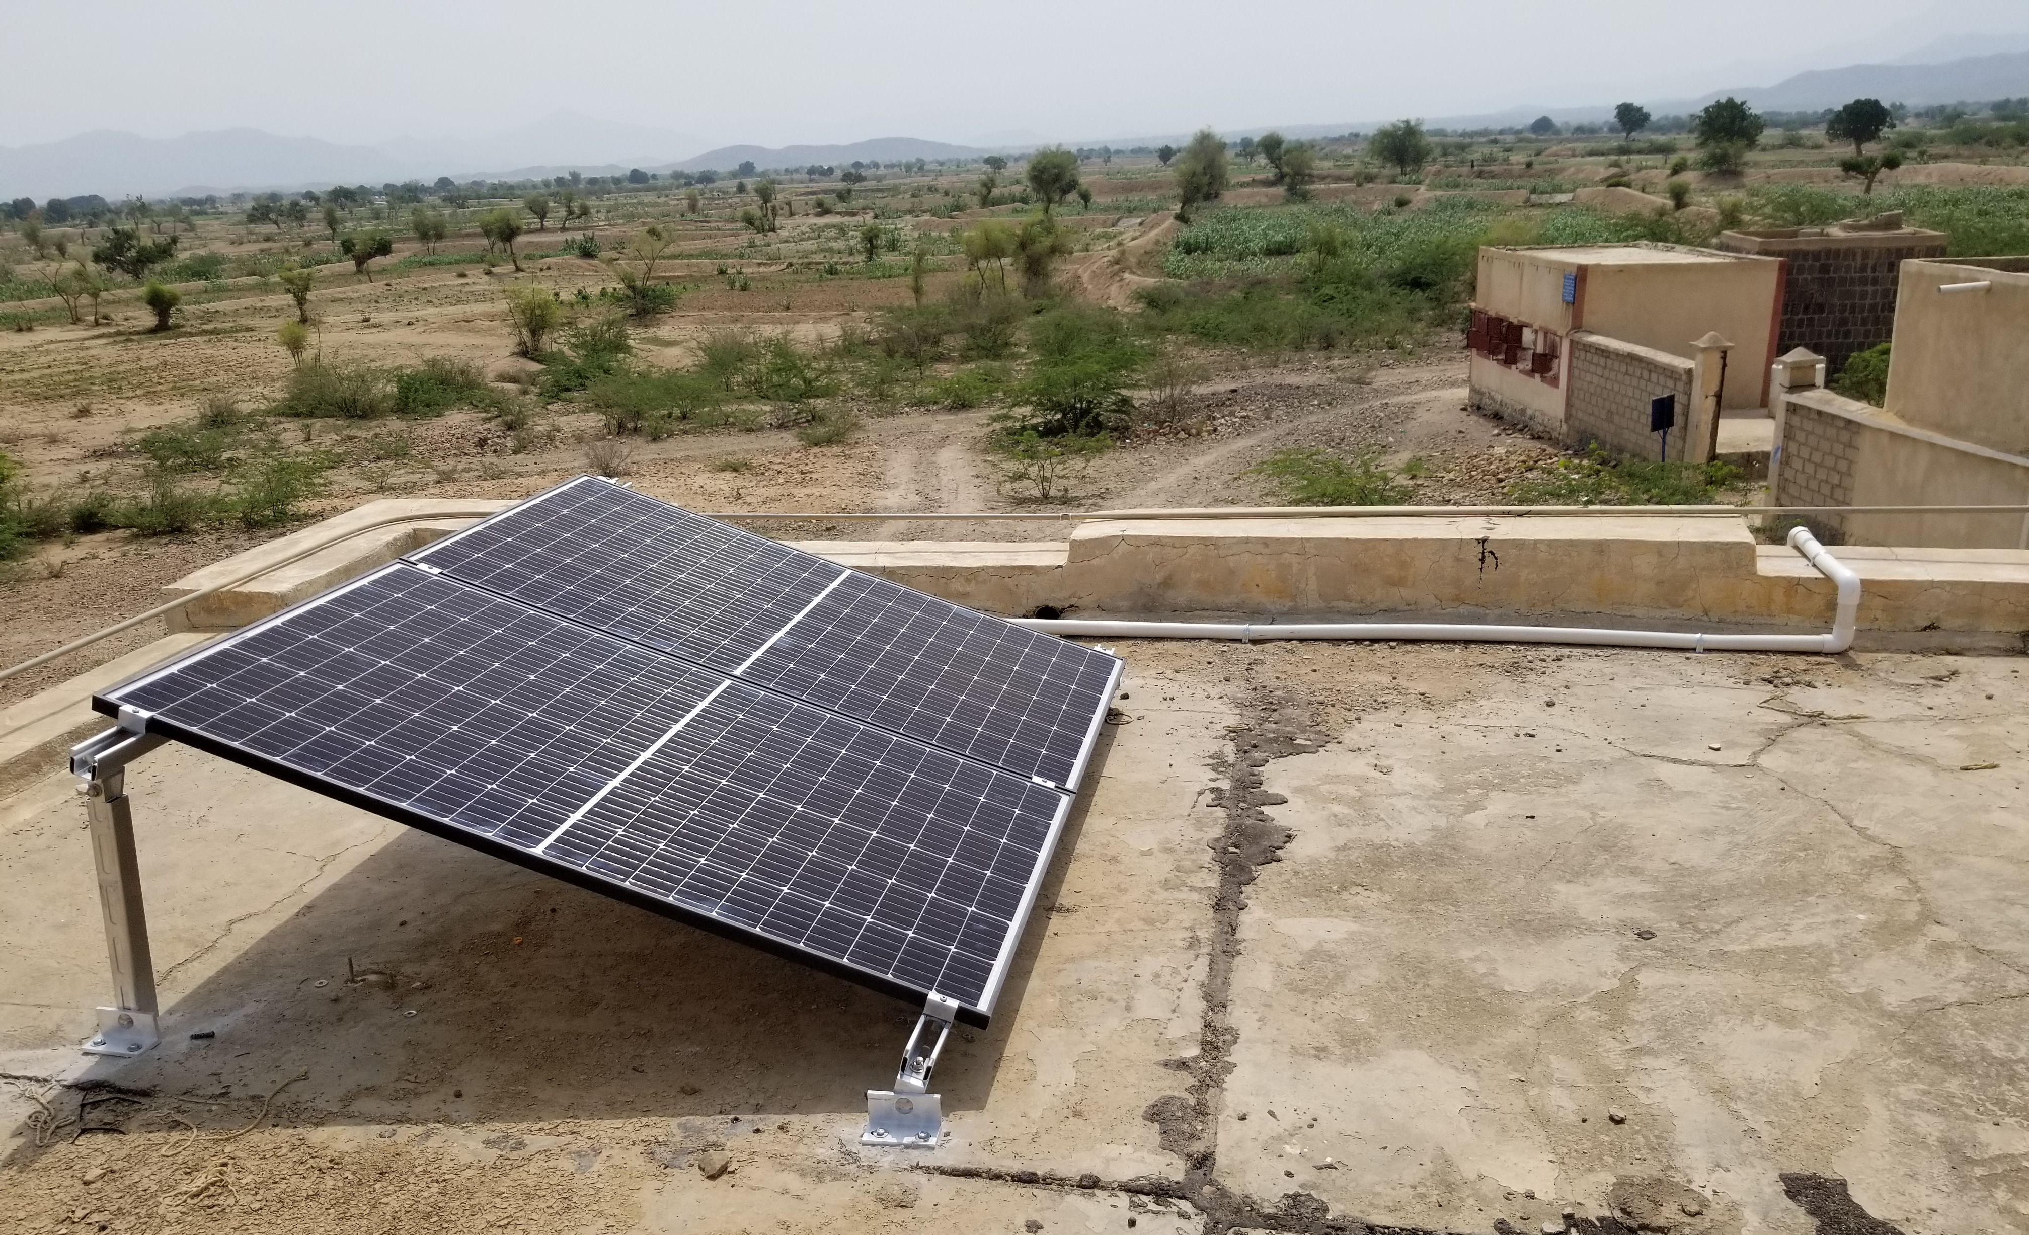
Our projects: Yemen
The supply of over 2,000 SDD refrigerators
We have worked in Yemen for over 25 years delivering our solar powered refrigerators to support the immunisation needs of the Ministry of Health.
Notes:
The installation of over 2000 refrigerators make up nearly 2MW of clean power – all generated from the sun. Harnessing natural energy is a sustainable resource which can only benefit generations to come.
Due to the continuing conflict in Yemen we have been unable to be in country to work with partners, therefore we delivered training to the MoH technicians in nearby Djibouti

Slide 8
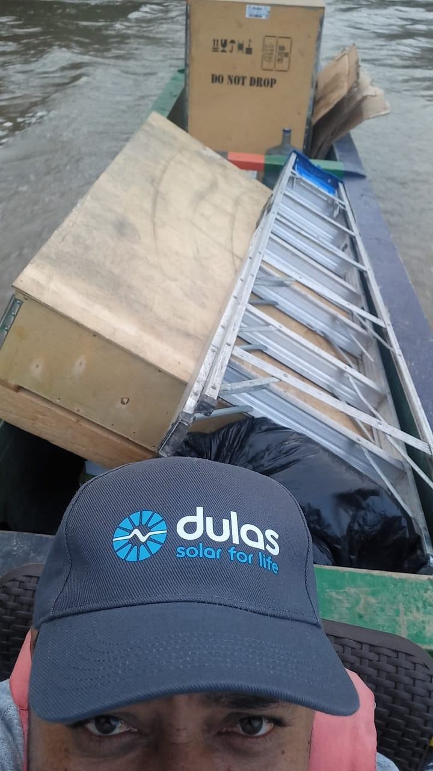
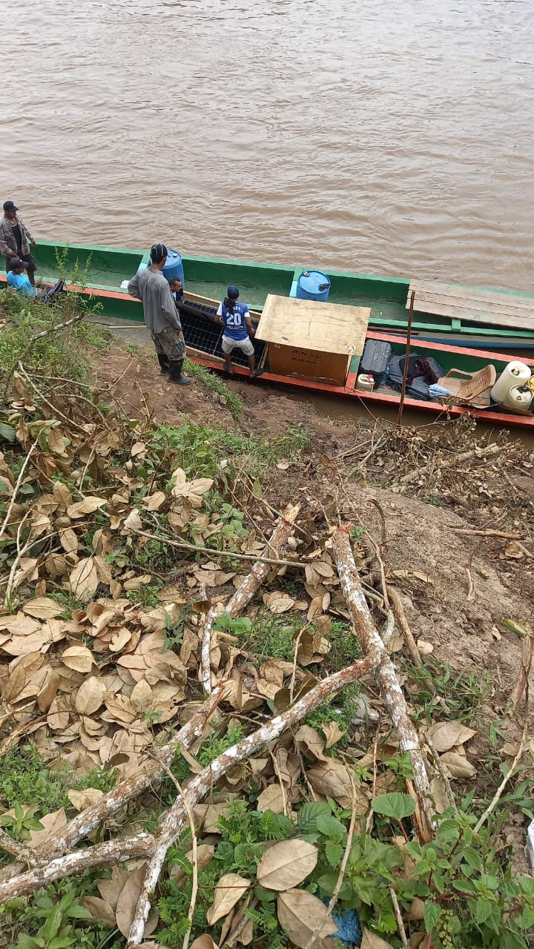
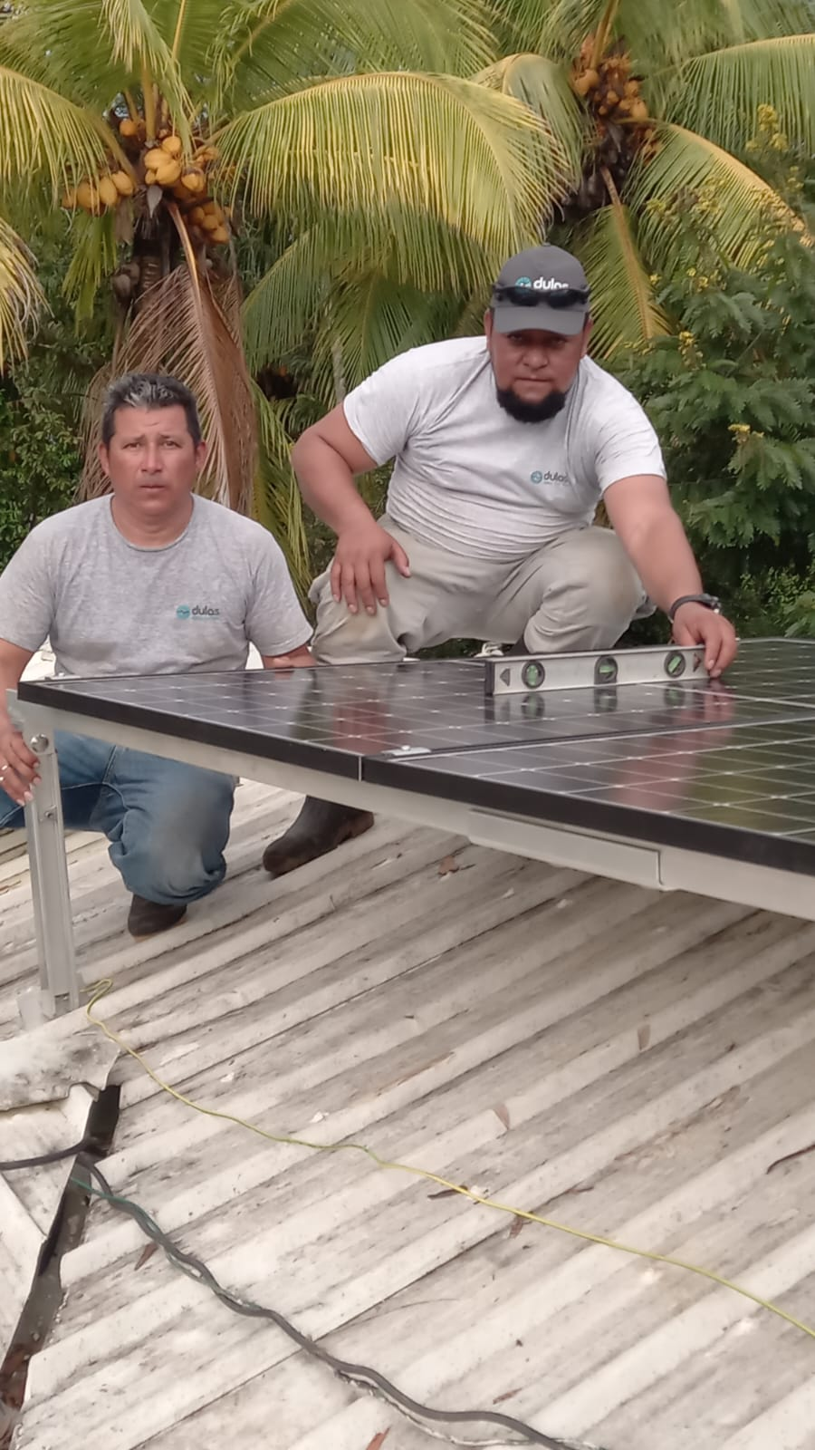
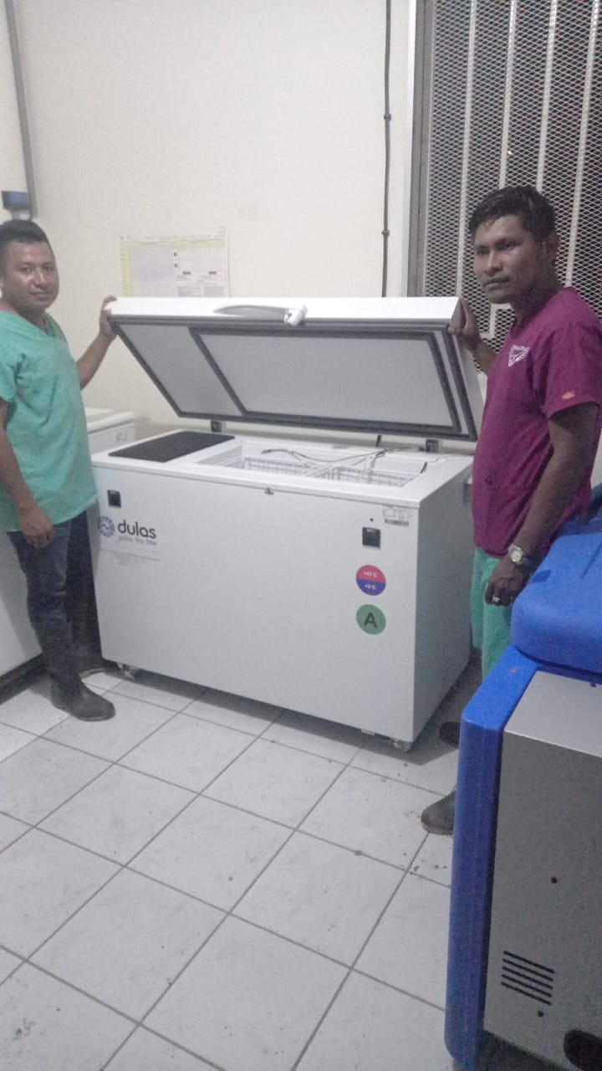
Our projects: Nicaragua
Delivery of a demonstration unit to Northern Nicaragua
Working with our in-country partners to deliver and install solar direct drive refrigerators to remote communities situated across the country

Slide 9
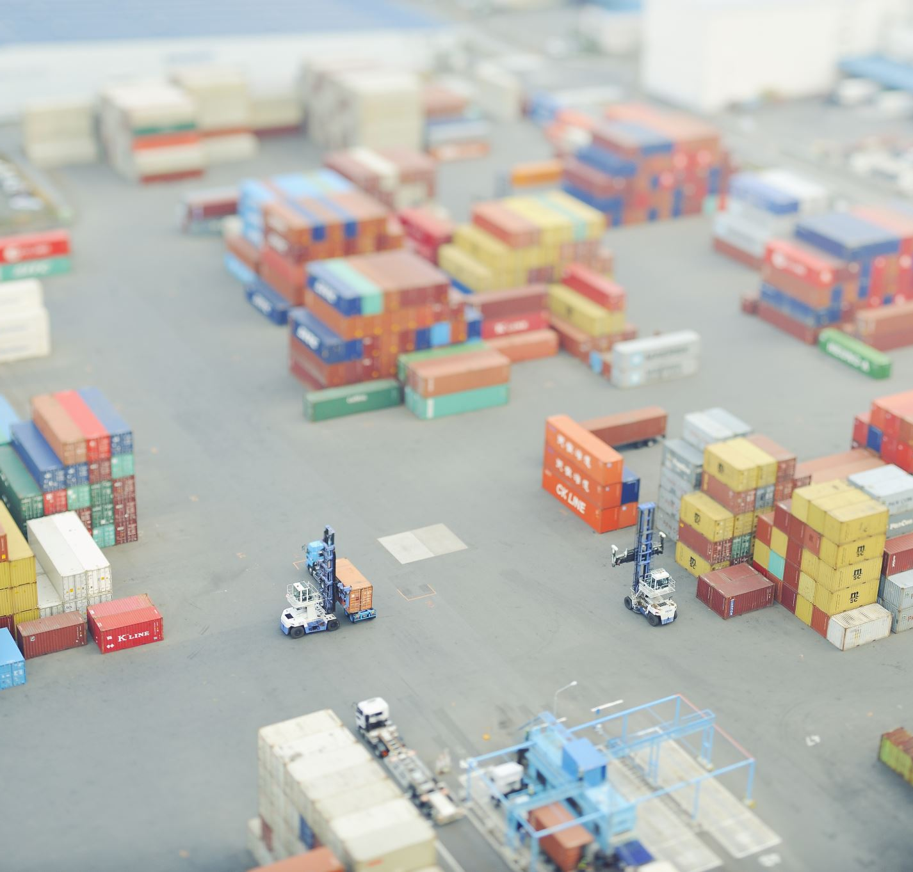
Challenges….
Market Access
Procurement and Cashflow
Specialist Skills
Notes:
SME – constraint by available cash and resource
Our market is complex and unpredictable – reliant on humanitarian aid funding. Sometimes responding to immediate crisis or waiting for countries to apply for funding for vaccination programmes. Leads to peaks and troughs in orders
Need to balance the amount of stock we hold to respond to this ‘vs’ producing to order – COVID also provided an unknown in this, whether we would see an extra demand in orders
Big overheads – we own a factory
External unforeseen events which impacts exports – Brexit, Covid, conflicts

Slide 10
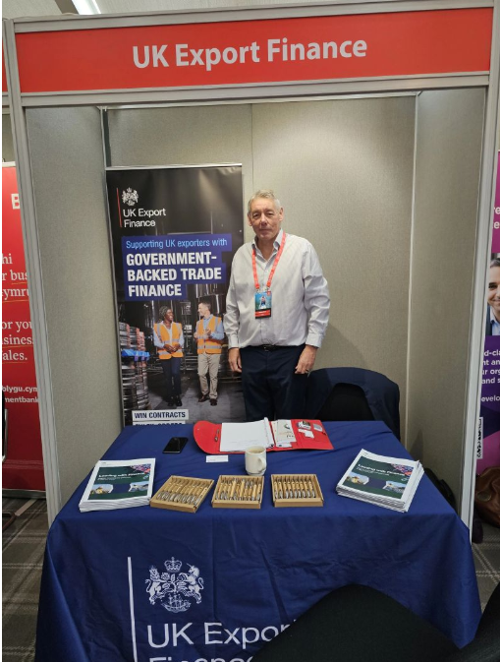
UK General Export Facility
UK Gov guarantees the loan by 80%
Administered by your bank
Has helped us to manage the peaks and troughs of orders
Notes:
The solution – a UK GEF
What is it?
A loan administered by your bank, to assist with exporting, that is 80% backed by the government. This de-risks the loan for the Bank and means that they are much more likely to support your application for a loan than normal.
How did we use it?
We secured a loan facility of £750k to fund the purchases of our fridges from our manufacturing facility. In practice this means that when we receive an invoice from our manufacturing facility for fridges they have built and sent to the warehouse we use the Bank loan to pay it and don’t have to repay the loan until 90 days later. This effectively helps us to manage our cashflow requirements, especially when we are building stock up for future unknow orders or are unsure when we get deliver the fridges to port for payment. It buys us an extra 90 days to secure payment from our client.
What was the process?
Led by the bank. Our UK Export champion helped us to explain our challenges around the peaks and troughs of orders and the pressure it put on the business. We had to provide an integrated forecast for the bank showing forecasted P&L, balance sheet and cashflow. We used our externa accountants to do this for us. Was at least a 6 month process.
Top Tip – use your export finance representative to champion your case with the Bank. The Banks can still be cautious despite the backing. Initially it took our bank a while to get there heads around the fact we were going to use the facility as an inter-company loan, but Stephen really support the case.
Plan ahead – if you can foresee the need for such support start the ball rolling straight away, as Bank processes can take some time.
There are other types of financial help available from UK Export Finance and you can check this out on the DBT website

Slide 11
Helping businesses to innovate for growth
Collaborative, three-way partnership
Part funded by Innovate UK
Associate is based in the business
Designed to build knowledge within the business
Notes:
The solution -
A DBT representative suggested we explore a KTP . A KTP is an InnovateUK initiative and it works by bringing together an academic institute with a business and then it provides part of the funding for the innovation project.
We contacted our local advisor who worked with us to determine what innovation was required. That advisor identified the University of Sussex as an academic partner who could work with us on the project as they have a Thermal engineering department. This was ideal for us as the University is local to the factory.
How?
We worked with the University of Sussex to develop the application form to Innovate UK which identified our problem and the innovation required to solve it. The application details out the intended timeline, milestones and outcomes of the project.
Once approved the University then advertises for the role of an ‘Associate’ who will deliver the project and this helps to attract academics interested in working in businesses
The Associate is then based within the business for the life-time of the project, solving the problem but also transferring the knowledge into the business
This helped us secure the knowledge to run the research which will give us options for how we improve the fridges performance and we hope this will give us a competitive edge in the marketplace.

Slide 12
dulas.org.uk
Notes:
Get to know your trade advisor
Explore what business support is available to support your specific challenges
Use business networks to find out what has worked for others

