Slide 1



Practical Masterclass:
In Scaling Your Business
(Small to Medium without going bust)
Cloudbusting Creations Ltd 2024 Copyright

Slide 2





Are You Scale-Up Ready? A Framework to navigate growth effectively
Get Your Priority Focuses in Order
Insights & Examples
Q&A
Notes:
Confidence comes from practice.
Quite simply, the more we have a go, the familiar it feels, the less anxious we are.

Slide 3
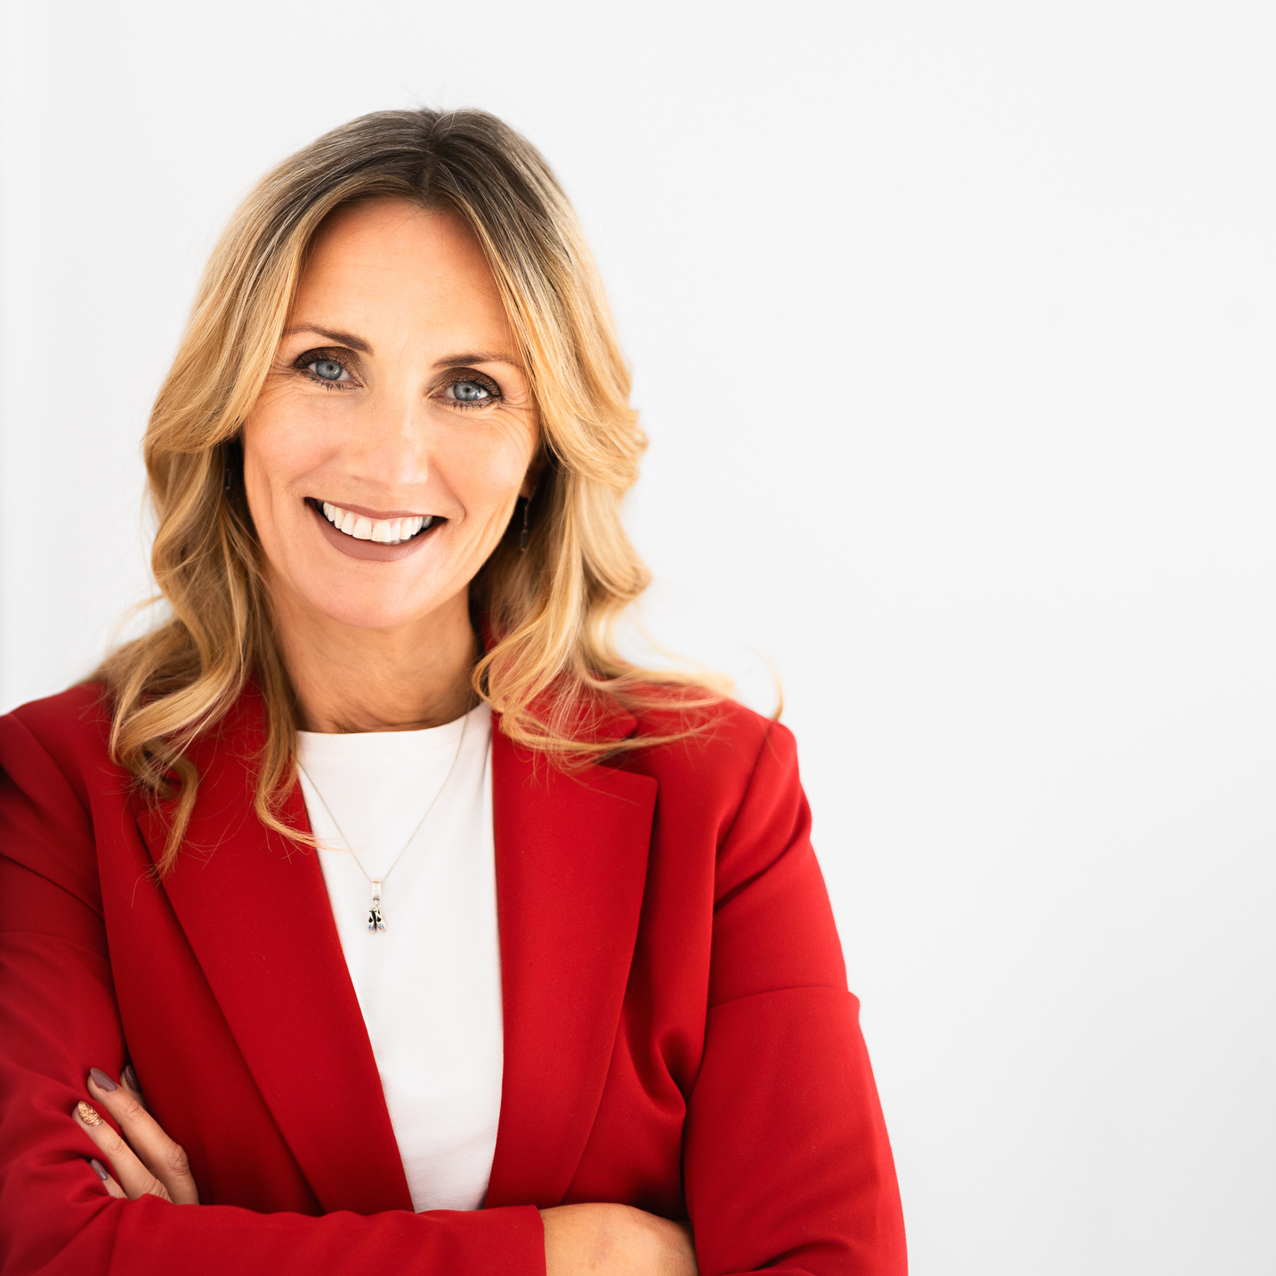
Mel Archbould
  Former MD for over 17 Years
  Shareholder in family-owned business
Growth Strategies to:
  Take the business International
  Enter new sectors with existing products
  New products for existing markets
  Establish long-lasting Customer Relationships
  Develop Operational Excellence
  Take solve significant problems for significant customers
Notes:
Briefly, in case you are not too sure who I am, and why I am here, I was an MD in an engineering business for over 17 years.
The business was formed by my parents back in 1985.
We sold the business in January 2022 and at the beginning of this year I launched Cloud-Busting. Working with busy business leaders who are navigating their journey towards growth, or it could be towards stepping back from their role, or it could be towards exiting the business.
Whichever journey they are on, I've learned so much from running a family-owned business that if I had a pound for every lesson-learned, I could start a whole new business to share my valuable lessons and help others make some decent money!
And that is exactly what I did!

Slide 4

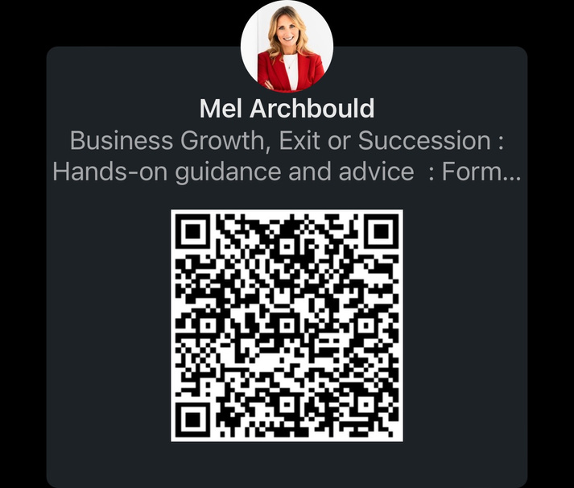
Mel Archbould
  Established Cloud-Busting in 2022
  Support SME Business Owners & Leaders
  Growth
  Succession
  Exit
Educate : Empower : Excite
Notes:
Briefly, in case you are not too sure who I am, and why I am here, I was an MD in an engineering business for over 17 years.
The business was formed by my parents back in 1985.
We sold the business in January 2022 and at the beginning of this year I launched Cloud-Busting. Working with busy business leaders who are navigating their journey towards growth, or it could be towards stepping back from their role, or it could be towards exiting the business.
Whichever journey they are on, I've learned so much from running a family-owned business that if I had a pound for every lesson-learned, I could start a whole new business to share my valuable lessons and help others make some decent money!
And that is exactly what I did!

Slide 5
What are your biggest business challenges today?

Slide 6



The Glass-Ceiling
Avg Revenue
£0m-£1m
£1m-£4.0m
£4.0m-£7.5m
£7.5m - £10m+
Employees
1-10
11-35
36-70
71-100+

Slide 7


Slide 8


Is Your Business
Ready To Scale?

Slide 9

Leadership Check-in

Slide 10
Leader Responsibilities
  Implements the company strategy
  Implements daily business operations
  Develops growth strategies
  Leads the team to meet and exceed goals and objectives
  Oversees [a department, a division, or multiple departments] and directly manages senior staff
  Presents strategies and results to executives, the board, and other stakeholders
  Adheres to state and local business laws and regulations and company policies

Slide 11
So how much TIME do you spend on your leadership role?

Slide 12
% Implementation
Time
% Strategy
Time
% Leadership
Time
% Everything Else

Slide 13
Micro Businesses
sub 10 employees
10hrs
20%
10hrs
20%
% Implementation
Time
% Strategy
Time
% Leadership
Time
% Everything Else
5hrs
50%
25hrs
50%

Slide 14
Small Businesses
10-49 employees
10hrs
20%
15hrs
20%
% Implementation
Time
% Strategy
Time
20hrs
40%
% Leadership
Time
% Everything Else
5hrs
10%

Slide 15
Medium Businesses
50-249 employees
15hrs
30%
10hrs
10%
% Implementation
Time
% Strategy
Time
% Leadership
Time
% Everything Else
25hrs
50%
Zero hrs
0%

Slide 16

Next Two Full Working Weeks
Log TOTAL Hours worked
Log Time Allocation
Analyse EE

Slide 17

How Compelling Is Your Vision?

Slide 18
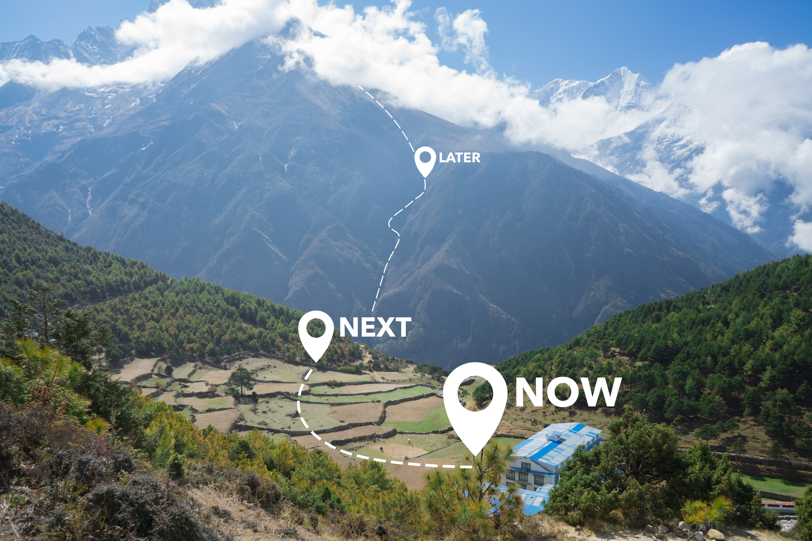

Vision
We start here
Then here

Slide 19








Timescale
Months
Months
Months
Months
Months
Months

Slide 20
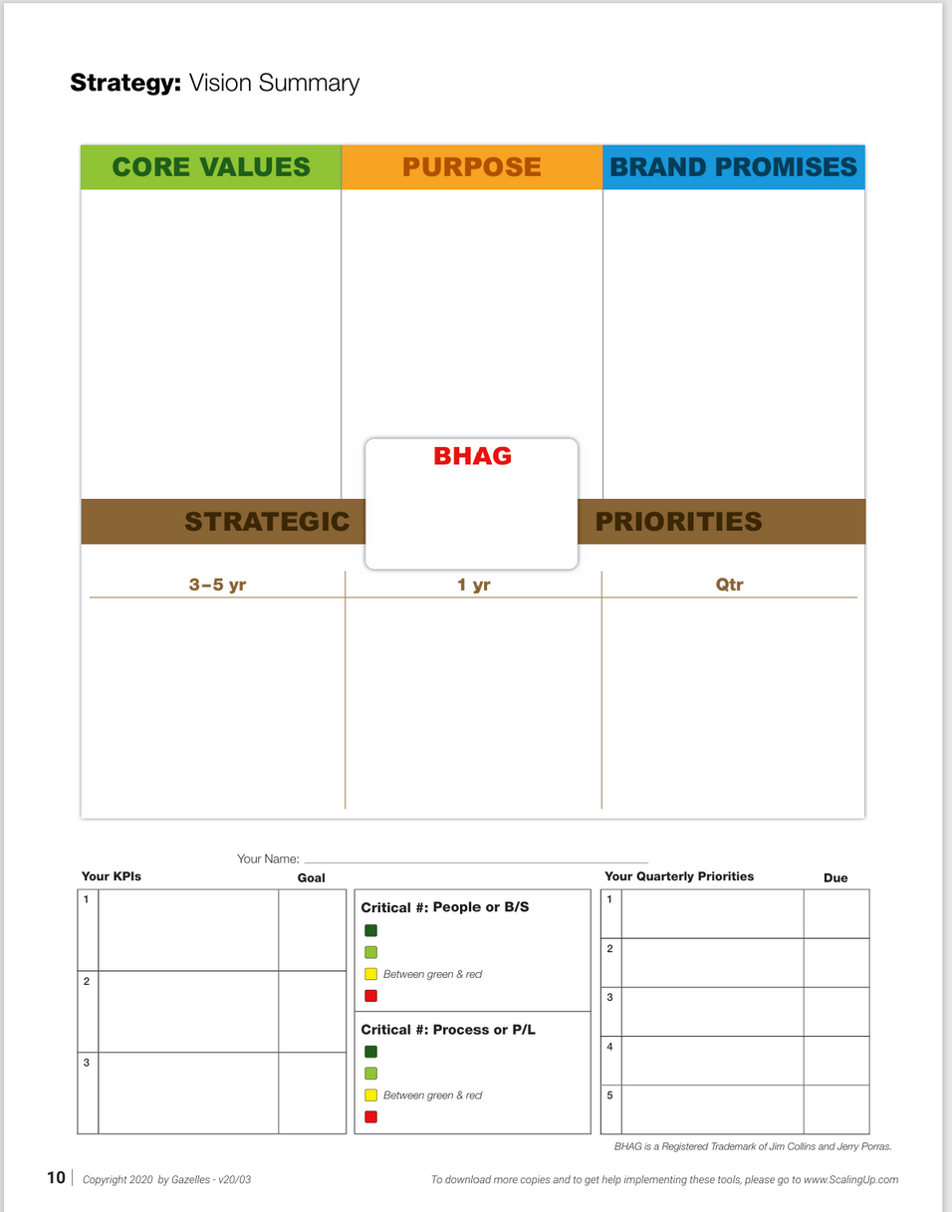



Slide 21

Notes:
Innovative thinking links the left hand brain with the right hand brain

Slide 22





Communicate
with Your Team

Slide 23
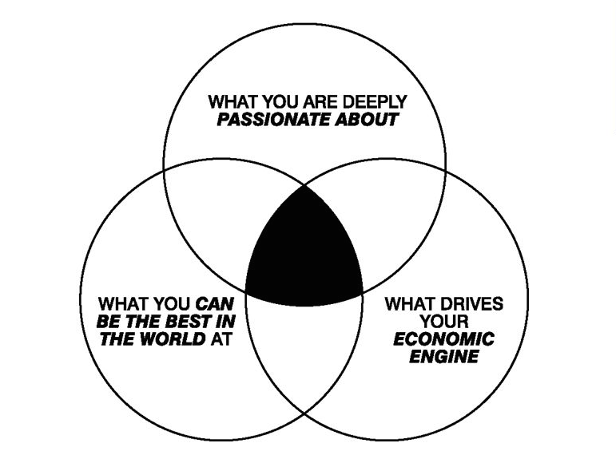
The Hedgehog Concept
Jim Collins
Good to Great

Slide 24

Does the organisation structure meet the business needs?

Slide 25


Slide 26


Slide 27
You can have one person in one seat or more - but you can’t have two people in one seat
Watch out for one person appearing in many critical seats
Watch out for gaps forming - who owns the function or role?
Everyone needs to GET IT, WANT IT & has the CAPACITY TO DO IT (Traction - Gino Wickman)

Slide 28

Financial Strength
-where are you on the scale?

Slide 29
Investment ALWAYS comes before growth in revenue & profit

Slide 30




Slide 31


Slide 32
Retrospective Reporting
  Profit & Loss (P&L)
  Balance Sheet
  Funds Flow (reconciles profit to cash)
  Gross Profit Margins
  Budgets
Forecasting
  12 Month P&L Forecast v Actual
  13 week rolling cashflow
  12 Month Cashflow
  Sales Pipeline
  Strategic Scenario Planning
  Aged Debtors
  Aged Creditors
Financial KPI’s
  Cash Conversion Cycle (days)
  Daily Available Cash
  12 Month Cashflow
  Sales Conversion Ratios

Slide 33
ALL Financial Reporting needs to be both
TIMELY & ACCURATE

Slide 34

Are Your Customers crazy for you?

Slide 35


Slide 36
Customer Feedback & Reviews
Net Promoter Score (NPS)
Customer Retention Rate
Engagement Metrics
Customer Lifetime Value (CLV)
Churn Rate
Customer Satisfaction Surveys
Referral Rates

Slide 37
Regular Monitoring & Reporting & Rewarding
Combine a mix of methods
Act on Feedback
Personalisation

Slide 38

Are your Systems & Processes scalable ?

Slide 39
How many documented core processes have you got in your business?

Slide 40

Operations
process
Marketing
process
Customer
-Retention
process
Accounting
process
Core Processes
HR Process
Sales
Process

Slide 41


Slide 42
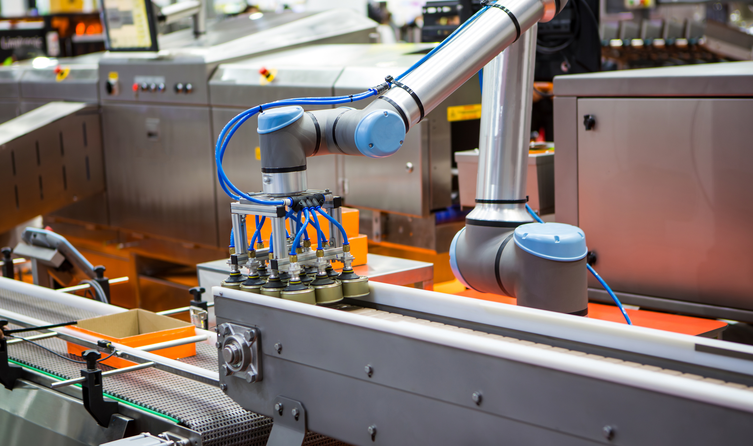

Slide 43

Objectives
Consistency
Quality Control
Repeatable Results

Slide 44

Is Your Marketing-Machine best-suited to grow your business
How effective is the business at winning sales?
How agile is the business when it comes to new technology?
Innovation, Product, Service
review
Where is the business on the Operational Excellence Roadmap?

Slide 45

Order of
Priority

Slide 46




LEADERSHIP
VISION
RIGHT PEOPLE
RIGHT SEATS
KNOW YOUR
NUMBERS

Slide 47



Decision-Making Table
High
Plan
Immediate
Typically worth doing Create Plan
Set deadline
Cost / Benefit
Crack on and get it done
Set deadline
Measure effect
Impact
Drop
Consider
Not worth wasting time
Set date to review again Do more research
or discussion
Low
Hard
Ease of Implementation
Easy

Slide 48
The Art of Delegation

Slide 49
Delegate
Automate
Recruit & Train

Slide 50
Small Businesses
10-49 employees
10hrs
20%
15hrs
20%
% Implementation
Time
% Strategy
Time
20hrs
40%
% Leadership
Time
% Everything Else
5hrs
10%

Slide 51
Consequences
1.Overburdening Yourself
2.Underutilising Team Members
3.Micromanagement
4.Missed Deadlines and Poor Quality
5.Lack of Skill Development

Slide 52
Delegation Done Well
1.Clear Communication
2.Selecting the Right Person
3.Provide Adequate Training and Support
4.Establish Trust and Empowerment
5.Set Clear Expectations
6.Monitor Progress and Provide Feedback
7.Be Willing to Let Go
8.Encourage Initiative and Ownership
9.Celebrate Success and Learn from Mistakes
10.Evaluate and Adjust

Slide 53

Where am I
going to be
in 90-days time?
90 Day Goals
Notes:
We really have to revisit the period of our lives when everything was novel and
and we were learning through play and using our imagination.
Not everything had a use, in fact much of what we made back then was useless.
Divergent thinking
Things didn't have to make sense. As we hadn't formed an appreciation of what was sensible or not.
Kids do it naturally as part of how they start to fill up their filing cabinet.
Convergent thinking
Adults do it naturally, it usually arrives at a solution to a problem quickly.

Slide 54



Slide 55

SCALE
GROWTH
The Glass-Ceiling
Avg Revenue
£0m-£1m
£1m-£3.0m
£3.0m-£7.5m
£7.5m - £10m+
Employees
1-10
11-29
30-70
71-100+

Slide 56
Are You Scale-Up Ready? A Framework to navigate growth effectively
Get Your Priority Focuses in Order
Insights & Examples
Q&A

Slide 57

Notes:
We really have to revisit the period of our lives when everything was novel and
and we were learning through play and using our imagination.
Not everything had a use, in fact much of what we made back then was useless.
Divergent thinking
Things didn't have to make sense. As we hadn't formed an appreciation of what was sensible or not.
Kids do it naturally as part of how they start to fill up their filing cabinet.
Convergent thinking
Adults do it naturally, it usually arrives at a solution to a problem quickly.

Slide 58

Link to www.cloud-busting.com
melanie.archbould@cloud-busting.com
Cloudbusting Creations Ltd 2023 Copyright

