Slide 1
You can’t back every horse in the race
David McGowan

Slide 2
HORSE 1
You can’t look A Gift horse in the mouth
10/1 faV

Slide 3
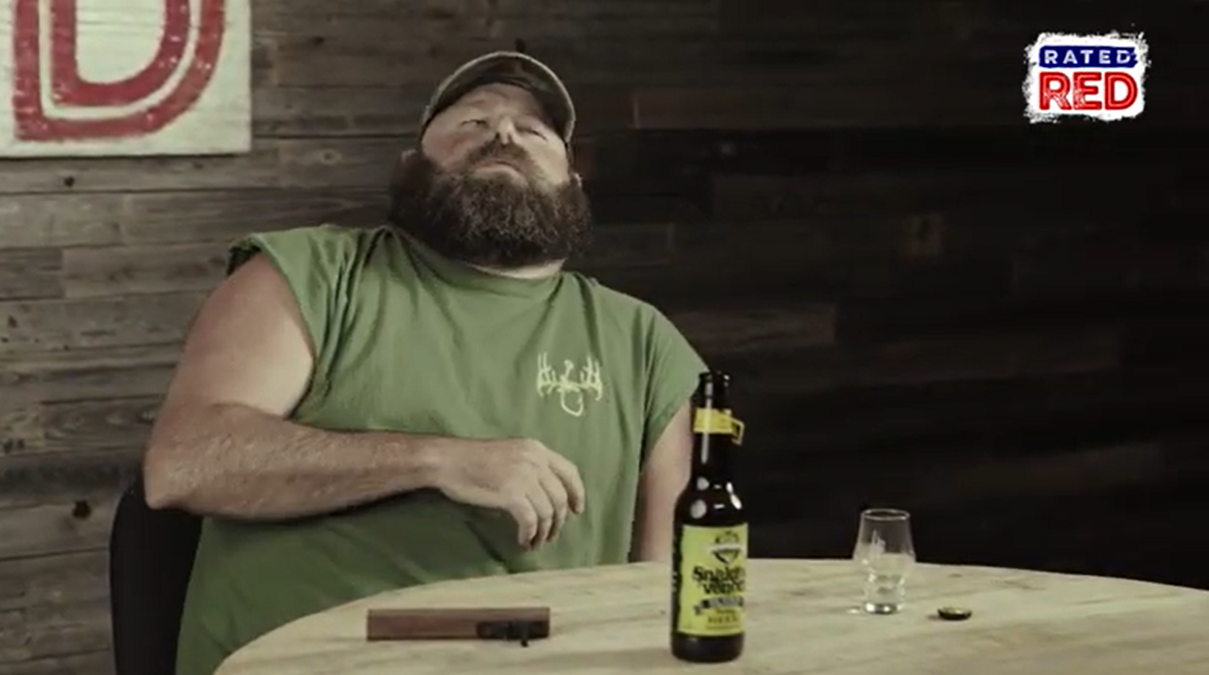
500K YOUTUBE VIEWS
10 M TIKTOK VIEWS
258 K INSTAGRAM VIEWS

Slide 4
HORSE 2
You can’t beat the bookies

Slide 5
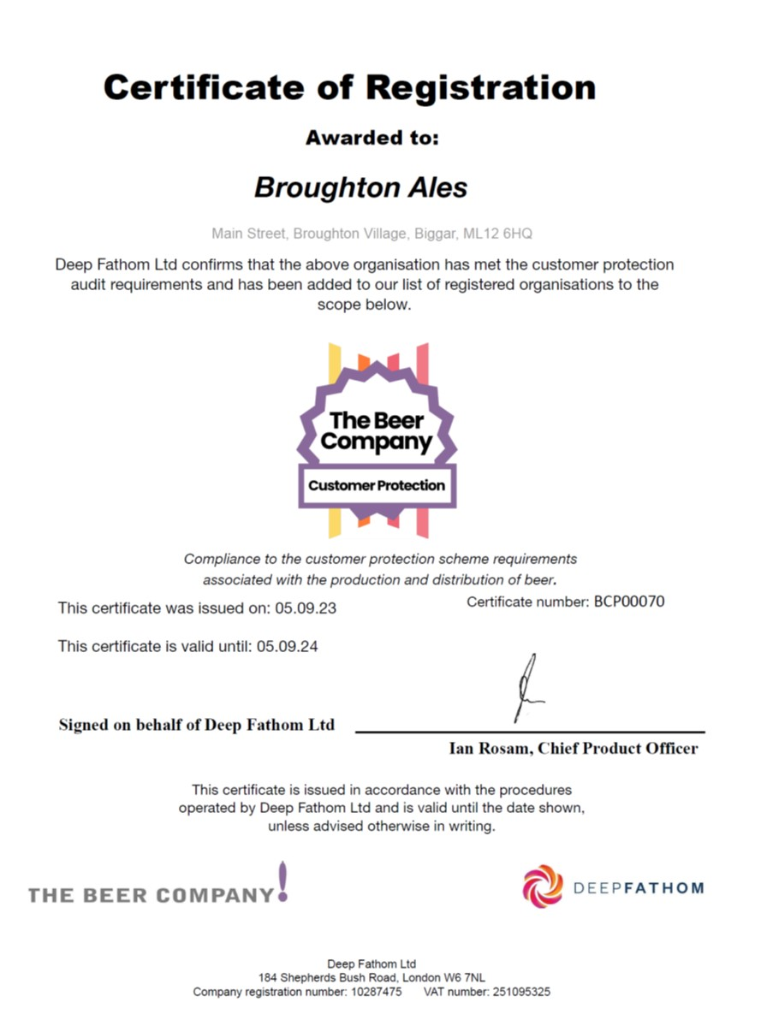
HORSE 3
You are not starting from scratch

Slide 6
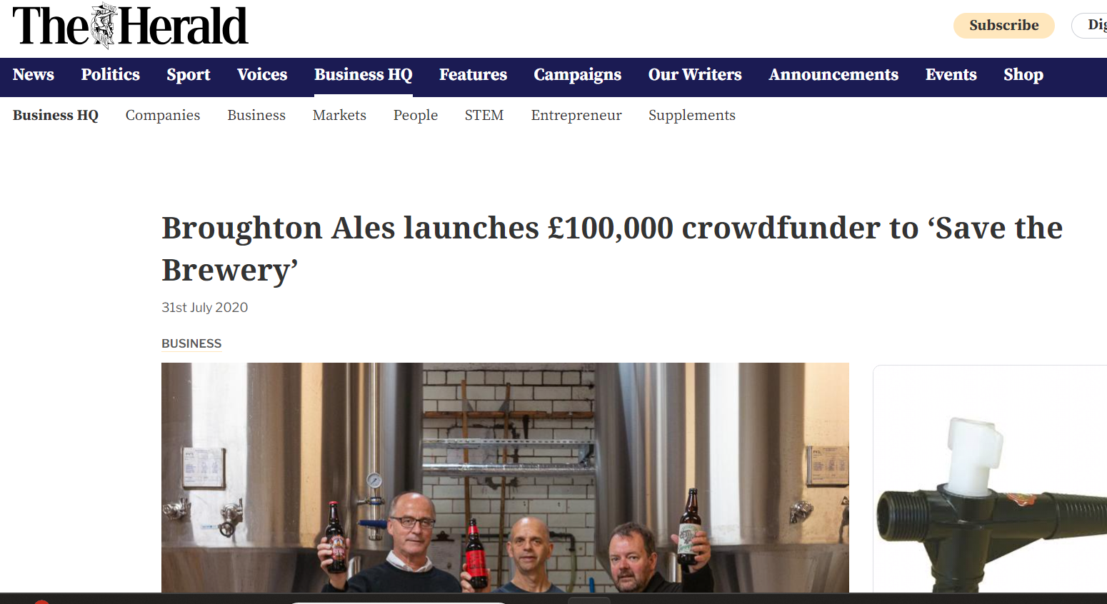
HORSE 4
The hurdle is too high AKA Never let a crisis go to waste

Slide 7
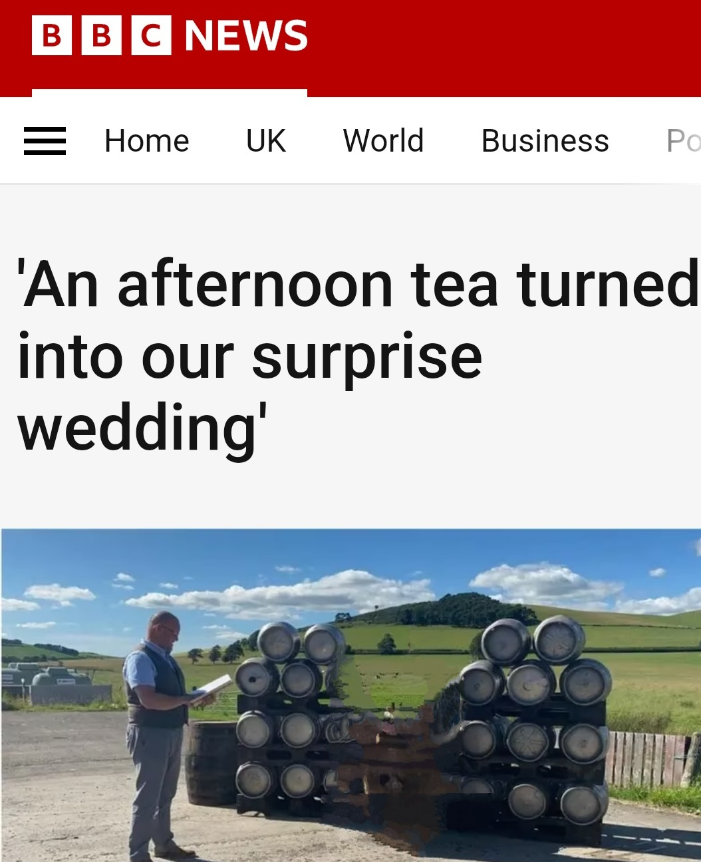
HORSE 5
Fast Track

Slide 8
HORSE 6
Ride the horse in the direction it’s going

Slide 9
www.scotbeers,com
www.Brewmeister.co.uk
Alabama Boss Snake Venom

