Slide 1




Accelerate Growth by embedding sustainability at the core of your business strategy
Delivered by Manchester Metropolitan University Business School
12, 19 and 20 March 2026
The SME Kick Start to Sustainable Development and Sustainability Reporting Programme
Delivered by Bournemouth University Business School
23, 24, 25 and 30 March
Women’s Growth and Leadership Accelerator Programme
Delivered by the William J Clinton Leadership Institute at Queen’s Business School
24 February – 24 March

Slide 2
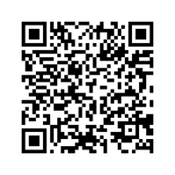




sign up here
Join us at the...
Alumni Network annual Conference
Thur 12th february 2026
FUNDED BY
delivered by

